Slide 1
Instance-based Classifiers
Anna Monreale
Computer Science Department
Introduction to Data Mining, 2nd Edition
Chapter 5.2

Slide 2
Instance-based Classifiers
Instead of performing explicit generalization, compare new instances with instances seen in training, which have been stored in memory.
Sometimes called memory-based learning.
Advantages
  Adapt its model to previously unseen data by storing a new instance or throwing an old instance away.
Disadvantages
  Lazy learner: it does not build a model explicitly.
  Classifying unknown records is relatively expensive: in the worst case, given n training items, the complexity of classifying a single instance is O(n).

Slide 3
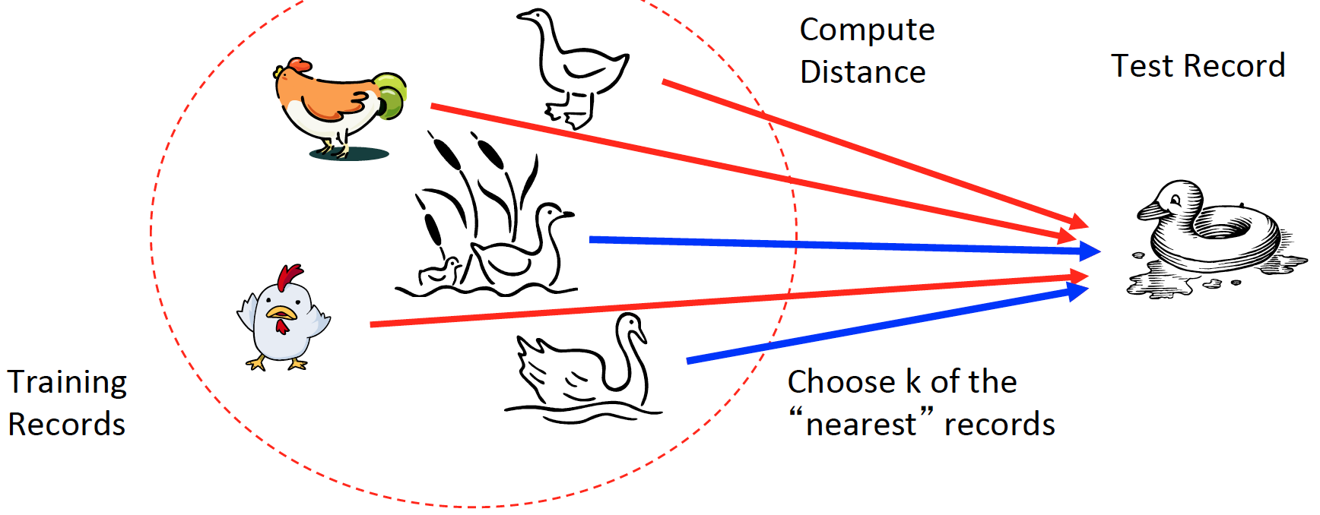
Nearest-Neighbor Classifier (K-NN)
Basic idea: If it walks like a duck, quacks like a duck, then it’s probably a duck.
Requires three things
Training set of stored records
Distance metric to compute distance between records
The value of k, the number of nearest neighbors to retrieve

Slide 4
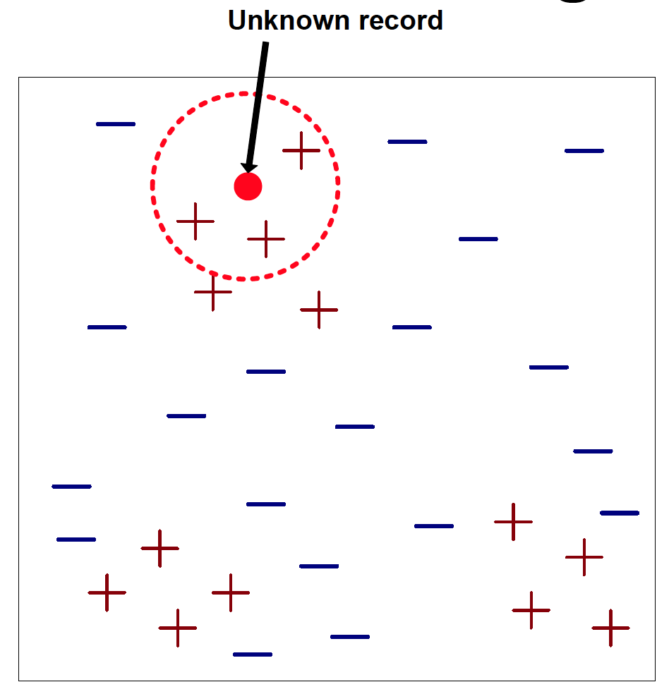
Nearest-Neighbor Classifier (K-NN)
Given a set of training records (memory), and a test record:
Compute the distances from the records in the training to the test.
Identify the k “nearest” records.
Use class labels of nearest neighbors to determine the class label of unknown record (e.g., by taking majority vote).

Slide 5
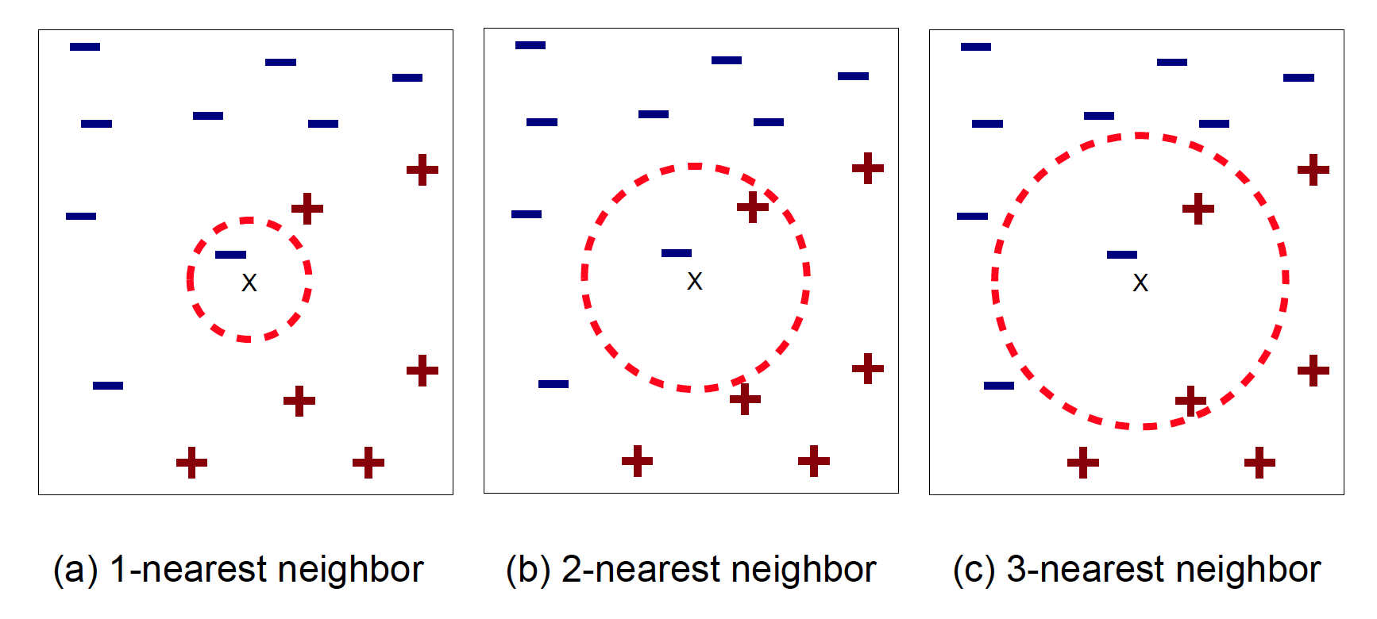
Definition of Nearest Neighbor
K-nearest neighbors of a record x are data points that have the k smallest distance to x.

Slide 6
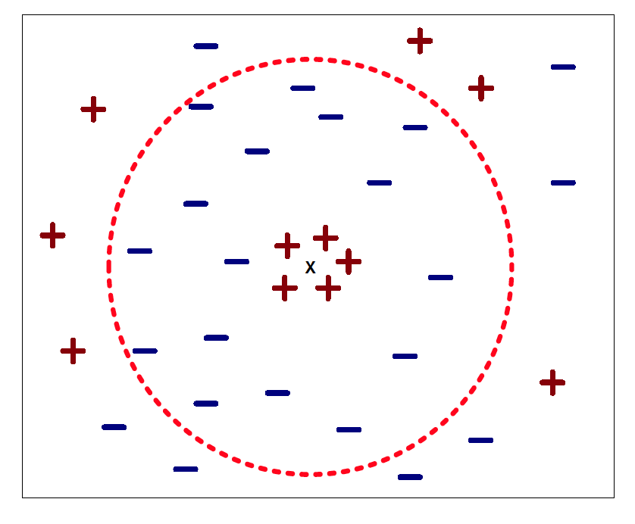
Choosing the Value of K
If k is too small, it is sensitive to noise points and it can leads to overfitting to the noise in the training set.
If k is too large, the neighborhood may include points from other classes.
General practice k = sqrt(N) where N is the number of samples in the training dataset.

Slide 7
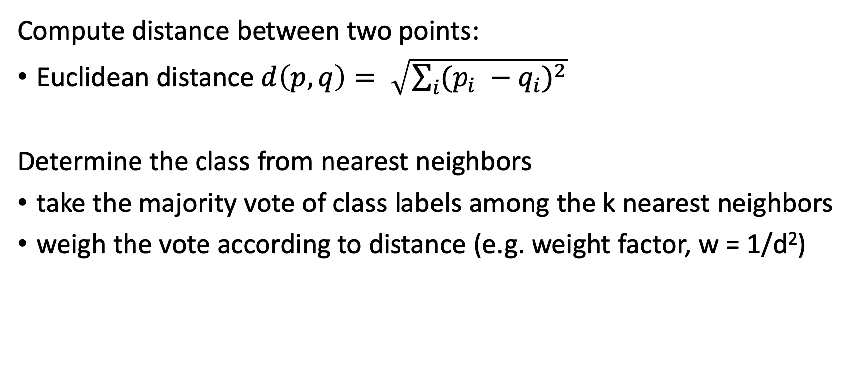
Nearest Neighbor Classification
Compute distance between two points:
Euclidean distance $d\left(p, q\right)= \sqrt{\sum_{i}{{(p_{i} −q_{i})}^{2}}}$
Determine the class from nearest neighbors
take the majority vote of class labels among the k nearest neighbors
weigh the vote according to distance (e.g. weight factor, w = 1/d²)

Slide 8
Dimensionality and Scaling Issues
Problem with Euclidean measure: high dimensional data can cause curse of dimensionality.
  Solution: normalize the vectors to unit length
Attributes may have to be scaled to prevent distance measures from being dominated by one of the attributes.
Example:
  height of a person may vary from 1.5m to 1.8m
  weight of a person may vary from 10km to 200kg
  income of a person may vary from $10K to $1M

Slide 9
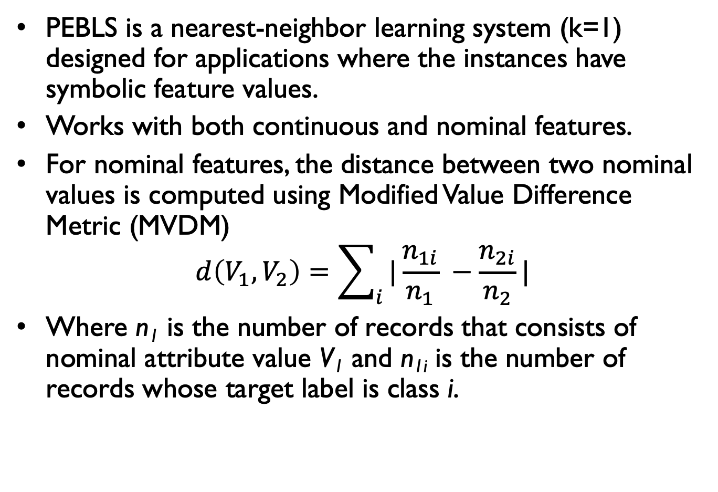
Parallel Exemplar-Based Learning System (PEBLS)
PEBLS is a nearest-neighbor learning system (k=1) designed for applications where the instances have symbolic feature values.
Works with both continuous and nominal features.
For nominal features, the distance between two nominal values is computed using Modified Value Difference Metric (MVDM)
$$d\left(V_{1},V_{2}\right)=\sum_{i}{|\frac{n_{1i}}{n_{1}} −\frac{n_{2i}}{n_{2}}|}$$
Where n₁ is the number of records that consists of nominal attribute value V₁ and n_{1i} is the number of records whose target label is class i.

Slide 10
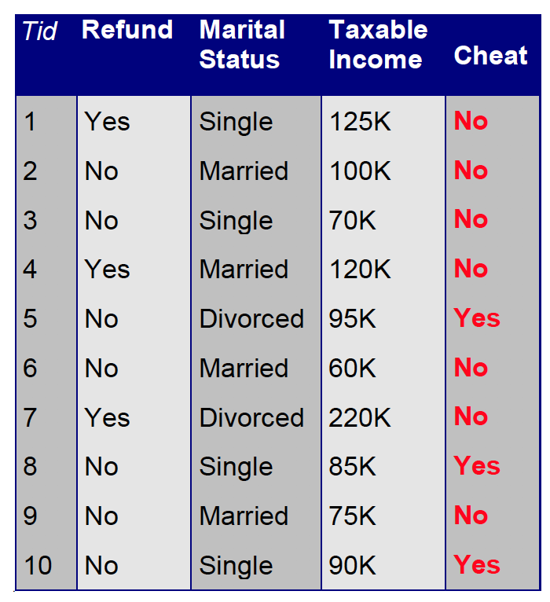
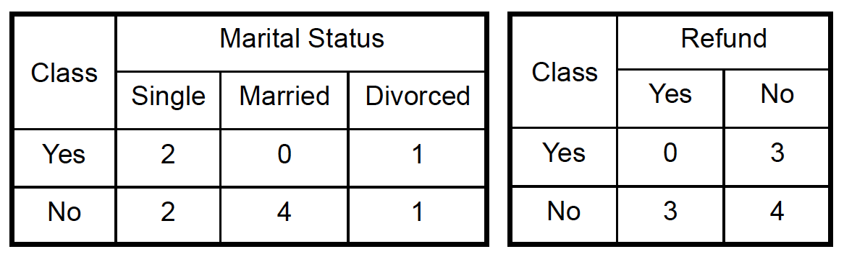
Distance Between Nominal Attribute Values
d(Status=Single, Status=Married) = | 2/4 – 0/4 | + | 2/4 – 4/4 | = 1
d(Status=Single, Status=Divorced) = | 2/4 – 1/2 | + | 2/4 – 1/2 | = 0
d(Status=Married, Status=Divorced) = | 0/4 – 1/2 | + | 4/4 – 1/2 | = 1
d(Refund=Yes, Refund=No) = | 0/3 – 3/7 | + | 3/3 – 4/7 | = 6/7

Slide 11
Characteristics of Nearest Neighbor Classifiers
Instance-based learner: makes predictions without maintaining abstraction, i.e., building a model like decision trees.
It is a lazy learner: classifying a test example can be expensive because need to compute the proximity values between test and training examples.
In contrast eager learners spend time in building the model but then the classification is fast.
Make their prediction on local information and for low k they are susceptible to noise.
Can produce wrong predictions if inappropriate distance functions and/or preprocessing steps are performed.

Slide 12
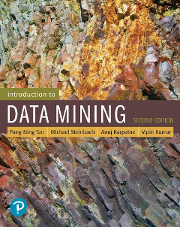
References
Nearest Neighbor classifiers. Chapter 5.2. Introduction to Data Mining.

Slide 13
Exercises - kNN

Slide 14
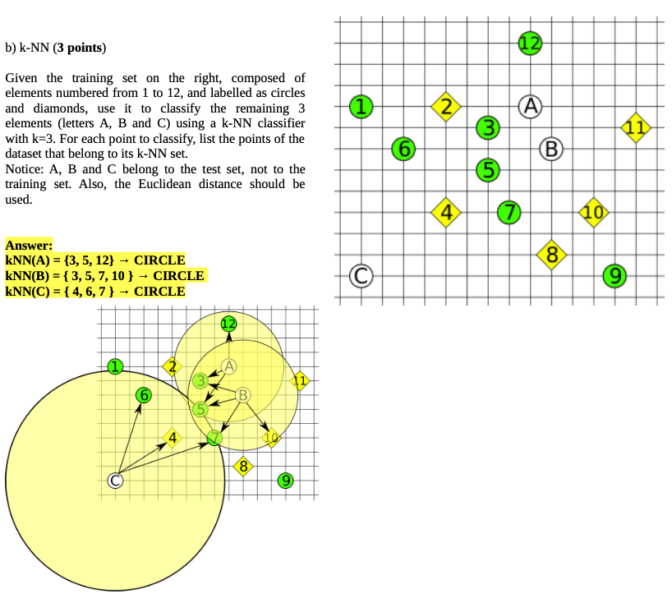

Slide 15
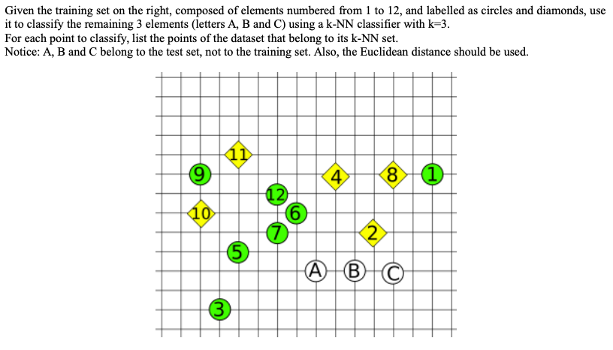

Slide 16
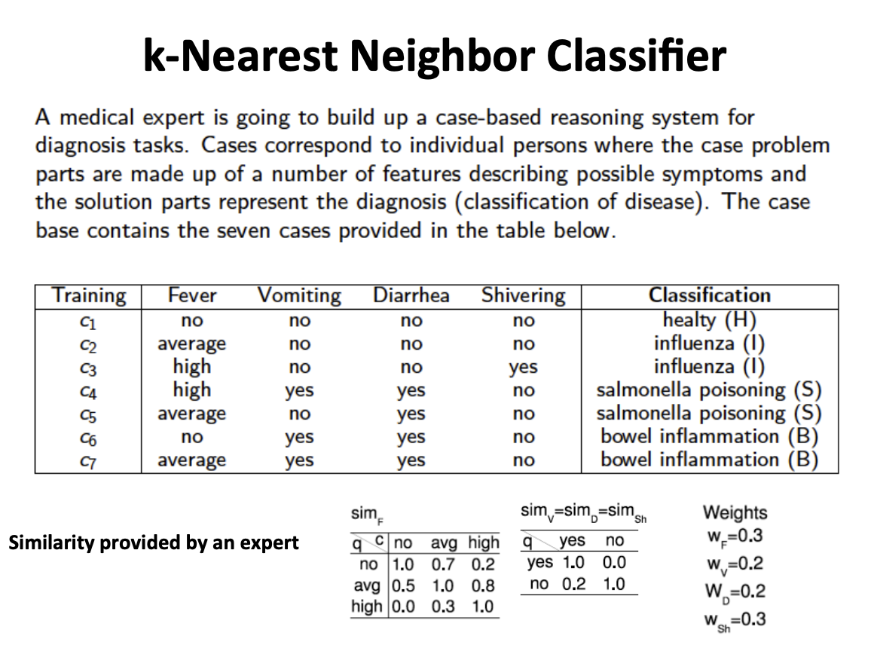

Slide 17
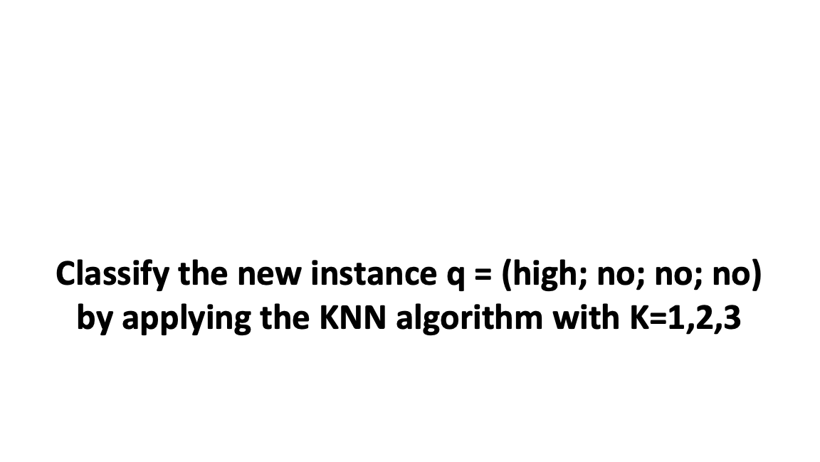

Slide 18
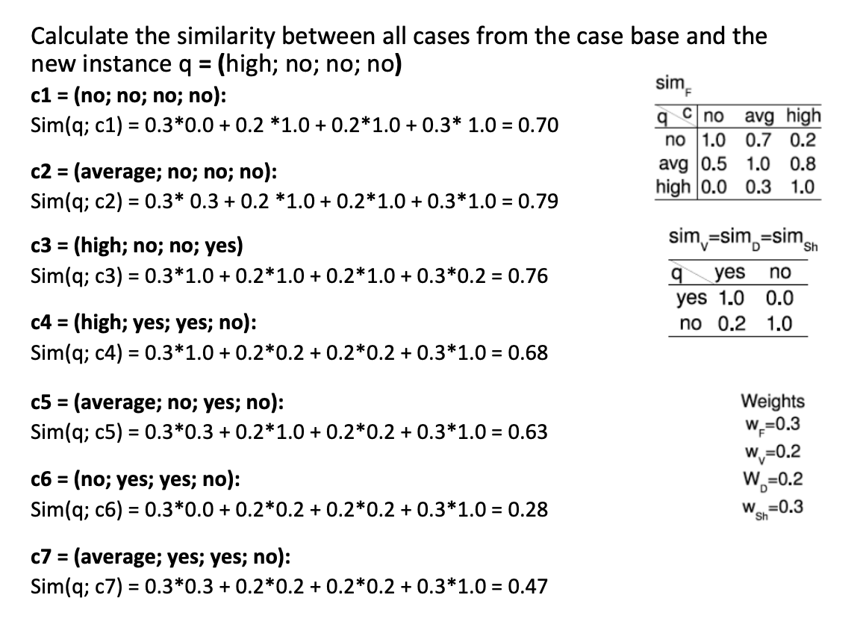

Slide 19
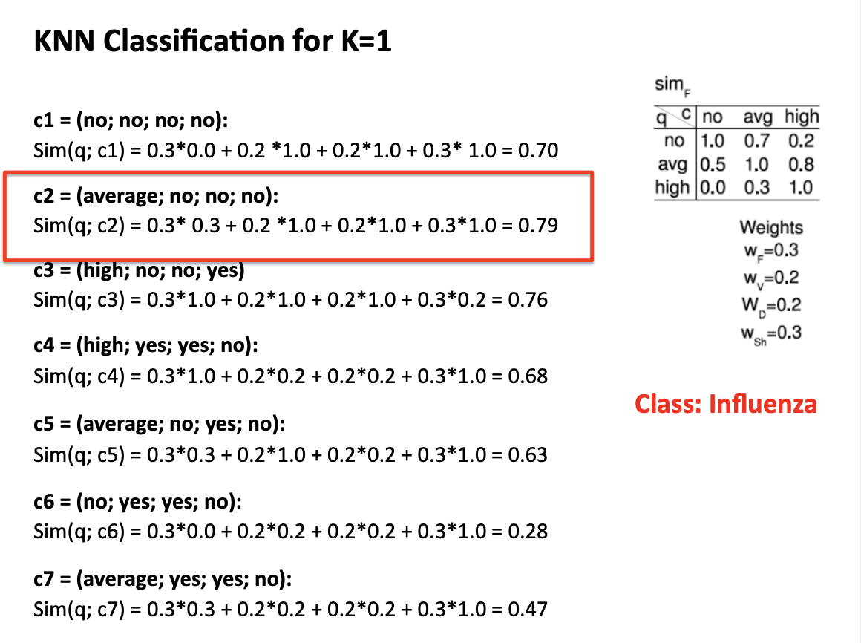

Slide 20
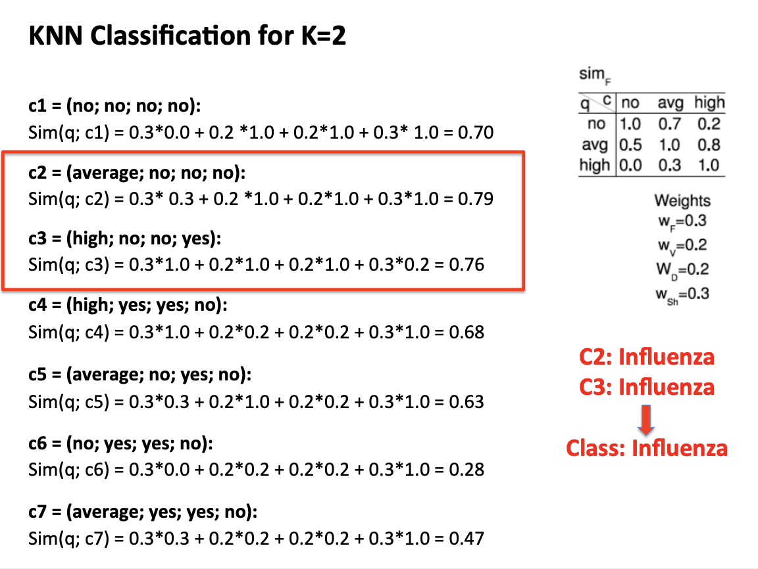

Slide 21
