Slide 1

Natural Language Processing
Università di Pisa
Giuseppe Attardi
Dipartimento di Informatica
Università di Pisa

Slide 2
Goal of NLP
Computers would be a lot more useful if they could handle our email, do our library research, chat to us …
But they are fazed by natural languages
  Or at least their programmers are … most people just avoid the problem and get into XML, or menus and drop boxes, or …
Big challenge
  How can we teach language to computers?
  Or help them learn it as kids do?

Slide 3

NL: Science Fiction
Star Trek
  universal translator: Babel Fish
  Language Interaction

Slide 4
September 2016
DeepMind (an Alphabet company, aka Google) announces
WaweNet: A Generative Model for Raw Audio

Slide 5
Early history of NLP: 1950s
Early NLP (Machine Translation) on machines less powerful than pocket calculators
Foundational work on automata, formal languages, probabilities, and information theory
First speech systems (Davis et al., Bell Labs)
MT heavily funded by military – a lot of it was just word substitution programs but there were a few seeds of later successes, e.g., trigrams
Little understanding of natural language syntax, semantics, pragmatics
Problem soon appeared intractable

Slide 6
Recent Breakthroughs
Watson at Jeopardy! Quiz:
  http://www.aaai.org/Magazine/Watson/watson.php
  Final Game
  PBS report
Google Translate on iPhone
  http://googleblog.blogspot.com/2011/02/introducing-google-translate-app-for.html
Apple SIRI

Slide 7
Smartest Machine on Earth
IBM Watson beats human champions at TV quiz Jeopardy!
State of the art Question Answering system

Slide 8
Tsunami of Deep Learning
AlphaGo beats human champion at Go.
RankBrain is third most important important factor in the ranking algorithm along with links and content at Google
RankBrain is given batches of historical searches and learns to make predictions from these
It learns to deal also with queries and words never seen before
Most likely it is using Word Embeddings

Slide 9
Dependency Parsing
DeSR is online since 2007
Stanford Parser
Google Parsey McParseFace in 2016

Slide 10
Google
“At Google, we spend a lot of time thinking about how computer systems can read and understand human language in order to process it in intelligent ways.”
Parser used to analyze most of text processed
Parser used in Machine Translation

Slide 11
Apple SIRI
ASR (Automated Speech Recognition) integrated in mobile phone
Special signal processing chip for noise reduction
SIRI ASR
Cloud service for analysis
Integration with applications

Slide 12
Google Voice Actions
Google: what is the population of Rome?
Google: how tall is Berlusconi
How old is Lady Gaga
Who is the CEO of Tiscali
Who won the Champions League
Send text to Gervasi Please lend me your tablet
Navigate to Palazzo Pitti in Florence
Call Antonio Cisternino
Map of Pisa
Note to self publish course slides
Listen to Dylan

Slide 13
NLP for Health
“Machine learning and natural language processing are being used to sort through the research data available, which can then be given to oncologists to create the most effect and individualised cancer treatment for patients.”
“There is so much data available, it is impossible for a person to go through and understand it all. Machine learning can process the information much faster than humans and make it easier to understand.”
Chris Bishop, Microsoft Research

Slide 14
IBM Watson
August 2016
IBM’s Watson ingested tens of millions of oncology papers and vast volumes of leukemia data made available by international research institutes.
Doctors have used Watson to diagnose a rare type of leukemia and identify life-saving therapy for a female patient in Tokyo.

Slide 15
DeepMind on Health
DeepMind will use million anonymous eye scans to train an algorithm to better spot the early signs of eye conditions such as wet age-related macular degeneration and diabetic retinopathy.

Slide 16
Technological Breakthrough
Machine learning
Huge amount of data
Large processing capabilities

Slide 17
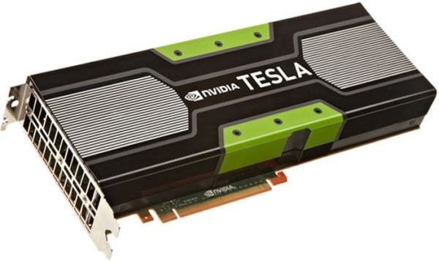
Big Data & Deep Learning
Neural Networks with many layers trained on large amounts of data
Requires high speed parallel computing
Typically using GPU (Graphic Processing Unit)

Slide 18
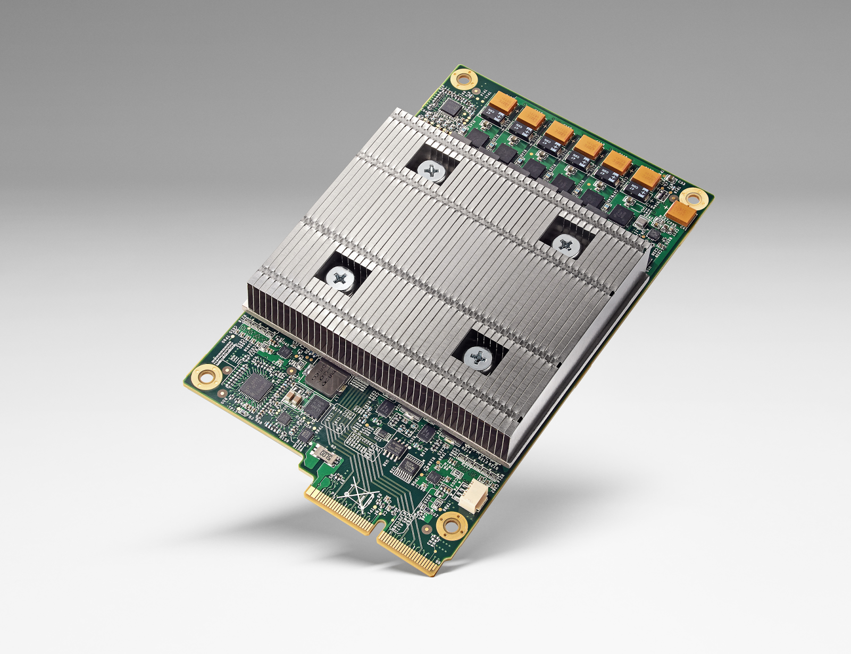
Big Data & Deep Learning
Google built TPU (Tensor Processing Unit)
10x better performance per watt
half-precision floats
Advances Moore's Law by 7 years

Slide 19
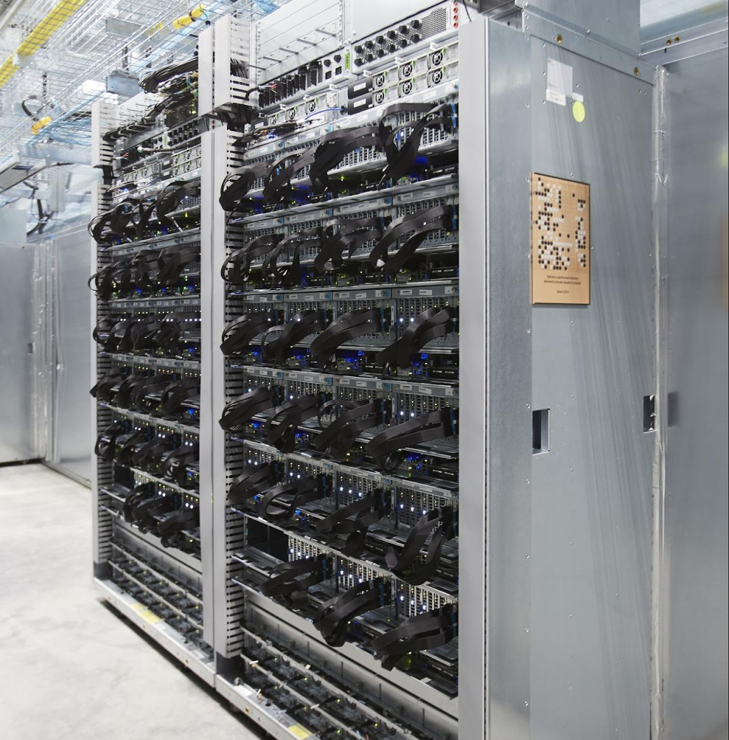
AlphaGo
TPU can fit into a hard drive slot within the data center rack and has already been powering RankBrain and Street View

Slide 20
Unreasonable Effectiveness of Data
Halevy, Norvig, and Pereira argue that we should stop acting as if our goal is to author extremely elegant theories, and instead embrace complexity and make use of the best ally we have: the unreasonable effectiveness of data.
A simpler technique on more data beat a more sophisticated technique on less data.
Language in the wild, just like human behavior in general, is messy.

Slide 21
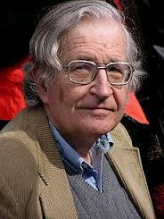

Scientific Dispute: is it science?
Prof. Noam Chomsky, Linguist, MIT
Peter Norvig, Director of research, Google

Slide 22
Chomsky
It's true there's been a lot of work on trying to apply statistical models to various linguistic problems. I think there have been some successes, but a lot of failures. There is a notion of success ... which I think is novel in the history of science. It interprets success as approximating unanalyzed data.
http://norvig.com/chomsky.html

Slide 23
Norvig
I agree that engineering success is not the goal or the measure of science. But I observe that science and engineering develop together, and that engineering success shows that something is working right, and so is evidence (but not proof) of a scientifically successful model.
Science is a combination of gathering facts and making theories; neither can progress on its own. I think Chomsky is wrong to push the needle so far towards theory over facts; in the history of science, the laborious accumulation of facts is the dominant mode, not a novelty. The science of understanding language is no different than other sciences in this respect.
I agree that it can be difficult to make sense of a model containing billions of parameters. Certainly a human can't understand such a model by inspecting the values of each parameter individually. But one can gain insight by examining the properties of the model—where it succeeds and fails, how well it learns as a function of data, etc.

Slide 24
Norvig (2)
Einstein said to make everything as simple as possible, but no simpler. Many phenomena in science are stochastic, and the simplest model of them is a probabilistic model; I believe language is such a phenomenon and therefore that probabilistic models are our best tool for representing facts about language, for algorithmically processing language, and for understanding how humans process language.
I agree with Chomsky that it is undeniable that humans have some innate capability to learn natural language, but we don't know enough about that capability to rule out probabilistic language representations, nor statistical learning. I think it is much more likely that human language learning involves something like probabilistic and statistical inference, but we just don't know yet.

Slide 25
End of Story
“Evidence Rebuts Chomsky’s Theory of Language Learning”
  Scientific American, September 2016
aka Universal Grammar

Slide 26
Linguistic Analysis
Two reasons:
  Exploiting digital knowledge
  Communicating with computer assistants

Slide 27
Why to study human language?

Slide 28
AI is fascinating since it is the only discipline where the mind is used to study itself
Luigi Stringa, director FBK

Slide 29
Language and Intelligence
“Understanding cannot be measured by external behavior; it is an internal metric of how the brain remembers things and uses its memories to make predictions”.
“The difference between the intelligence of humans and other mammals is that we have language”.
  Jeff Hawkins, “On Intelligence”, 2004

Slide 30
Hawkins’ Memory-Prediction framework
The brain uses vast amounts of memory to create a model of the world. Everything you know and have learned is stored in this model. The brain uses this memory-based model to make continuous predictions of future events. It is the ability to make predictions about the future that is the crux of intelligence.

Slide 31
More …
“Spoken and written words are just patterns in the world…
The syntax and semantics of language are not different from the hierarchical structure of everyday objects.
We associate spoken words with our memory of their physical and semantic counterparts.
Through language one human can invoke memories and create next justapositions of mental objects in another human.”

Slide 32
Thirty Million Words
The number of words a child hears in early life will determine their academic success and IQ in later life.
Researchers Betty Hart and Todd Risley (1995) found that children from professional families heard thirty million more words in their first 3 years
http://www.youtube.com/watch?v=qLoEUEDqagQ

Slide 33
Exploiting Knowledge
Reason 1

Slide 34
Scientia Potentia Est
But only if you know how to acquire it …
The Economist, May 8, 2003
Knowledge Management
Requires
  Repositories of knowledge
  Mechanism for using knowledge

Slide 35
Limitations of Desktop Metaphor
Reason 2

Slide 36
Personal Computing
Desktop Metaphor: highly successful in making computers popular
Benefits:
  Point and click intuitive and universal
Limitations:
  Point and click involves quite elementary actions
  People are required to perform more and more clerical tasks
  We have become: bank clerks, typographers, illustrators, librarians

Slide 37
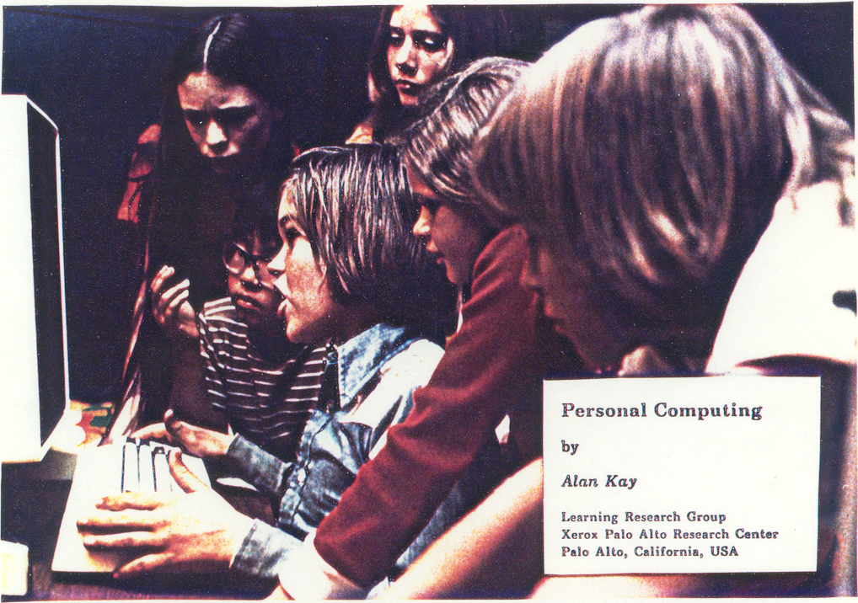

Slide 38
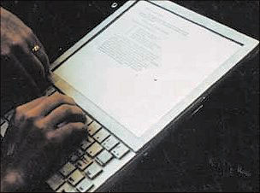
The DynaBook Concept

Slide 39
Kay’s Personal Computer
A quintessential device for expression and communication
Had to be portable and networked
For learning through experimentation, exploration and sharing

Slide 40
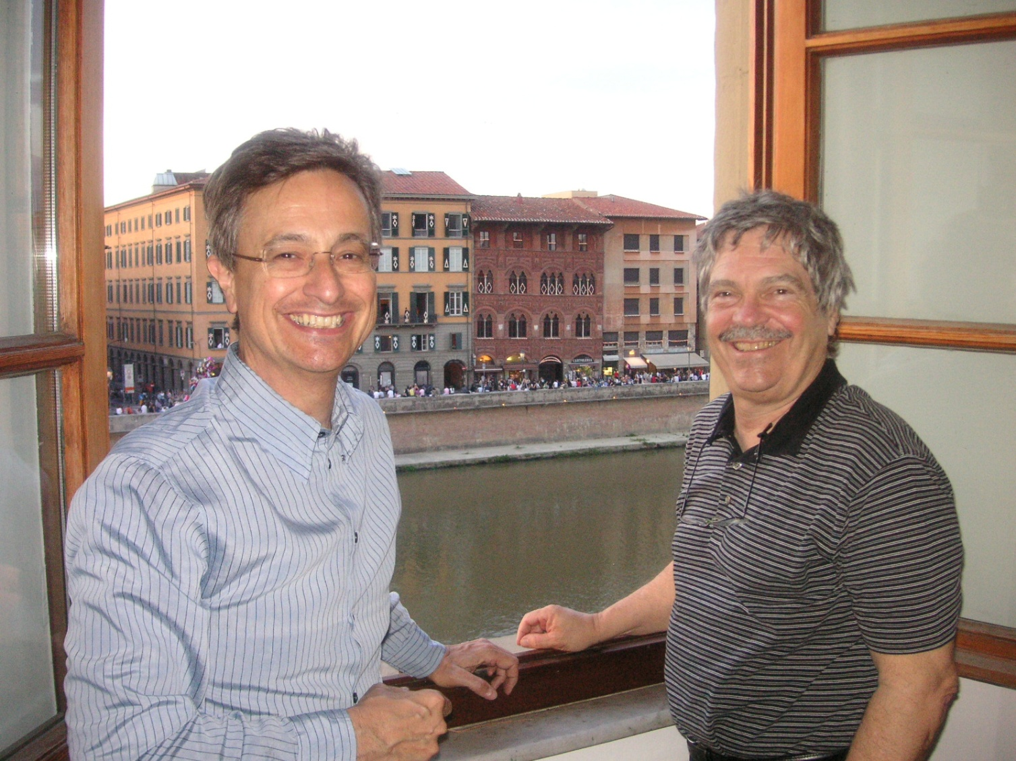
Alan Kay: Laurea ad honoris

Slide 41
An Ordinary Task
Add a table to a document with results from latest benchmarks and send it to my colleague Antonio
7-8 point&click just to get to the document
dozen point&click to get to the data
lengthy fiddling with table layout
3-4 point&click to retrieve mail address
etc.

Slide 42
Prerequisites
Declarative vs Procedural Specification
Details irrelevant
Many possible answers: user will choose best

Slide 43
Going beyond Desktop Metaphor
Could think of just one possibility:
  Raise the level of interaction with computers
How?
Could think of just one possibility:
  Use natural language

Slide 44
Linguistic Applications
So far self referential: from language to language
  Classification
  Extraction
  Summarization
More challenging:
  Derive conclusion
  Perform actions

Slide 45
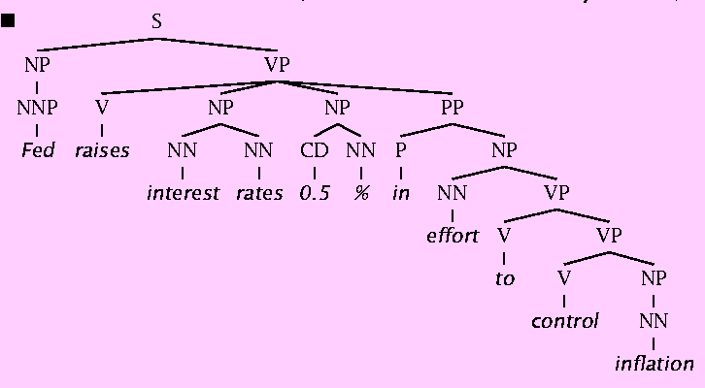
Natural Language Understanding is difficult
The hidden structure of language is highly ambiguous
Structures for: Fed raises interest rates 0.5% in effort to control inflation (NYT headline 5/17/00)
Slide by C. Manning

Slide 46
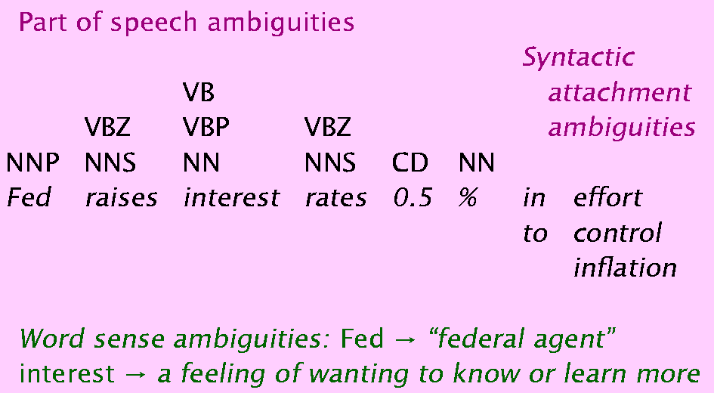
Where are the ambiguities?
Slide by C. Manning

Slide 47
Newspaper Headlines
Minister Accused Of Having 8 Wives In Jail
Juvenile Court to Try Shooting Defendant
Teacher Strikes Idle Kids
China to Orbit Human on Oct. 15
Local High School Dropouts Cut in Half
Red Tape Holds Up New Bridges
Clinton Wins on Budget, but More Lies Ahead
Hospitals Are Sued by 7 Foot Doctors
Police: Crack Found in Man's Buttocks

Slide 48
Reference Resolution
U: Where is The Green Hornet playing in Mountain View?
S: The Green Hornet is playing at the Century 16 theater.
U: When is it playing there?
S: It’s playing at 2pm, 5pm, and 8pm.
U: I’d like 1 adult and 2 children for the first show.
How much would that cost?
Knowledge sources:
  Domain knowledge
  Discourse knowledge
  World knowledge

Slide 49
NLP hard
Natural language is:
  highly ambiguous at all levels
  complex and subtle use of context to convey meaning
  fuzzy?, probabilistic
  involves reasoning about the world
  a key part of people interacting with other people (a social system):
    persuading, insulting and amusing them
But NLP can also be surprisingly easy sometimes:
  rough text features can often do half the job

Slide 50
Hidden Structure of Language
Going beneath the surface…
  Not just string processing
  Not just keyword matching in a search engine
    Search Google on “tennis racquet” and “tennis racquets” or “laptop” and “notebook” and the results are quite different …
    though these days Google does lots of subtle stuff beyond keyword matching itself
  Not just converting a sound stream to a string of words
    Like Nuance/IBM/Dragon/Philips speech recognition
To recover and manipulate at least some aspects of language structure and meaning

Slide 51
About the Course
Assumes some skills…
  basic linear algebra, probability, and statistics
  decent programming skills
  willingness to learn missing knowledge
Teaches key theory and methods for Statistical NLP
  Useful for building practical, robust systems capable of interpreting human language
Experimental approach:
  Lots of problem-based learning
  Often practical issues are as important as theoretical niceties

Slide 52
Experimental Approach
Formulate Hypothesis
Implement Technique
Train and Test
Apply Evaluation Metric
If not improved:
  Perform error analysis
  Revise Hypothesis
Repeat

Slide 53
Program
Introduction
  History
  Present and Future
  NLP and the Web
Mathematical Background
  Probability and Statistics
  Language Model
  Hidden Markov Model
  Viterbi Algorithm
  Generative vs Discriminative Models
Linguistic Essentials
  Part of Speech and Morphology
  Phrase structure
  Collocations
  n-gram Models
  Word Sense Disambiguation
  Word Embeddings

Slide 54
Preprocessing
  Encoding
  Regular Expressions
  Segmentation
  Tokenization
  Normalization

Slide 55
Machine Learning Basics
Text Classification and Clustering
Tagging
  Part of Speech
  Named Entity
  Named Entity Linking
Sentence Structure
  Constituency Parsing
  Dependency Parsing

Slide 56
Sentence Structure
  Constituency Parsing
  Dependency Parsing
Semantic Analysis
  Semantic Role Labeling
  Coreference resolution
Statistical Machine Translation
  Word-Based Models
  Phrase-Based Models
  Decoding
  Syntax-Based SMT
  Evaluation metrics

Slide 57
Deep Learning
Libraries
  NLTK
  Theano/Keras
  Tensorflow
Applications
  Information Extraction
  Information Filtering
  Recommender System
  Opinion Mining
  Semantic Search
  Question Answering
    Language Inference

Slide 58
Exam
Project
Seminar

Slide 59
Previous Year Projects
Participation to Evalita 2011
  Task POS + Lemmatization: 1st position
  Task Domain Adaptation: 1st position
  Task SuperSense: 1st position
  Task Dependency Parsing: 2nd position
  Task NER: 3rd position
SemEval 2012
  Sentiment Analysis on tweets
Participation to Evalita 2014
  Sentiment Analysis on tweets
Disaster Reports in Tweets

Slide 60
Participation to Evalita 2016
  Task POS on Tweets:
  Task Sentiment Polarity on Tweets:
  Task Named Entity Extraction and Linking on Tweets:

Slide 61
Books
D. Jurafsky, J.H. Martin, Speech and Language Processing. 2nd edition, Prentice-Hall, 2008.
S. Bird, E. Klein, E. Loper. Natural Language Processing with Python.
C. Manning, H. Schutze. Foundations of Statistical Natural Language Processing. MIT Press, 2000.
S. Kubler, R. McDonald, J. Nivre. Dependency Parsing. 2010.
P. Koehn. Statistical Machine Translation. Cambridge University Press, 2010.
I. Goodfellow, Y. Bengio, A. Courville. Deep Learning. MIT Press, 2016.

