Slide 1
L’età della parola
Giuseppe Attardi Dipartimento di Informatica Università di Pisa
NLP

Slide 2
Issues
Children reach the age of talking at 3 years
When will computers reach the age of talking?
Are we making progress?
What are the promising directions?
How to exploit large processing capabilities and big data?
Can we take inspiration from biology?

Slide 3
Motivation
Language is the most distinctive feature of human intelligence
Language shapes thought
Emulating language capabilities is a scientific challenge
Keystone for intelligent systems

Slide 4
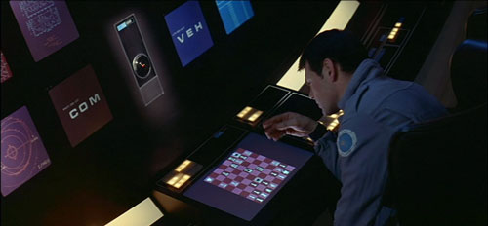
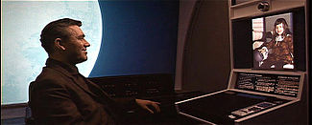
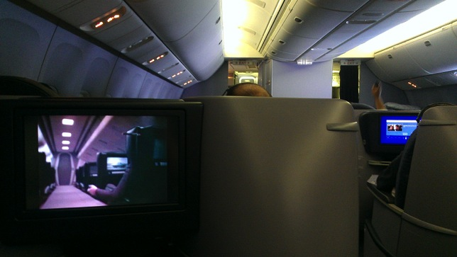
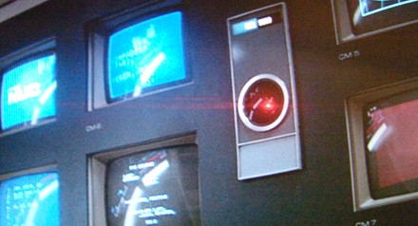
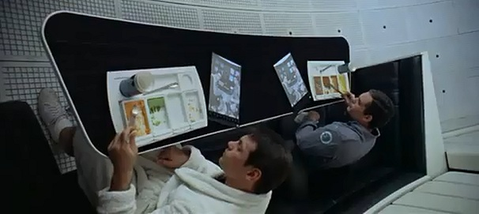
2001 a space Odyssey: 40 years later
Technology surpassed the vision
Internet
The Web
Smartphones
Genomics
Unmanned space exploration
Home computing
Big data
Computer chess
Audio-video communication
On board entertainment
Computer graphics
Except for
Tablet devices
Computer Speech
…and bad airline food
Computer Vision
Computer cognition

Slide 5
Speech technology in 2001: the vision

Slide 6
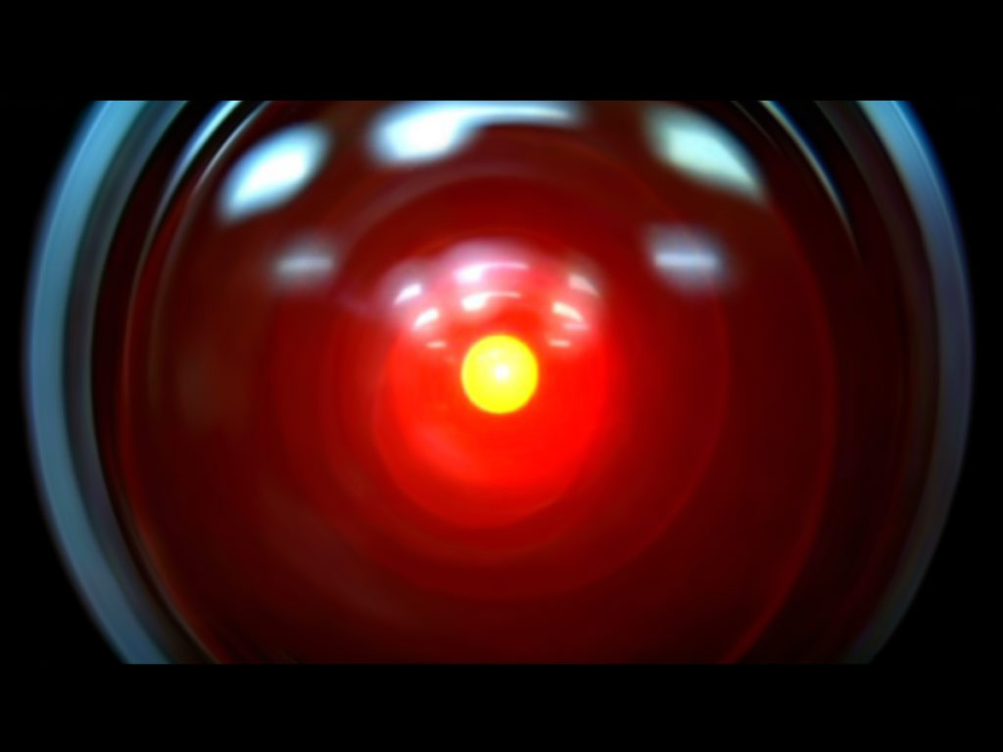
Speech technology in 2001: the reality
Design: Jonathan Bloom
Realization: Peter Krogh

Slide 7
Machine Translation, circa 2001
Lo spirito è forte ma la carne è debole
tradotto in russo
La vodka è forte ma la bistecca è tenera
apocrifo

Slide 8
Machine Translation Progress
Gli chiese di riorganizzare Forza Italia
The churches to reorganize Italy Force (Altavista)
She asked him to reorganize Forza Italia (Google)
Il ministro Stanca si è laureato alla Bocconi
The Minister Stanca graduated at Mouthfuls (Altavista)
The Minister Stanca is a graduate of Bocconi (Google)

Slide 9
How to learn natural language
Children learn to speak naturally, by interacting with others
Nobody teaches them grammar
Is it possible to let computer learn language in a similarly natural way?

Slide 10
Statistical Machine Learning
Supervised Training
Annotated document collections
Ability to process Big Data
If we used same algorithms 10 years ago they would still be running
Similar techniques for speech and text

Slide 11
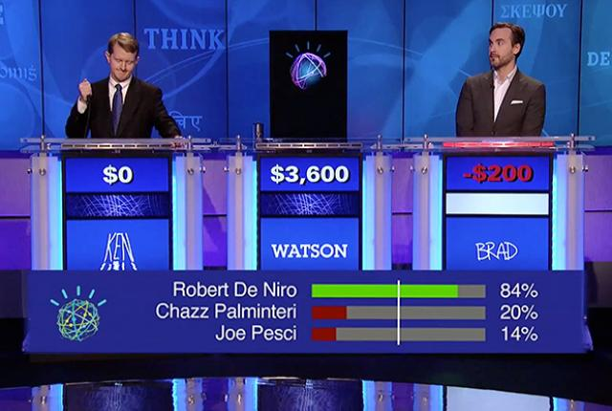
Breakthrough recenti
Speech to text
Apple Siri, Google Now
Machine Translation
Google translate
Question Answering
IBM Watson
battuti i campioni del quiz televisivo Jeopardy!

Slide 12
Quiz Bowl Competition
Iyyer et al. 2014: A Neural Network for Factoid Question Answering over Paragraphs
QUESTION:
He left unfinished a novel whose title character forges his father’s signature to get out of school and avoids the draft by feigning desire to join.
One of his novels features the jesuit Naptha and his opponent Settembrini, while his most famous work depicts the aging writer Gustav von Aschenbach.
Name this German author of The Magic Mountain and Death in Venice.
ANSWER: Thomas Mann

Slide 13
QANTA vs Ken Jennings
QUESTION:
Along with Evangelista Torricelli, this man is the namesake of a point the minimizes the distances to the vertices of a triangle.
He developed a factorization method …
ANSWER: Fermat
QUESTION:
A movie by this director contains several scenes set in the Yoshiwara Nightclub.
In a movie by this director a man is recognized by a blind beggar because he is wistlinIn the hall of the mountain king.
ANSWER: Fritz Lang

Slide 14
Speech Understanding

Slide 15
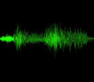
The parts of a speech understanding system
FRONT-END
From speech to features
I want to fly to San Francisco leaving from New York in the morning
SEARCH
From features to words
to
leaving from
I
San Francisco
morning
want
fly
New York
LANGUAGE
UNDERSTANDING
From words to meaning
request(flight)
origin(SFO)
destination(NYC)
time(morning)
Acoustic Models
Representation of speech units derived from data
Language Models
Representation of sequences of words derived from data
DIALOG
From meaning to actions
What date do you want to leave?
Courtesy: R. Pieraccini

Slide 16
The parts of a speech understanding system
FRONT-END
From speech to features
I want to fly to San Francisco leaving from New York in the morning
For decades we have been using variations and transformations of a coarse spectral representation of each 10 msec. segment of speech (frames)
But … what does the human brain use as its front-end? After all the human brain is the best “speech recognizer” we know
Courtesy: R. Pieraccini

Slide 17
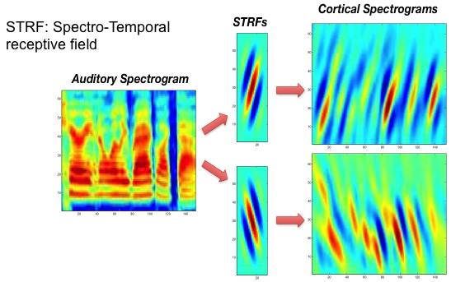
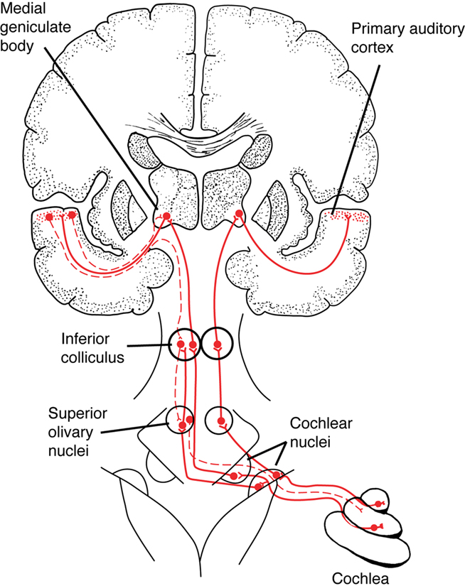
Emulating the human brain cortex
Reduction of up to 52% word error rate in noisy digits
(Stern, Morgan, IEEE Signal Processing Magazine, 2012)
Courtesy: R. Pieraccini

Slide 18
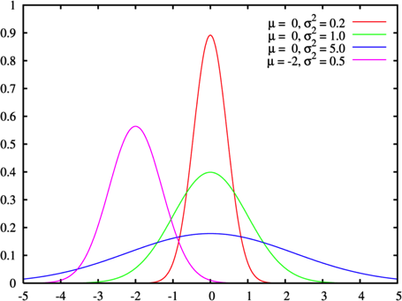
The parts of a speech understanding system
SEARCH
From features to words
to
leaving from
I
San Francisco
morning
want
fly
New York
Since the 1970s, the leading approach to acoustic modeling has been that of Hidden Markov Models (HMM) based on parametric statistical distributions (Gaussian Mixture Models or GMMs)
Acoustic Models
Representation of speech units derived from data
Language Models
Representation of sequences of words derived from data
Both assumptions are known to be wrong with respect to the properties of human speech, but useful to simplify the models
But now with have so much more data and so much computer power that we could try to find better and fitter models
Courtesy: R. Pieraccini

Slide 19
The return of
Artificial
neural networks
Courtesy: R. Pieraccini

Slide 20
The return of Artificial Neural Networks
Although many tried to use Artificial Neural Networks as an alternative to Hidden Markov Models, no one could really outperform the mighty HMMs
Through the years, the only successful use of neural network was as probability density estimators in hybrid HMMs
… speech research forgot about them … until recently, when some tried to go deeper … as in DEEP NEURAL NETWORKS
OUTPUT LAYER
HIDDEN LAYER
INPUT LAYER
Courtesy: R. Pieraccini

Slide 21
Deep Neural Networks
OUTPUT LAYER
HIDDEN LAYER
INPUT LAYER
Courtesy: R. Pieraccini

Slide 22
Deep Neural Networks
OUTPUT LAYER
HIDDEN LAYER
HIDDEN LAYER
HIDDEN LAYER
HIDDEN LAYER
HIDDEN LAYER
Multiple layers could provide better classification accuracy
HIDDEN LAYER
HIDDEN LAYER
…but training them from scratch is hard
However, providing them with a proper initialization before training seems to work quite well
INPUT LAYER
Courtesy: R. Pieraccini

Slide 23
Deep Neural Networks (before 2006)
Standard learning strategy
Randomly initializing the weights of the network
Applying gradient descent using backpropagation
But, backpropagation does not work well (if randomly initialized)
Deep networks trained with back-propagation (without unsupervised pre-train) perform worse than shallow networks
ANN have been limited to one or two layers

Slide 24
Slide credit : Yoshua Bengio

Slide 25
Layer-wise Unsupervised Pre-training
?
=
reconstruction
of input
features
input
…
…
…
…
Courtesy: G. Hinton

Slide 26
Courtesy: G. Hinton

Slide 27
Deep Learning in Text

Slide 28
DeSR: Dependency Shift Reduce Parser
Multilanguage statistical transition based dependency parser
Multilayer Perceptron learning (designed with Bengio’s group in Montréal)
Fast linear algorithm
50,000 token/sec (single core)
Handles non-projectivity
Customizable feature model
Available from: http://desr.sourceforge.net/

Slide 29
Tanl Linguistic Pipeline
text
Sentence Splitter
Enumerator<string>
Enumerator<Token>
POS Tagger
Word Tokenizer
Parser
Enumerator<Token>
Enumerator<vector<Token>>
NER Tagger
Enumerator<vector<Token>>
SuperSense Tagger

Slide 30
Performance
10.000 words per second
Accuracy:
POS: 97,9 %
Parsing: 85-90 %

Slide 31
http://tanl.di.unipi.it/it/

Slide 32
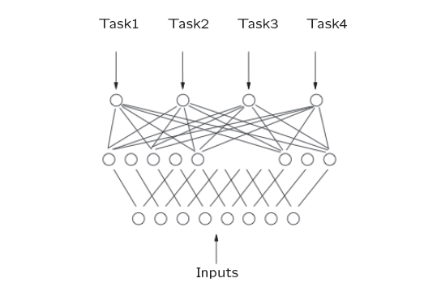
Alternative to pipelines: Multi-Task Learning

Slide 33
Word Embeddings
Ronan Collobert et al. Natural Language Processing (Almost) from Scratch. Journal of Machine Learning Research vol.12 (2011)

Slide 34
Transforming Words into Feature Vectors

Slide 35
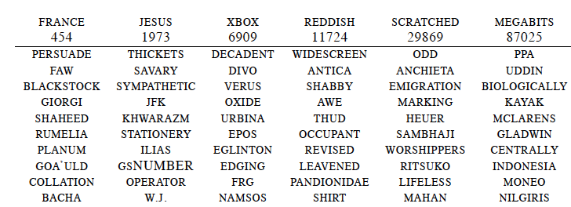
Word Embeddings after Training for SRL
neighboring words are not semantically related

Slide 36
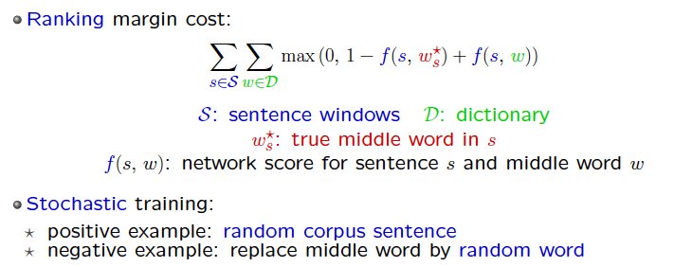
Language Model based on Acceptability
to minimize:

Slide 37
Lots of Unlabeled Data
LM1
Wikipedia: 631 M words
order dictionary words by frequency
dictionary size: 100,000
4 weeks of training
LM2
Wikipedia + Reuter = 852 M words
initialized with LM1, dictionary size is 130,000
30,000 additional most frequent Reuters words
3 additional weeks of training

Slide 38
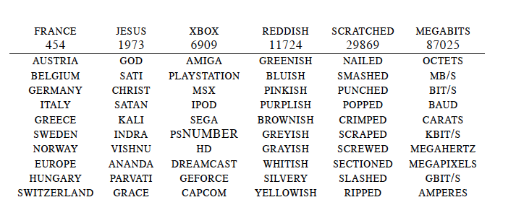
Word Embeddings
neighboring words are semantically related

Slide 39
Deep Learning Performance
Approach | POS | CHUNK | NER | SRL
Best | 97.24 | 94.13 | 88.76 | 79.92
CNN | 96.85 | 88.82 | 81.61 | 51.16
CNN+Embeddings | 97.29 | 94.32 | 89.59 | 74.55

Slide 40
The Unreasonable Effectiveness of Big Data
Peter Norvig, Fernando Pereira argue with Noam Chomsky
Chomsky dismisses statistical approaches as “non scientific”: without a mathematical model there is no understanding
Norvig & Pereira counter with the fact that models are often abstractions that dismiss lots of special or border cases

Slide 41
Machine Translation
Arabic to English, five-gram language models, of varying size

Slide 42
Deep vs Shallow Analysis

Slide 43
Shallow Analysis
Tagging:
Part of Speech
Named Entity Recognition
Classification and clustering
Summarization
Machine Translation
Sentiment Analysis (sort of)

Slide 44
Deep analysis required
Parsing
Word Sense Disambiguation
Anafora Resolution
Information Extraction
Sentiment Analysis
Text Entailment
Question Answering

Slide 45
Deep Analysis for Sentiment Analysis
L’iPhone è il mio preferito
Android è preferito all’iPhone
Android è meno preferito dell’iPhone
Il gioco preferito per Android
Android è l’obiettivo preferito dai pirati
Lo schermo non è tanto bello

Slide 46
Syntax Tree
ROOT
PRED
SUBJ
MOD
COMP
PREP
MOD
Android è l’ obiettivo preferito dai pirati informatici

Slide 47
Analisi profonda
Parte dall’albero sintattico
Identifica menzioni e relazioni
Applica filtri
Assegna punteggio

Slide 48
Example
CONJ
PRED
SUBJ
SUBJ
PRED
Il prezzo è elevato ma la qualità è notevole
Mention 1: il prezzo è elevato
Concept: prezzo
Attribute: elevato
Value: -1.00
Mention 2: la qualità è notevole
Concept: qualità
Attribute: elevato
Value: +4.00

Slide 49
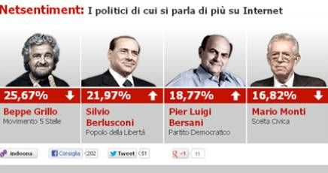
WebSays + Tiscali
17/1/2013

Slide 50
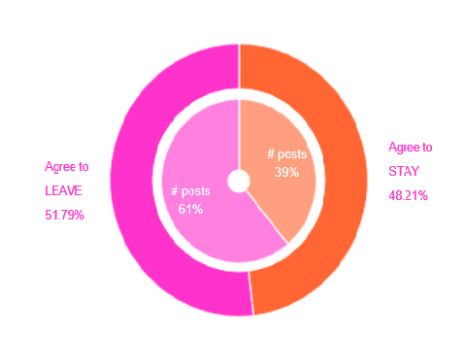
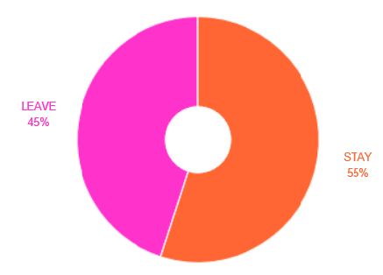
Monitoring Brexit Referendum
Predicted by Web Analysis
Exit Polls
http://www.sense-eu.info/

Slide 51
Potential Applications
Individuazione di entità
Estrazione di concetti
Estrazione di eventi
Analisi di Sentimenti
Classificazione
Intenzione di acquisto
Raccomandazione
Supporto al cliente (CRM)
Individuazione di interessi
Ricerca semantica

Slide 52
Data Needed
Data are an asset
Not just content from publishers
User generated content
Usage data
Social interaction
A few companies own them

Slide 53
Big data, Big Brain
Google DistrBelief
Cluster capable of simulating 100 billion connections
Used to learn unsupervised image classification
Used to produce tiny ASR model
Similar basic capability for processing image, audio and language
European FET Brain project
Biologically inspired solutions

Slide 54
No Real Language Understanding
Most successful application are self referential: input text, output text
Examples:
machine translation
tasks reducible to classification:
tagging
parsing
sentiment analysis
entity extraction
summarization
clustering

Slide 55
Knowledge Representation Hypothesis
Knowledge must be represented in some abstract representation in order to be used (Levesque)
In 1979 I did agree: Omega was one of the earliest Description Logics
Omega was conceived as a semantic network, consisting of a large tangle of concepts
What if such representation does not exists?

Slide 56
Alternative view
Imagine instead a structure that just stores elementary utterances and a huge tangle of connections between them
Even further, subunits of words, i.e. features
… and links have weights
Question answering can be easily dealt
Understanding is recognizing the presence of a large number of interconnections

Slide 57
An experiment

Slide 58
CLEF QA Task on Alzheimer Disease
Multiple Choice Reading Comprehension test
4 articles on Alzheimer’s disease
10 questions on each
5 possible answers for each

Slide 59
Index Expansion
Index Expansion
less noise than query expansion
document provides context for disambiguation
Document analysis provides connections:
POS, lemma, Stanford dependencies
synonym, hypernym
Index
special multilayer index
represents dependencies as posting lists
sort of DB denormalization

Slide 60
Layered Multi-Sentence
form | lemma | POS | H | dep | NE | Synonym | hypernym
the | the | DT | 4 | det | O
γ-secretase | γ-secretase | JJ | 3 | amod | B-protein
inhibitor | inhibitor | NN | 4 | appos | O | inhibitor | substance drug
Semacestat | Semacestat | NN | 11 | nsubj_pass dobj | O
tested | test | VBN | 4 | nmod | O | essay run exam screen examine prove try trial test examination | examine evaluate judge submit check experiment attempt effort endeavor check see ascertain watch ...

Slide 61
Apposition and Passive Forms
Apposition
“inhibitor” is added as hypernym of “Semacestat”
Alternative passive forms:
“Semacestat” annotated also as “dobj” of “test”

Slide 62
DeepSearch Queries
Named Entity layer
ne:protein | dep:nsubj
(ne:protein|dep:nsubj <- lemma:test)
(phase <- lemma:trial <- lemma:test)
align
dependency
Search on Pilot test documents at:
http://semawiki.di.unipi.it/alzheimer/

Slide 63
Question Answering
Query generation: from parse tree of
What candidate drug that blocks the γ-secretase is now tested in clinical trials?
Generate base query (edited):
syn:candidate OR syn:drug OR syn:γ-secretase OR
syn:clinical OR
(hyp:drug <- lemma:block -> syn:γ-secretase) OR
(hyp:drug <- lemma:test -> lemma:trial)

Slide 64
Syntactic and Semantic Analysis
ROOT
SUBJ
OBJ
APPO
OBJ
the γ-secretase inhibitor Semacestat failed to slow cognitive decline
protein
drug
disorder
SnowMed: C0236848
substance
QA on Alzheimer Competition

Slide 65
http://tanl.di.unipi.it/search/demo.html

Slide 66
Dependencies and Stanford Dependencies
dependencies
Bell sells and repairs jet engines
Stanford
not a tree

Slide 67
DL Applications

Slide 68
Learning semantic similarity between X and Y
Tasks | X | Y
Web search | Search query | Web documents
Ad selection | Search query | Ad keywords
Entity ranking | Mention (highlighted) | Entities
Recommendation | Doc in reading | Interesting things in doc or other docs
Machine translation | Sentence in language A | Translations in language B
Nature User Interface | Command (text/speech) | Action
Summarization | Document | Summary
Query rewriting | Query | Rewrite
Image retrieval | Text string | Images
… | … | …

Slide 69
Machine Translation
Jean, S., Cho, K., Memisevic, R. & Bengio, Y. On using very large target vocabulary for neural machine translation. In Proc. ACL-IJCNLP http://arxiv.org/abs/1412.2007 (2015).
Sutskever, I. Vinyals, O. & Le. Q. V. Sequence to sequence learning with neural networks. In Proc. Advances in Neural Information Processing Systems 27 3104–3112 (2014).

Slide 70
Security
Symantec uses DL for identifying and defending against zero-day malware attacks

Slide 71
Image Captioning
Extract features from images with CNN
Input to LSTM
Trained on MSCOCO
300k images, 6 caption/image
Target sequence
Un
gato
con
un
Image features
-
Un
gato
con
-

Slide 72
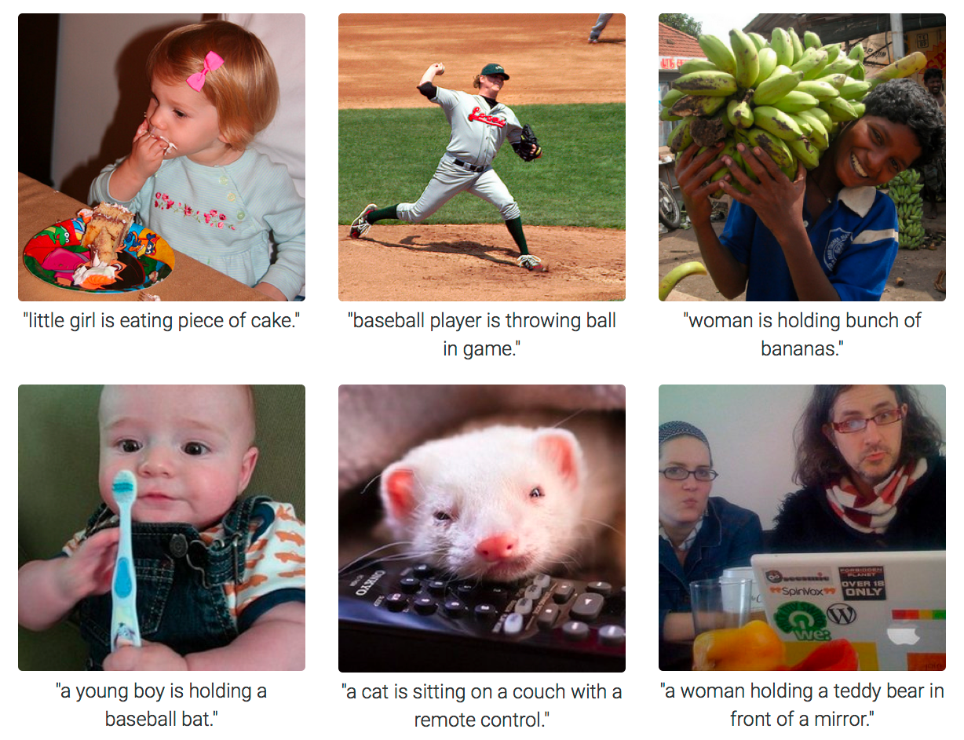

Slide 73
Sentence Compression
Three stacked LSTM
Vinyals, Keiser, Koo, Petrov. Grammar as a Foreign Language. NIPS 2015.
Softmax
LSTM
LSTM
LSTM
Embedding of previous word
prev. label

Slide 74
Examples
Alan Turing, known as the father of computer science, the codebreaker that helped win World War 2, and the man tortured by the state for being gay, is given a pardon nearly 60 years after his death.
Alan Turing is given a pardon.
Gwyneth Paltrow and her husband Chris Martin, are to separate after more than 10 years of marriage.
Gwyneth Paltrow are to separate.

Slide 75
Natural Language Inference

Slide 76
Question Answering
Bordes, A., Chopra, S. & Weston, J. Question answering with subgraph embeddings. In Proc. Empirical Methods in Natural Language Processing http://arxiv.org/abs/1406.3676v3 (2014).
B. Peng, Z. Lu, H. Li, K.F. WongToward Neural Network-based Reasoning
A. Kumar et al.Ask Me Anything: Dynamic Memory Networks for Natural Language Processing
H. Y. Gao et al. Are You Talking to a Machine? Dataset and Methods for Multilingual Image Question Answering, NIPS, 2015.

Slide 77
Reasoning in Question Answering
Reasoning is essential in a QA task
Traditional approach: rule-based reasoning
Mapping natural languages to logic form
Inference over logic forms
Dichotomy:
ML for NL analysis
symbolic reasoning for QA
DL perspective:
distributional representation of sentences
remember facts from the past
… so that it can suitably deal with long-term dependencies
not easy
Slide by Cosimo Ragusa

Slide 78
Motivations
Purely neural network-based reasoning systems with fully distributed semantics:
They can infer over multiple facts to answer simple questions
Simple way of modelling the dynamics of question-fact interaction
Complex reasoning process
NN-based trainable in an end-to-end fashion
But it is insensitive to the:
Number of supporting facts
Form of language and type of reasoning
I: Joe travelled to the hallway
I: Mary went to the bathroom
Q: Where is Mary?

Slide 79
Episodes
From Facebook BaBl data set:
I: Jane went to the hallway
I: Mary walked to the bathroom
I: Sandra went to the garden
I: Sandra took the milk there
Q: Where is the milk?
A: garden

Slide 80
Tasks
Path Finding:
I: The bathroom is south of bedroom
I: The bedroom is east of kitchen
Q: How do you go from bathroom to kitchen?
A: north, west
Positional Reasoning:
I: The triangle is above the rectangle
I: The square is to the left of the triangle
Q: Is the rectangle to the right of the square?
A: Yes

Slide 81
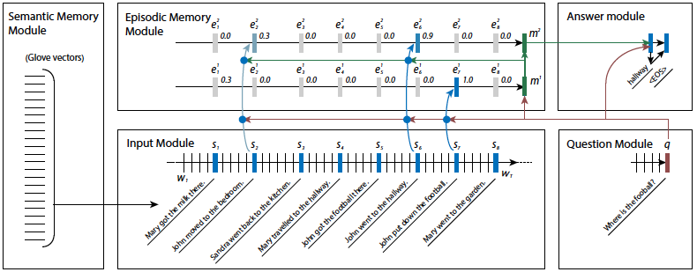
Dynamic Memory Network

Slide 82
Neural Reasoner
Layered architecture for dealing with complex logic relations in reasoning:
One encoding layer
Multiple reasoning layers
Answer layer (either chooses answer, or generates answer sentence)
Interaction between question and facts representations models the reasoning

Slide 83
Results
Classification accuracy | Positional Reasoning (1K) | Positional Reasoning (10K)
Dynamic Memory Network | 59.6 | -
Neural Reasoner | 66.4 | 97.9
Classification accuracy | Path Finding (1K) | Path Finding (10K)
Dynamic Memory Network | 34.5 | -
Neural Reasoner | 17.3 | 87.0

Slide 84
Text Understanding from Scratch
Convolutional network capable of SOTA on Movie Reviews working just from characters
no tokenization, no sentence splitting, no nothing
Zhang, X., & LeCun, Y. (2015). Text Understanding from Scratch. http://arxiv.org/abs/1502.01710

Slide 85
References
Attardi, G. (2005) IXE at the TREC Terabyte Task. In Proc. of The Forteenth Text Retrieval Conference (TREC 2005), NIST, Gaithersburg (MD).
Attardi, G. (2006) Experiments with a Multilanguage non-projective dependency parser. In Proc. of the Tenth CoNLL.
Attardi,G., Simi, M. (2006) Blog Mining Through Opinionated Words, Proc. of The Fifteenth Text Retrieval Conference (TREC 2006), NIST, Gaithersburg (MD).
G. Attardi, S. Dei Rossi, M. Simi. The Tanl Pipeline. Proc. of LREC Workshop on WSPP, Malta, 2010.
G. Attardi, L. Atzori, M. Simi. Index Expansion for Machine Reading and Question Answering. CLEF 2012 Evaluation Labs and Workshop - Online Working Notes, P. Forner, J. Karlgren, C. Womser-Hacker (eds.), Rome, Italy, 17-20 September, 2012. ISBN 978-88-904810-3-1, ISSN 2038-4963.

