Slide 1
The tsunami of Deep Learning over NLP
Giuseppe Attardi Dipartimento di Informatica Università di Pisa
Pisa, December 15, 2015

Slide 2
Statistical Machine Learning
Training on large amounts of data
Requires ability to process Big Data
If we used same algorithms 10 years ago they would still be running
The Unreasonable Effectiveness of Big Data
Norvig vs Chomsky controversy

Slide 3
Supervised Statistical ML Methods
Devise a set of features to represent data:
φ(x) ∈ R^{D} and weights w_{y} ∈ R^{D}
Prediction function
f(x) = argmax_{y} w_{y} ⋅ φ(x)
Learn w by minimizing error wrt training examples
Freed us from devising rules or algorithms
Requires creation of annotated training corpora
Imposed the tyranny of feature engineering

Slide 4
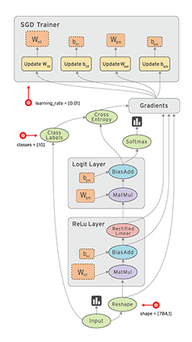
Deep Learning
Design a model architecture
Define loss function
Run the network letting the parameters and the representation of the data self-organize as to minimize this loss
End-to-end learning: no intermediate stages nor representations

Slide 5
Deep Neural Network Model
Output layer
Prediction of target
Hidden layers
Learn more abstract representations
Input layer
Raw input
…
…
…
…

Slide 6
More Abstract Representations

Slide 7
Deep vs Shallow
Given the same number of non-linear units, a deep architecture is more expressive than a shallow one (Bishop 1995)
Two layer (plus input layer) neural networks have been shown to be able to approximate any function
However, functions compactly represented in k layers may require exponential size when expressed in 2 layers

Slide 8
Deep Network
Shallow Network
Shallow (2 layer) networks need a lot more hidden layer nodes to compensate for lack of expressivity
In a deep network, high levels can express combinations between features learned at lower levels

Slide 9
Problem
Training deep network faces the vanishing gradient problem
Back propagation of error gradients
Gradient tend to get smaller moving backward through the hidden layers
Neurons in the bottom layers learn much more slowly

Slide 10
Slide credit : Yoshua Bengio

Slide 11
Deep Learning Breakthrough: 2006
Unsupervised learning of shallow features from large amounts of unannotated data
Features are tuned to specific tasks with second stage of supervised learning

Slide 12
Layer-wise Unsupervised Pre-training
?
=
reconstruction
of features
more abstract
features
features
input
…
…
…
…
…
Courtesy: G. Hinton

Slide 13
Supervised Fine Tuning
Should be: 2
Output: f(x)
Courtesy: G. Hinton

Slide 14
State of the Art in Many Areas
Speech Recognition (2010, Dahl et al)
MNIST hand-written digit recognition (Ciresan et al, 2010)
Image Recognition (Krizhevsky won 2012 ImageNet competition)
Andrew Ng, Stanford:
“I’ve worked all my life in Machine Learning, and I’ve never seen one algorithm knock over benchmarks like Deep Learning”

Slide 15
DL for NLP

Slide 16
Vector Representation of Words
From discrete to distributed representation
Word meanings are dense vectors of weights in a high dimensional space
Algebraic properties
Background
Philosophy: Hume, Wittgenstein
Linguistics: Firth, Harris
Statistics ML: Feature vectors
”You shall know a word by the company it keeps”
(Firth, 1957).

Slide 17
Distributional Semantics
Co-occurrence counts
High dimensional sparse vectors
Similarity in meaning as vector similarity?
 | shining | bright | trees | dark | look
stars | 38 | 45 | 2 | 27 | 12
tree
stars
sun

Slide 18
Co-occurrence Vectors
FRANCE 454 | JESUS 1973 | XBOX 6909 | REDDISH 11724 | SCRATCHED 29869 | MEGABITS 87025
PERSUADE | THICKETS | DECADENT | WIDESCREEN | ODD | PPA
FAW | SAVARY | DIVO | ANTICA | ANCHIETA | UDDIN
BLACKSTOCK | SYMPATHETIC | VERUS | SHABBY | EMIGRATION | BIOLOGICALLY
GIORGI | JFK | OXIDE | AWE | MARKING | KAYAK
SHAFFEED | KHWARAZM | URBINA | THUD | HEUER | MCLARENS
RUMELLA | STATIONERY | EPOS | OCCUPANT | SAMBHAJI | GLADWIN
PLANUM | GSNUMBER | EGLINTON | REVISED | WORSHIPPERS | CENTRALLY
GOA’ULD | OPERATOR | EDGING | LEAVENED | RITSUKO | INDONESIA
COLLATION | OPERATOR | FRG | PANDIONIDAE | LIFELESS | MONEO
BACHA | W.J. | NAMSOS | SHIRT | MAHAN | NILGRIS
neighboring words are not semantically related

Slide 19
Techniques for Creating Word Embeddings
Collobert et al.
SENNA
Polyglot
DeepNL
Mikolov et al.
word2vec
Lebret & Collobert
DeepNL
Socher & Manning
GloVe

Slide 20
Neural Network Language Model
LM likelihood
Expensive to train:
3-4 weeks on Wikipedia
U
Word vector
the cat sits on
… cat …
LM prediction
Quick to train:
40 min.on Wikipedia
tricks:
parallelism
avoid synchronization
U
Σ
the sits on

Slide 21
Lots of Unlabeled Data
Language Model
Corpus: 2 B words
Dictionary: 130,000 most frequent words
4 weeks of training
Parallel + CUDA algorithm
40 minutes

Slide 22
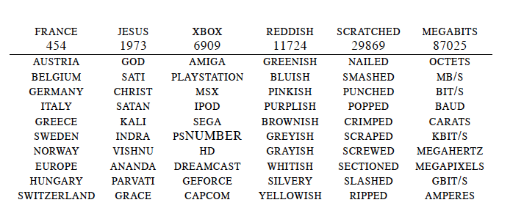
Word Embeddings
neighboring words are semantically related

Slide 23
Back to Co-occurrence Counts
 | breeds | computing | cover | food | is | meat | named | as
cat | 0.04 | 0.0 | 0.0 | 0.13 | 0.53 | 0.02 | 0.16 | 0.1
dog | 0.11 | 0.0 | 0.0 | 0.12 | 0.39 | 0.06 | 0.18 | 0.17
cloud | 0/0 | 0.29 | 0.19 | 0.0 | 0.12 | 0.0 | 0.0 | 0.4
Big matrix |V| × |V| (~ 100k × 100k)
Dimensionality reduction:
Principal Component Analysis, Hellinger PCA, SVD
Reduce to:100k × 50, 100k × 100

Slide 24
Deep Learning for NLP

Slide 25
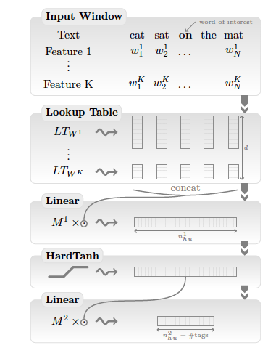
A Unified Deep Learning Architecture for NLP
NER (Named Entity Recognition)
POS tagging
Chunking
Parsing
SRL (Semantic Role Labeling)
Sentiment Analysis

Slide 26
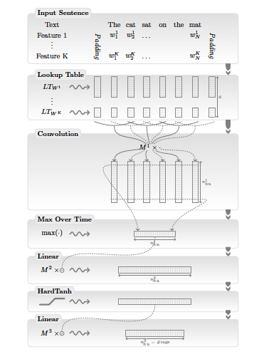
Convolutional Network
Convolution over whole sentence

Slide 27
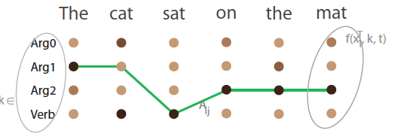
Training
Sentence Level Log-Likelihood:
transition score to jump from tag k to tag i
Sentence score for a tag path

Slide 28
Training
Recursive Forward algorithm computed with parallel matrix computation
Inference: Viterbi algorithm (replace logAdd by max)

Slide 29
Sequence Taggers

Slide 30
POS Tagging
Input: tab separated token/tag, one per line
Mr. NNP
Vinken NNP
is VBZ
chairman NN
of IN
Elsevier NNP

Slide 31
NER Tagging
Input in Conll03 tab separated format:
EU NNP I-ORG
rejects VBZ O
German JJ I-MISC
call NN O
to TO O
boycott VB O
British JJ I-MISC
lamb NN O

Slide 32
Results
 | POS | CHUNK | NER | SRL
SOTA | 97.24 | 94.29 | 89.31 | 77.92
DeepNL | 97.20 | 94.63 | 89.51 | 74.15

Slide 33
Applications
NER
IMDB Movie Reviews
Approach | F1
Ando et al. 2005 | 89.31
Word2Vec | 88.20
GloVe | 88.30
SENNA | 89.51
Model | Accuracy
Wang & Manning | 91.2
Brychcin & Habernal | 92.2
H-PCA | 89.9

Slide 34
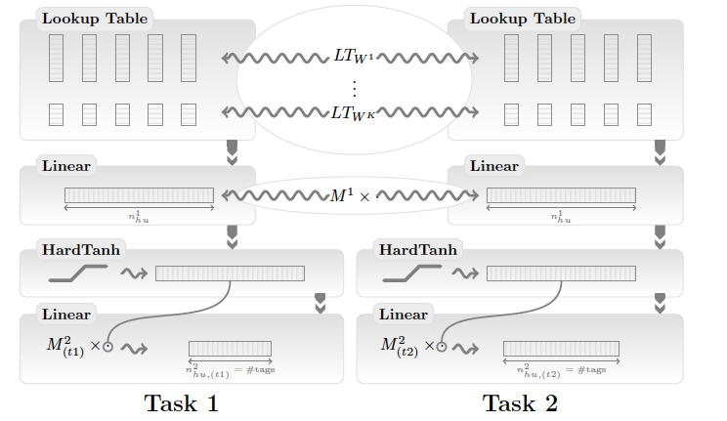
Multitask learning
Use single network for multiple tasks
Avoids error propagation

Slide 35
Question?
Do we need multiple tasks, aka NLP pipelines?
Some tasks are artificial:
e.g are POS tags useful
End-to-end training allows avoiding splitting into tasks
Let the layer learn abstract representation
Example:
dependency parsing with clusters of words performs similarly to using POS

Slide 36
Question
Do we need linguists at all?
Children learn to talk with no linguistic training
This is what Manning calls
The tsunami of DL over NLP

Slide 37
The tsunami
High percent of papers at ACL using DL
Neil Lawrence:
NLP is kind of like a rabbit in the headlights of the Deep Learning machine, waiting to be flattened.
Geoff Hinton:
In a few years time we will put DL on a chip that fits into someone’s ear is just like a real Babel fish
Michael Jordan:
“I’d use the billion dollars to build a NASA-size program focusing on natural language processing, in all of its glory (semantics, pragmatics, etc.).”

Slide 38
Companies Involvement
Pradeep Dubey, VP at Intel:
“Machine Learning is the most significant emerging algorithm class today”
Google, Facebook, Microsoft, etc.
too many to mention

Slide 39
Manning is not worried
Problems in higher-level language processing have not seen the dramatic error rate reductions from deep learning that have been seen in speech recognition and in object recognition in vision
NLP is the domain science of language technology; it’s not about the best method of machine learning—the central issue remains the domain problems.
People in linguistics, people in NLP, are the designers

Slide 40
Manning remarks
Most gains from word embeddings
The use of small dimensionality and dense vectors for words allows us to model large contexts, leading to greatly improved language models
The exponentially greater sparsity that comes from increasing the order of traditional word n-gram models seems conceptually bankrupt
Intelligence requires being able to understand bigger things from knowing about smaller parts
Understanding complex sentences crucially depends on being able to construct their meaning compositionally from smaller parts of which they are constituted

Slide 41
But…
Isn’t fascinating that we can develop systems that can deal with disparate tasks using a unified learning architecture?
After all, children learn to speak in 3 years without much study

Slide 42
Biological Inspiration
This is NOT how humans learn
Humans first learn simple concepts, and then learner more complex ideas by combining simpler concepts
There is evidence though that the cortex has a single learning algorithm:
Inputs from optic nerves of ferrets was rerouted to into their audio cortex
They were able to learn to see with their audio cortex instead
If we want a general learning algorithm, it needs to be able to:
Work with any type of data
Extract it’s own features
Transfer what it’s learned to new domains
Perform multi-modal learning – simultaneously learn from multiple different inputs (vision, language, etc)

Slide 43
Dependency Parser

Slide 44
DeSR (Dependency Shift Reduce)
Multilanguage statistical transition based dependency parser
Linear algorithm
Capable of handling non-projectivity
Trained on 28 languages

Slide 45
Transition-based Shift-Reduce Parsing
top
next
Shift
Left
Right
He
PP
saw
VVD
a
DT
girl
NN
with
IN
a
DT
telescope
NN
.
SENT

Slide 46
Parser Online Demo

Slide 47
Code Base
DeepNL
https://github.com/attardi/deepnl
DeSR parser
https://sites.google.com/site/desrparser/

Slide 48
Limits of Word Embeddings
Limited to words (neither MW nor phrases)
Represent similarity: antinomies often appear similar
Not good for sentiment analysis
Not good for polysemous words
Solution
Semantic composition
or …

Slide 49
Discriminative Word Embeddings
Sentiment Specific Word Embeddings
Uses an annotated corpus with polarities (e.g. tweets)
SS Word Embeddings achieve SOTA accuracy on tweet sentiment classification
LM likelihood + Polarity
U
the cat sits on

Slide 50
Semeval 2015 Sentiment on Tweets
Team | Phrase Level Polarity | Tweet
Moschitti | 84.79 | 64.59
KLUEless | 84.51 | 61.20
IOA | 82.76 | 62.62
WarwickDCS | 82.46 | 57.62
Webis |  | 68.84

Slide 51
Social Sensing
Detecting reports of natural disasters on Twitter
System | Precision | Recall | F-1
Baseline | 86.87 | 70.96 | 78.11
Discrim. Embeddings | 85.94 | 75.05 | 80.12
Convolutional | 96.65 | 95.52 | 96.08

Slide 52
Context Aware Word Embeddings
LM likelihood
U
W
Σ
the cat sits on
Applications:
Word sense disambiguation
Document Classification
Polarity detection
Adwords matching

Slide 53
Recurrent Neural Network
Long Short-Term Memory
Gated Recurrent Units

Slide 54
DL Applications

Slide 55
Machine Translation
K. Cho, B. van Merrienboer, C. Gulcehre, F. Bougares, H. Schwenk, Y. Bengio. Learning phrase representations using RNN encoder-decoder for statistical machine translation. arXiv preprint arXiv:1406.1078, 2014.

Slide 56
Image Captioning
Extract features from images with CNN
Input to LSTM
Trained on MSCOCO
300k images, 6 caption/image
Target sequence
Un
gato
con
un
Image features
-
Un
gato
con
-

Slide 57
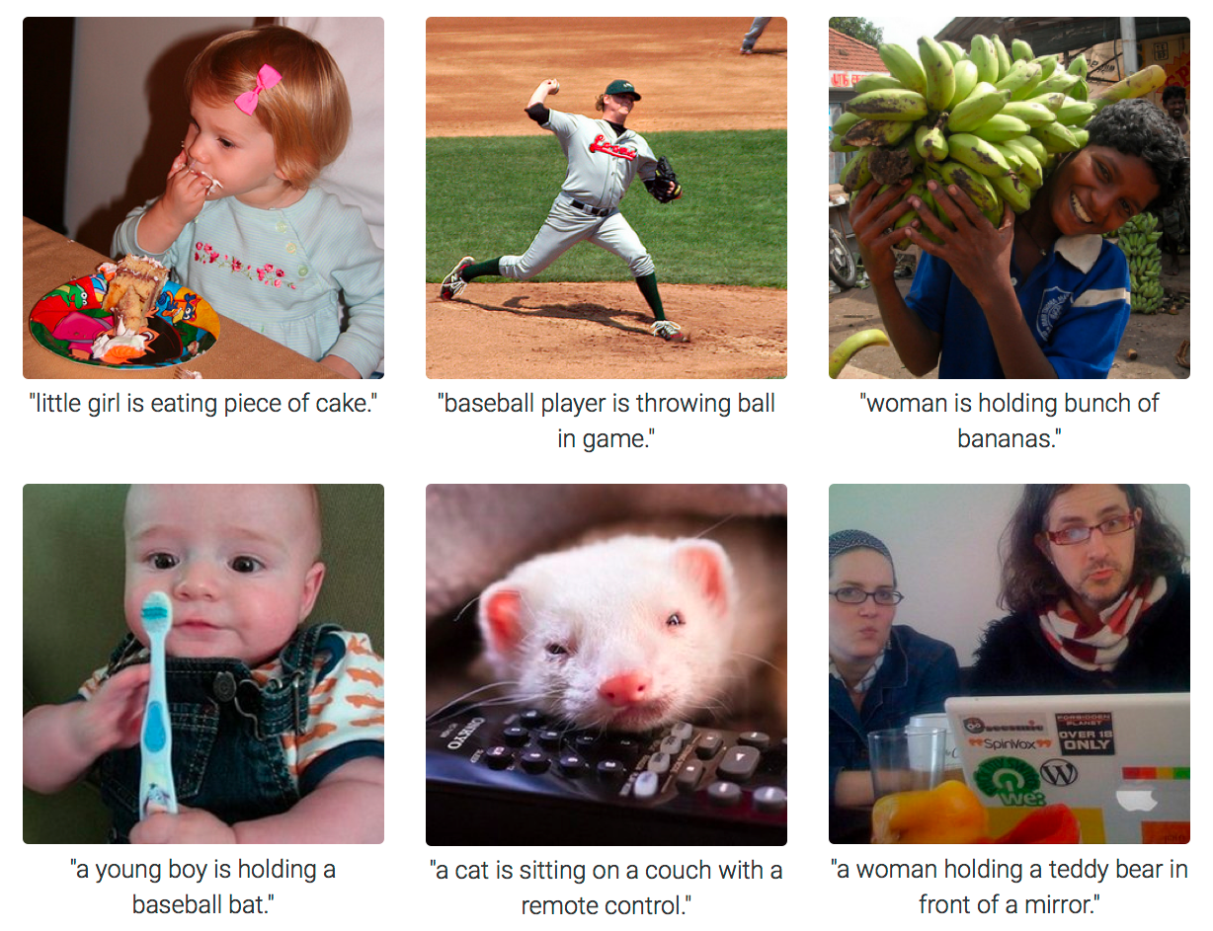

Slide 58
Sentence Compression
Three stacked LSTM
Vinyals, Keiser, Koo, Petrov. Grammar as a Foreign Language. NIPS 2015.
Softmax
LSTM
LSTM
LSTM
Embedding of previous word
prev. label

Slide 59
Examples
Alan Turing, known as the father of computer science, the codebreaker that helped win World War 2, and the man tortured by the state for being gay, is given a pardon nearly 60 years after his death.
Alan Turing is given a pardon.
Gwyneth Paltrow and her husband Chris Martin, are to separate after more than 10 years of marriage.
Gwyneth Paltrow are to separate.

Slide 60
Natural Language Inference

Slide 61
Question Answering
B. Peng, Z. Lu, H. Li, K.F. WongToward Neural Network-based Reasoning
A. Kumar et al.Ask Me Anything: Dynamic Memory Networks for Natural Language Processing
H. Y. Gao et al. Are You Talking to a Machine? Dataset and Methods for Multilingual Image Question Answering, NIPS, 2015.

Slide 62
Reasoning in Question Answering
Reasoning is essential in a QA task
Traditional approach: rule-based reasoning
Mapping natural languages to logic form
Inference over logic forms
Dichotomy:
ML for NL analysis
symbolic reasoning for QA
DL perspective:
distributional representation of sentences
remember facts from the past
… so that it can suitably deal with long-term dependencies
not easy
Slide by Cosimo Ragusa

Slide 63
Motivations
Purely neural network-based reasoning systems with fully distributed semantics:
They can infer over multiple facts to answer simple questions
Simple way of modelling the dynamics of question-fact interaction
Complex reasoning process
NN-based trainable in an end-to-end fashion
But it is insensitive to the:
Number of supporting facts
Form of language and type of reasoning
I: Joe travelled to the hallway
I: Mary went to the bathroom
Q: Where is Mary?

Slide 64
Episodes
From Facebook babl data set:
I: Jane went to the hallway
I: Mary walked to the bathroom
I: Sandra went to the garden
I: Sandra took the milk there
Q: Where is the milk?
A: garden

Slide 65
Tasks
Path Finding:
I: The bathroom is south of bedroom
I: The bedroom is east of kitchen
Q: How do you go from bathroom to kitchen?
A: north, west
Positional Reasoning:
I: The triangle is above the rectangle
I: The square is to the left of the triangle
Q: Is the rectangle to the right of the square?
A: Yes

Slide 66
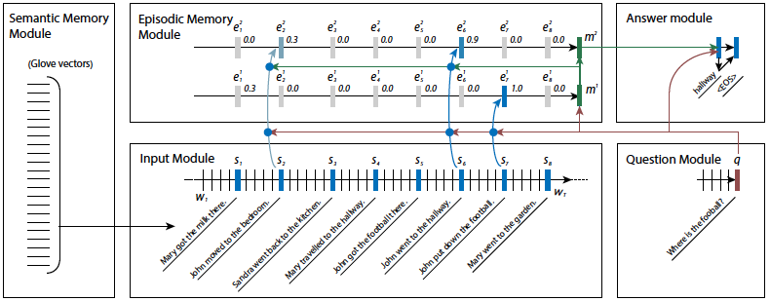
Dynamic Memory Network

Slide 67
Neural Reasoner
Layered architecture for dealing with complex logic relations in reasoning:
One encoding layer
Multiple reasoning layers
Answer layer (either chooses answer, or generates answer sentence)
Interaction between question and facts representations models the reasoning

Slide 68
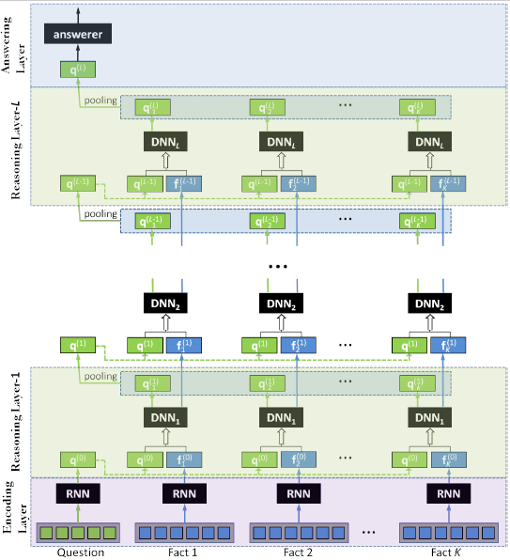
Architecture

Slide 69
Results
Classification accuracy | Positional Reasoning (1K) | Positional Reasoning (10K)
Dynamic Memory Network | 59.6 | -
Neural Reasoner | 66.4 | 97.9
Classification accuracy | Path Finding (1K) | Path Finding (10K)
Dynamic Memory Network | 34.5 | -
Neural Reasoner | 17.3 | 87.0

Slide 70
Text Understanding from Scratch
Convolutional network capable of SOTA on Movie Reviews working just from characters
no tokenization, no sentence splitting, no nothing
Zhang, X., & LeCun, Y. (2015). Text Understanding from Scratch. http://arxiv.org/abs/1502.01710

Slide 71
Quiz Bowl Competition
Iyyer et al. 2014: A Neural Network for Factoid Question Answering over Paragraphs
QUESTION:
He left unfinished a novel whose title character forges his father’s signature to get out of school and avoids the draft by feigning desire to join.
One of his novels features the jesuit Naptha and his opponent Settembrini, while his most famous work depicts the aging writer Gustav von Aschenbach.
Name this German author of The Magic Mountain and Death in Venice.
ANSWER: Thomas Mann

Slide 72
QANTA vs Ken Jennings
QUESTION:
Along with Evangelista Torricelli, this man is the namesake of a point the minimizes the distances to the vertices of a triangle.
He developed a factorization method …
ANSWER: Fermat
QUESTION:
A movie by this director contains several scenes set in the Yoshiwara Nightclub.
In a movie by this director a man is recognized by a blind beggar because he is wistlinIn the hall of the mountain king.
ANSWER: Fritz Lang

Slide 73
More examples
Deep Learning Applications
R. Socher, Stanford
https://www.youtube.com/watch?v=BVbQRrrsJo0

Slide 74
DL Libraries

Slide 75
Caffe
deep learning framework from Berkeley
focus on vision
coding in C++ or Python
Network consists in layers:
layer = { name = “data”, …}
layer = { name = “conv”, ...}
data and derivatives flow through net as blobs

Slide 76
Theano
Python linear algebra compiler that optimizes symbolic mathematical computations generating C code
integration with NumPy
transparent use of a GPU
efficient symbolic differentiation

Slide 77
Example
>>> x = theano.dscalar('x')
>>> y = x ** 2
>>> gy = theano.grad(y, x)
>>> f = theano.function([x], gy)
>>> f(4)
array(8.0)

Slide 78
2-layer Neural Network
z1 = X.dot(W1) + b1 # first layer
a1 = tanh(z1) # activation
z2 = a1.dot(W2) + b2 # second layer
y_hat = softmax(z2) # output probabilties
# class prediction
prediction = T.argmax(y_hat, axis=1)
# the loss function to optimize
loss = categorical_crossentropy(y_hat, y).mean()

Slide 79
Gradient Descent
dW2 = T.grad(loss, W2)
db2 = T.grad(loss, b2)
dW1 = T.grad(loss, W1)
db1 = T.grad(loss, b1)
gradient_step = theano.function([X, y],
updates = ((W2, W2 - epsilon * dW2),
(W1, W1 - epsilon * dW1),
(b2, b2 - epsilon * db2),
(b1, b1 - epsilon * db1)))

Slide 80
Training loop
# Gradient descent. For each batch...
for i in xrange(0, epochs):
# updates parameters W2, b2, W1 and b1!
gradient_step(train_X, train_y)

Slide 81
DeepNL
C++ with Eigen
Wrapper for Python, Java, PHP automatically generated with SWIG

Slide 82
TensorFlow
C++ core code using Eigen
Eigen template metaprogramming linear albegra generates code for CPU or GPU
Build architecture as dataflow graphs:
Nodes implement mathematical operations, or data feed or variables
Nodes are assigned to computational devices and execute asynchronously and in parallel
Edges carry tensor data between nodes

Slide 83
Training
Gradient based machine learning algorithms
Automatic differentiation
Define the computational architecture, combine that with your objective function, provide data -- TensorFlow handles computing the derivatives

Slide 84
Performance
Support for threads, queues, and asynchronous computation
TensorFlow allows assigning graph to different devices (CPU or GPU)

Slide 85
Conclusions
DL is having huge impacts in many areas of AI
Ability to process Big Data with parallel hardware crucial
Embrace or die?

Slide 86
References
R. Collobert et al. 2011. Natural Language Processing (Almost) from Scratch. Journal of Machine Learning Research, 12, 2461–2505.
Q. Le and T. Mikolov. 2014. Distributed Representations of Sentences and Documents. In Proc. of the 31st International Conference on Machine Learning, Beijing, China, 2014. JMLR:W&CP volume 32.
Rémi Lebret and Ronan Collobert. 2013. Word Embeddings through Hellinger PCA. Proc. of EACL 2013.
O. Levy and Y. Goldberg. 2014. Neural Word Embeddings as Implicit Matrix Factorization. In Advances in Neural Information Processing Systems (NIPS).
T. Mikolov, K. Chen, G. Corrado, and J. Dean. 2013. Efficient Estimation of Word Representations in Vector Space. In Proceedings of Workshop at ICLR, 2013.
Tang et al. 2014. Learning Sentiment-Specific Word Embedding for Twitter Sentiment Classification. In Proc. of the 52nd Annual Meeting of the ACL, 1555–1565,

