Slide 1
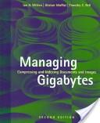
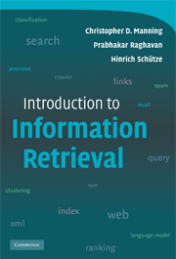
IR
Paolo Ferragina
Dipartimento di Informatica
Università di Pisa
Many slides are revisited from Stanford’s lectures by P.R.
Reading Chapter 1

Slide 2
Information Retrieval
Information Retrieval (IR) is finding material (usually documents) of an unstructured nature (usually text) that satisfies an information need from within large collections (usually stored on computers).

Slide 3
IR vs. databases:
Unstructured vs Structured data
Structured data tends to refer to information in “tables”
Employee
Manager
Salary
Smith
Jones
50000
Chang
Smith
60000
Ivy
Smith
50000
Typically allows numerical range and exact match
(for text) queries, e.g.,
Salary < 60000 AND Manager = Smith.

Slide 4
Unstructured data
Typically refers to free text, and allows
Keyword queries including operators
More sophisticated “concept” queries e.g.,
  find all web pages dealing with drug abuse
Classic model for searching text documents

Slide 5
Semi-structured data: XML
In fact almost no data is “unstructured”
  E.g., this slide has distinctly identified zones such as the Title and Bullets
Facilitates “semi-structured” search such as
  Title contains data AND Bullets contain search
Issues:
  how do you process “about”?
  how do you rank results?

Slide 6
Boolean queries: Exact match
The Boolean retrieval model is being able to ask a query that is a Boolean expression:
  Boolean Queries are queries using AND, OR and NOT to join query terms
    Views each document as a set of words
    Is precise: document matches condition or not.
  Perhaps the simplest model to build an IR system on
Many search systems still use it:
  Email, library catalog, Mac OS X Spotlight

Slide 7
IR basics: Term-document matrix
Matrix could be very big
1 if play contains word, 0 otherwise
Brutus AND Caesar
BUT NOT Calpurnia

Slide 8
Inverted index
For each term t, we must store a list of all documents that contain t.
  Identify each by docID, a document serial number
Can we used fixed-size arrays for this?
Brutus
1
2
4
11
31
45
173
174
Caesar
1
2
4
5
6
16
57
132
Calpurnia
2
31
54
101
What happens if the word Caesar is added to document 14?

Slide 9
Inverted index
We need variable-size postings lists
  On disk, a continuous run of postings is normal and best
  In memory, can use linked lists or variable length arrays (…. Trade-offs….)
Brutus
1
2
4
11
31
45
173
174
Caesar
1
2
4
5
6
16
57
132
Calpurnia
2
31
54
101
Dictionary
Postings
Sorted by docID (more later on why).
Notes:
Linked lists generally preferred to arrays
Dynamic space allocation
Insertion of terms into documents easy
Space overhead of pointers

Slide 10
Query processing: AND
Consider processing the query:
  Brutus AND Caesar
  Fetch the lists and “Merge” them
2
2
4
4
8
8
16
16
32
64
128
32
64
128
Brutus
2
8
1
Caesar
1
2
2
3
5
5
8
8
13
13
21
21
34
3
34
If the list lengths are x and y, the merge takes O(x+y).
Crucial: postings sorted by docID.

Slide 11
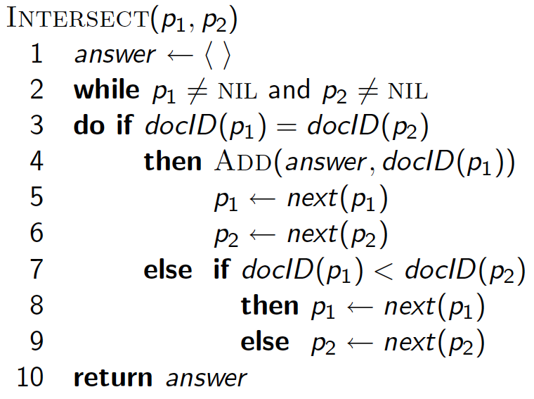
Intersecting two postings lists

Slide 12
Query optimization
What is the best order for query processing?
  Consider a query that is an AND of n terms.
  For each of the n terms, get its postings, then AND them together.
Brutus
2
4
8
16
32
64
128
Caesar
1
2
3
5
8
16
21
34
Calpurnia
13
16
Query: Brutus AND Calpurnia AND Caesar
12

Slide 13
Boolean queries:
More general merges
Sec. 1.3
Exercise: Adapt the merge for :
Brutus AND NOT Caesar
Brutus OR NOT Caesar
Can we still run the merge in time O(x+y)?

Slide 14
IR is much more…
What about phrases?
  “Stanford University”
Proximity: Find Gates NEAR Microsoft.
  Need index to capture position information in docs.
Zones in documents: Find documents with (author = Ullman) AND (text contains automata).

Slide 15
Ranking search results
Boolean queries give inclusion or exclusion of docs.
But
  often results are too many and we need to rank results
  Classification, clustering, summarization, text mining, etc…

Slide 16
Web IR and its challenges
Unusual and diverse
  Documents
  Users
  Queries
  Information needs
Exploit ideas from social networks
  link analysis, click-streams, ...
How do search engines work?

Slide 17
Our topics, on an example
?
Page archive
Crawler
Hashing
Linear Algebra
Clustering
Classification
Query
Web
Page
Analizer
Indexer
Query
resolver
Ranker
Sorting
Dictionaries
Which pages
to visit next?
text
auxiliary
Data Compression
Structure

Slide 18
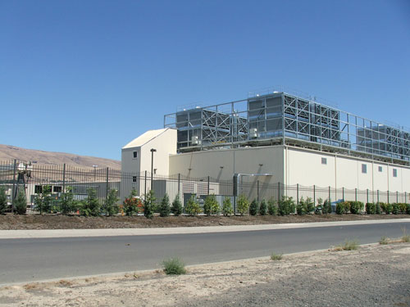
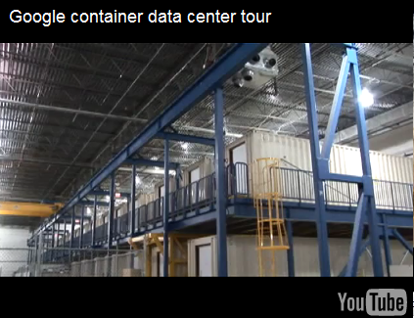
Notes:
50 MegaWatt, il fabbisogno utile per far funzionare 140.000 televisori, e uno allestito su una superficie di 5.000 metri quadrati che opera a 4 MegaWatt (la capacità di quello di Google è di 10 MegaWatt) consuma l’equivalente di 57 barili di petrolio al giorno

Slide 19
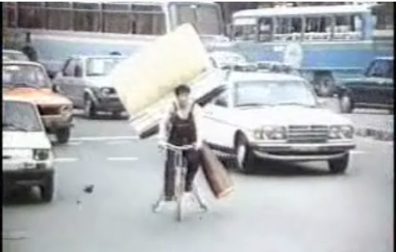
Do big DATA need big PCs ??
an Italian Ad of the ’80 about a BIG brush or a brush BIG....

Slide 20
big DATA → big PC ?
We have three types of algorithms:
  T₁(n) = n, T₂(n) = n², T₃(n) = 2^{n}
... and assume that 1 step = 1 time unit
How many input data n each algorithm may process within t time units?
  n₁ = t, n₂ = √t, n₃ = log₂ t
What about a k-times faster processor?
...or, what is n, when the available time is k*t ?
  n₁ = k * t, n₂ = √k * √t, n₃ = log₂ (kt) = log₂ k + log₂ t

Slide 21
A new scenario for Algorithmics
Data are more available than even before
n ➜ ∞
... is more than a theoretical assumption
The RAM model is too simple
Step cost is ω(1)

Slide 22
The memory hierarchy
net
1
L2
RAM
CPU
CPU
RAM
HD
L1
registers
Few Gbs
Tens of nanosecs
Some words fetched
Few Tbs
Cache
Few Mbs
Some nanosecs
Few words fetched
Few millisecs
B = 32K page
Many Tbs
Even secs
Packets

Slide 23
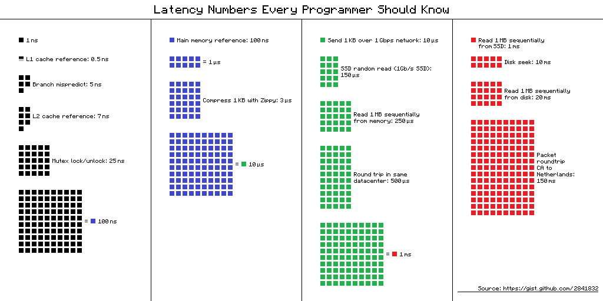

Slide 24
The I/O-model
read/write head
track
read/write arm
RAM
B
HD
CPU
1
Count I/Os
magnetic surface
“The difference in speed between modern CPU and disk technologies is analogous to the difference in speed in sharpening a pencil using a sharpener on one’s desk or by taking an airplane to the other side of the world and using a sharpener on someone else’s desk.” (D. Comer)
Spatial locality or Temporal locality
Less and faster I/Os
caching

Slide 25
Index Construction
Paolo Ferragina
Dipartimento di Informatica
Università di Pisa

Slide 26
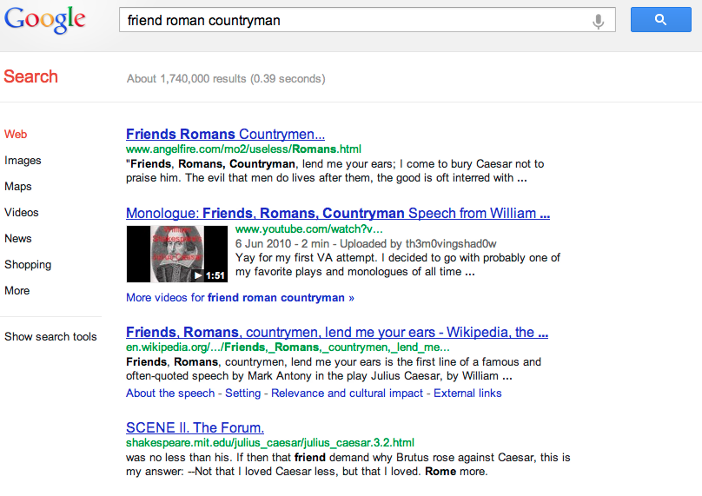





Inverted index construction
Sec. 1.2
Documents to
be indexed.
Friends, Romans, countrymen.
Tokenizer
Token stream.
Friends
Romans
Countrymen
Linguistic modules
Modified tokens.
friend
roman
countryman
Indexer
friend
2
4
roman
1
2
Inverted index.
countryman
13
16

Slide 27
Index Construction:
Parsing
Paolo Ferragina
Dipartimento di Informatica
Università di Pisa
Reading 2.1 and 2.2

Slide 28
Parsing a document
What format is it in?
  pdf/word/excel/html?
What language is it in?
What character set is in use?
Each of these is a classification problem, which we will study later in the course.
But these tasks are often done heuristically …

Slide 29
Tokenization
Input: “Friends, Romans and Countrymen”
Output: Tokens
  Friends
  Romans
  Countrymen
A token is an instance of a sequence of characters
Each such token is now a candidate for an index entry, after further processing
But what are valid tokens to emit?

Slide 30
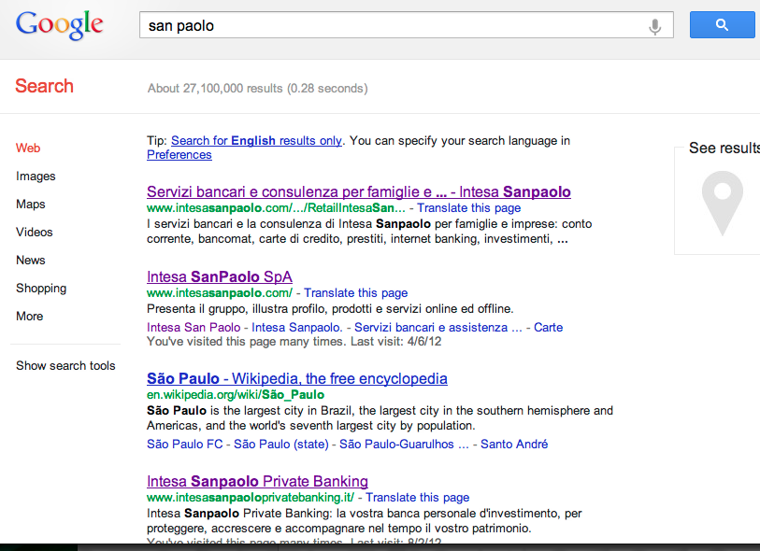
Tokenization: terms and numbers
Issues in tokenization:
  Barack Obama: one token or two?
  San Francisco?
  Hewlett-Packard: one token or two?
  B-52, C++, C#
  Numbers ? 24-5-2010
  192.168.0.1
  Lebensversicherungsgesellschaftsangestellter == life insurance company employee in german!

Slide 31
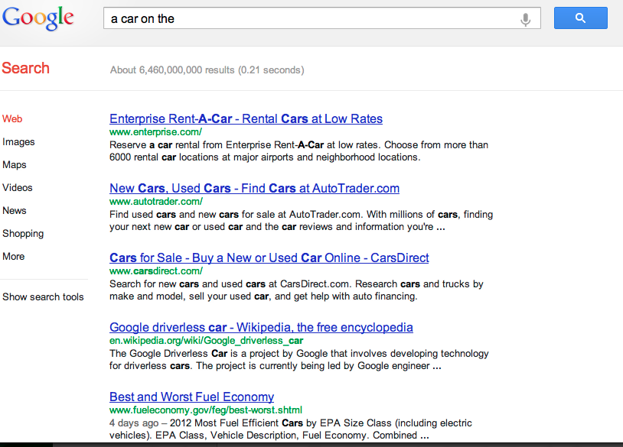
Stop words
We exclude from the dictionary the most common words (called, stopwords). Intuition:
  They have little semantic content: the, a, and, to, be
  There are a lot of them: ~30% of postings for top 30 words
But the trend is away from doing this:
  Good compression techniques (lecture!!) means the space for including stopwords in a system is very small
  Good query optimization techniques (lecture!!) mean you pay little at query time for including stop words.
  You need them for phrase queries or titles. E.g., “As we may think”

Slide 32
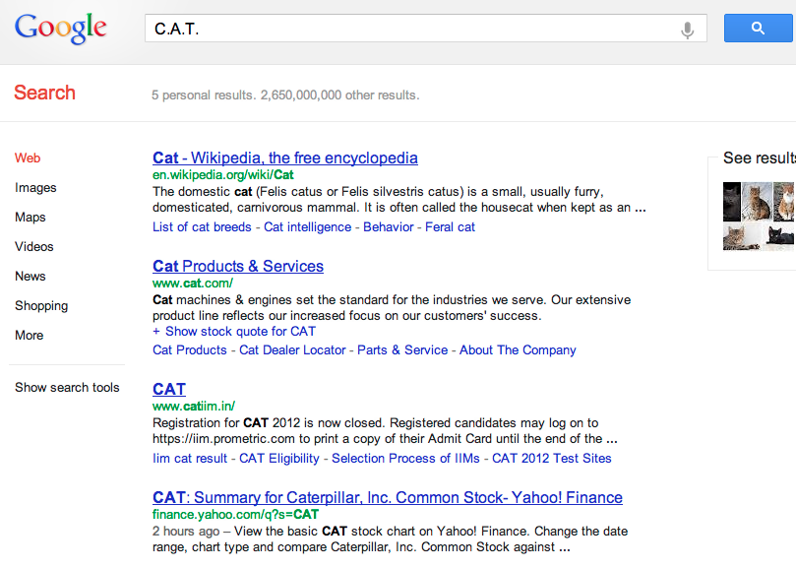
Normalization to terms
We need to “normalize” terms in indexed text and query words into the same form
  We want to match U.S.A. and USA
We most commonly implicitly define equivalence classes of terms by, e.g.,
  deleting periods to form a term
    U.S.A., USA → USA
  deleting hyphens to form a term
    anti-discriminatory, antidiscriminatory → antidiscriminatory
C.A.T. → cat ?

Slide 33
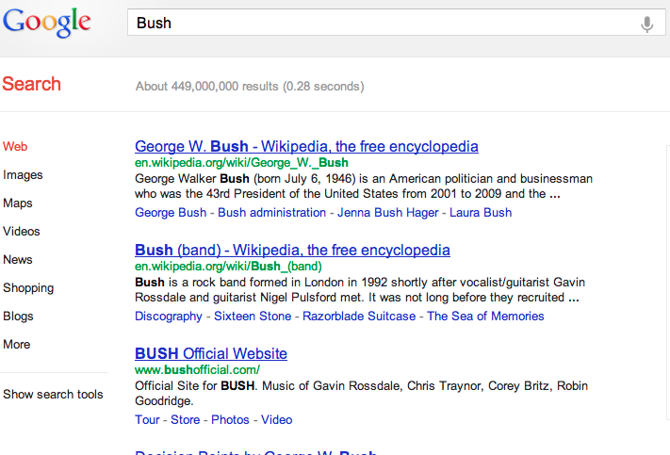
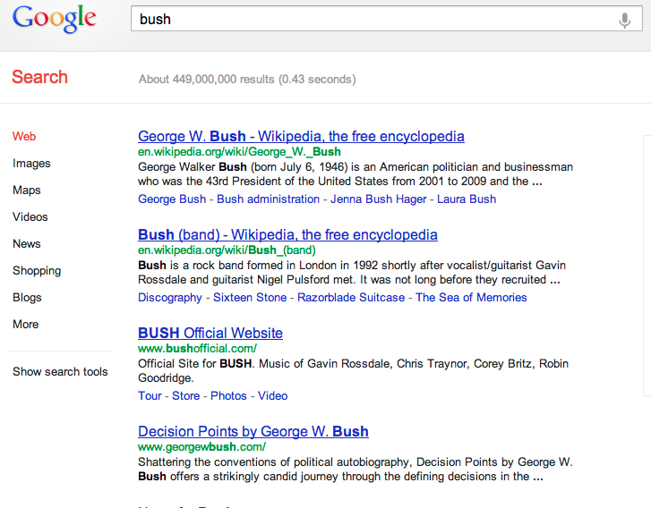
Case folding
Reduce all letters to lower case
  exception: upper case in midsentence?
    e.g., General Motors
    SAIL vs. sail
    Bush vs. bush
Often best to lower case everything, since users will use lowercase regardless of ‘correct’ capitalization…

Slide 34
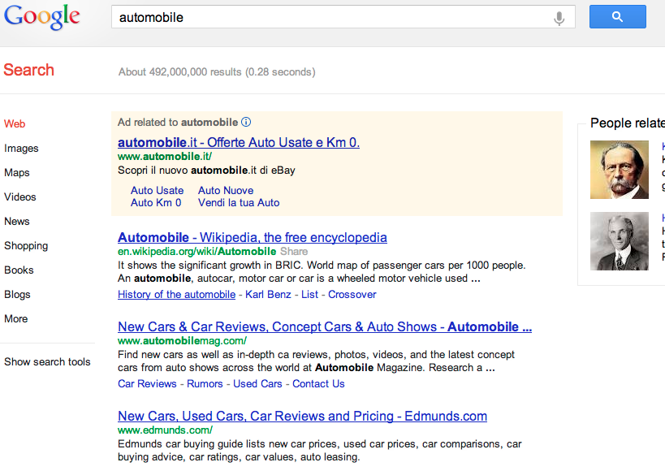
Thesauri
Do we handle synonyms and homonyms?
  E.g., by hand-constructed equivalence classes
    car = automobile color = colour
  We can rewrite to form equivalence-class terms
    When the document contains automobile, index it under car-automobile (and vice-versa)
  Or we can expand a query
    When the query contains automobile, look under car as well

Slide 35
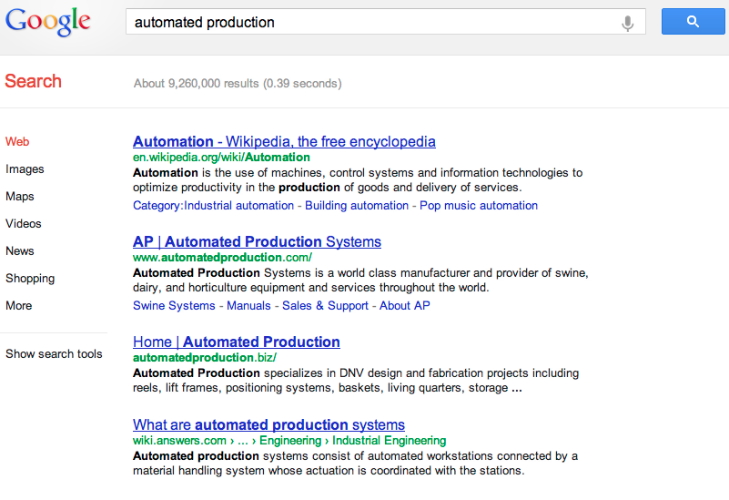
Stemming
Porter’s algorithm
Reduce terms to their “roots” before indexing
“Stemming” suggest crude affix chopping
  language dependent
  e.g., automate(s), automatic, automation all reduced to automat.
for example compressed
and compression are both
accepted as equivalent to
compress.
for exampl compress and
compress ar both accept
as equival to compress

Slide 36
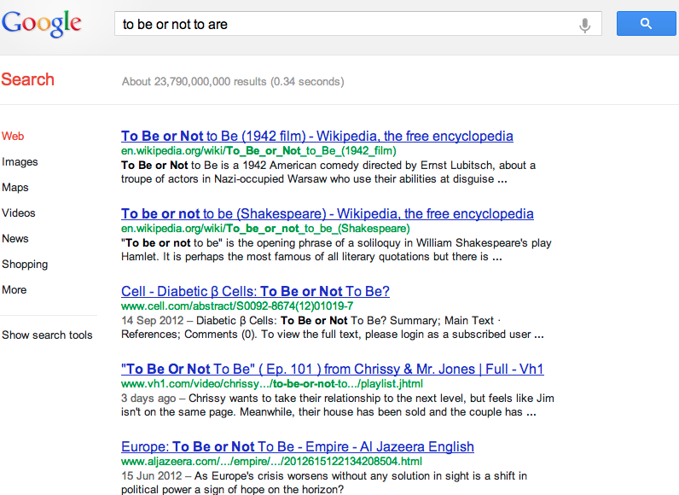
Lemmatization
Reduce inflectional/variant forms to base form
E.g.,
  am, are, is → be
  car, cars, car's, cars' → car
Lemmatization implies doing “proper” reduction to dictionary headword form

Slide 37
Language-specificity
Sec. 2.2.4
Many of the above features embody transformations that are
  Language-specific and
  Often, application-specific
These are “plug-in” addenda to indexing
Both open source and commercial plug-ins are available for handling these

Slide 38
Index Construction: statistical properties of text
Paolo Ferragina
Dipartimento di Informatica
Università di Pisa
Reading 5.1

Slide 39
Statistical properties of texts
Tokens are not distributed uniformly. They follow the so called “Zipf Law”
    Few tokens are very frequent
    A middle sized set has medium frequency
    Many are rare
The first 100 tokens sum up to 50% of the text, and many of them are stopwords

Slide 40
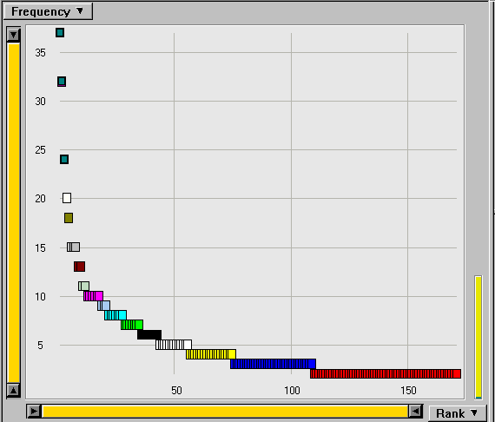
An example of “Zipf curve”

Slide 41
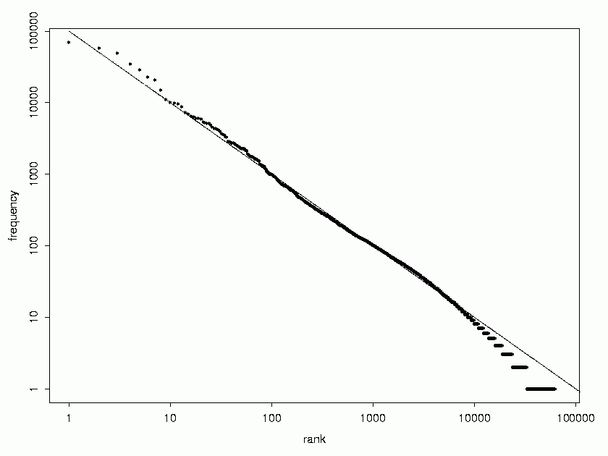
A log-log plot for a Zipf’s curve

Slide 42
The Zipf Law, in detail
k-th most frequent token has frequency f(k) approximately 1/k;
Equivalently, the product of the frequency f(k) of a token and its rank k is a constant
Scale-invariant: f(b*k) = b^{−s} * f(k)
k * f(k) = c
f(k) = c / k
f(k) = c / k
s = 1.5÷2.0
s
General Law

Slide 43
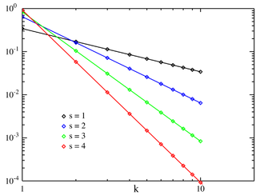
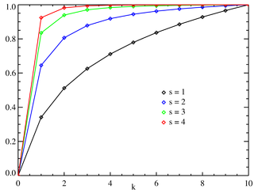
Distribution vs Cumulative distr
Log-log plot
Power-law with smaller exponent
Sum after the k-th element is ≤ f(k) * k/(s-1)
Sum up to the k-th element is ≥ f(k) * k

Slide 44
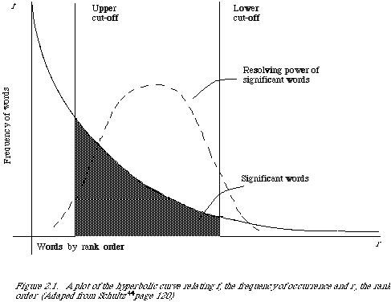
Other statistical properties of texts
The number of distinct tokens grows as
  The so called “Heaps Law” (n^{β} where β<1, tipically 0.5, where n is the total number of tokens)
  The average token length grows as Ω(log n)
Interesting words are the ones with medium frequency (Luhn)

