Slide 1


Beyond Hadoop: Pig and Giraph
Fabrizio Silvestri
HPCLab@ISTI
ISTI – CNR, Pisa, Italy

Slide 2
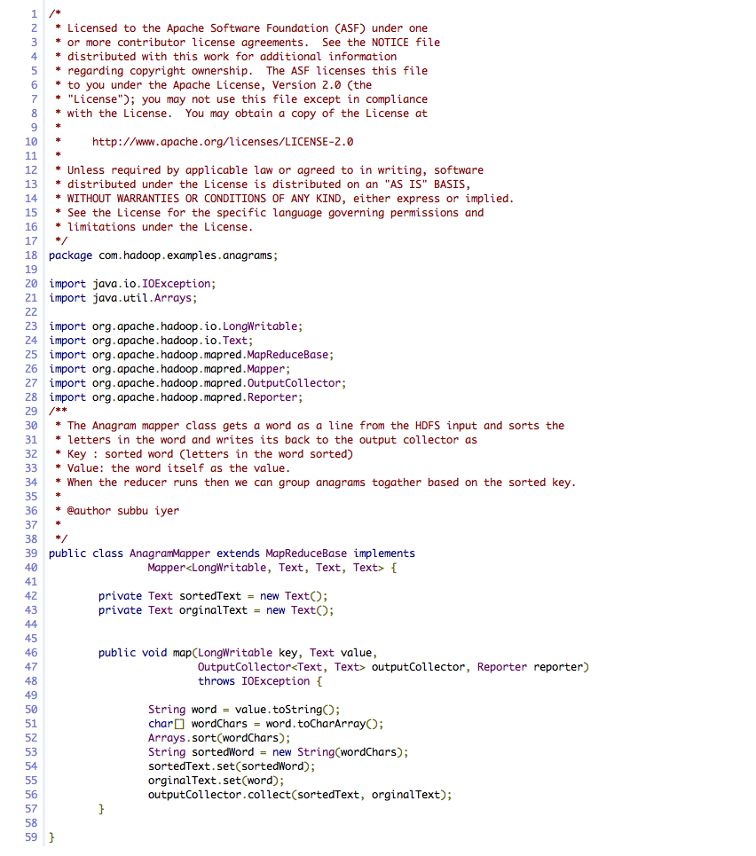
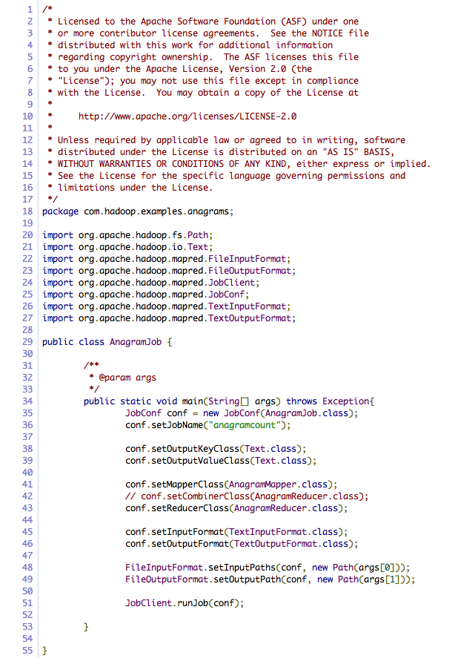
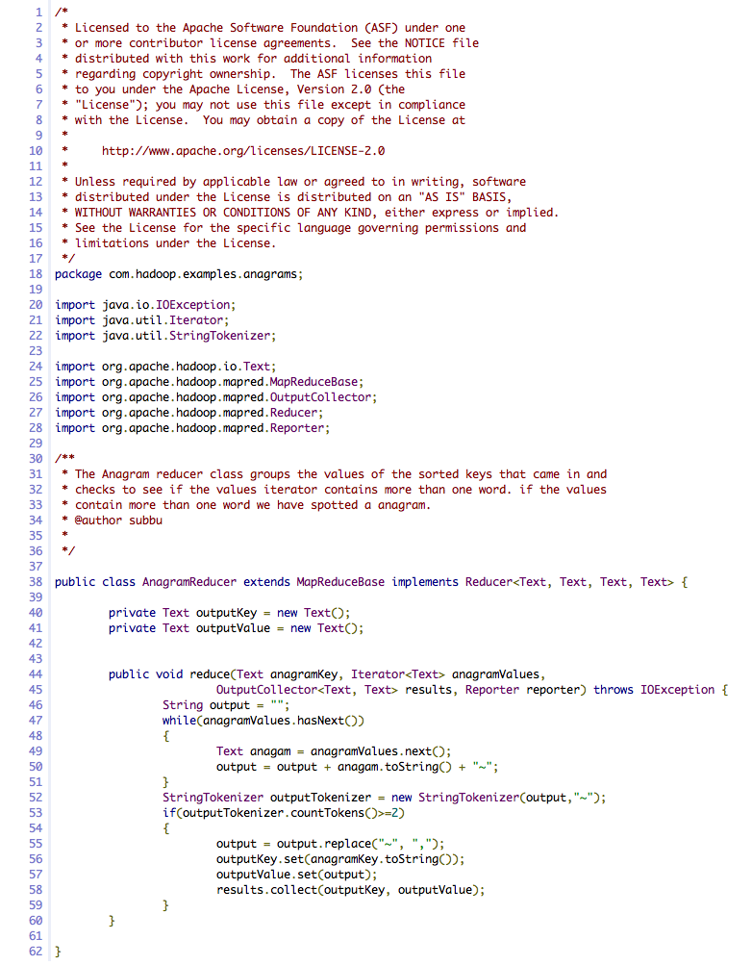
Introduction
Hadoop is programmers-friendly but:
  Too low-level
  Rigid
  Great amount of user code that is hard to understand and maintain

Slide 3
Map-Reduce Limitations
One-input, Two-stage dataflow
  That’s it!!!
Other flows constantly hacked in
Need to program over and over (or to build library functions):
  Projections
  Filtering
  Aggregates
  Order By
  Distinct
M
M
R
M
Join, Union
Split
Chains

Slide 4
Solution: Pig Latin
Eway escribeday away ewnay anguagelay alledcay Igpay Atinlay atthay eway avehay esignedday otay itfay inway away eetsway otspay etweenbay ethay eclarativeday ylestay ofway SQLAY, andway ethay owlay-evellay, oceduralpray ylestay ofway apmay-educeray. Ethay accompanyingway ystemsay, Igpay, isway ullyfay implementedway, andway ompilescay Igpay Atinlay intoway ysicalphay ansplay atthay areway executedway overway Adoophay, anway openway-ourcesay, apmay-educeray implementationway.
Christopher Olston, Benjamin Reed, Utkarsh Srivastava, Ravi Kumar, and Andrew Tomkins. 2008. Pig latin: a not-so-foreign language for data processing. In Proceedings of the 2008 ACM SIGMOD international conference on Management of data (SIGMOD '08). ACM, New York, NY, USA, 1099-1110.
It is a high-level declarative language (à la SQL) and a low level procedural programming (à la Map-Reduce)
Example
  urls = LOAD ‘urls.txt’ AS (url,category,pagerank);
  ok_urls = FILTER urls BY pagerank > 0.2;
  groups = GROUP good_urls BY category;
  big_groups = FILTER groups BY COUNT(ok_urls)>10^6
  o = FOREACH big_groups GENERATE category,
  AVG(good_urls.pagerank)

Slide 5
Step-by-Step Procedure Control
Target users are entrenched procedural programmers
The step-by-step method of creating a program in Pig is much cleaner and simpler to use than the single block method of SQL. It is easier to keep track of what your variables are, and where you are in the process of analyzing your data.
Jasmine Novak
Engineer, Yahoo!
With the various interleaved clauses in SQL, it is difficult to know what is actually happening sequentially. With Pig, the data nesting and the temporary tables get abstracted away. Pig has fewer primitives than SQL does, but it’s more powerful.
David Ciemiewicz
Search Excellence, Yahoo!
Automatic query optimization is hard
Pig Latin does not preclude optimization

Slide 6
Data Format
None!
The good news is that Pig is able to read text files.
No need to import data into a DB-like application.
Pig applications requirements are, often, the following:
  Read-only data analysis workload (no transactional consistency guarantees)
  Scan-centric (no point lookups)
  Datasets are temporary (no curation needed)
Even a fixed schema is not necessary as in Pig you can refer to dimensions in tuples vis $i notation, e.g.,
ok_urls = FILTER urls BY $2 > 0.2;

Slide 7
Nested Data Model
Pig Latin has a fully-nestable data model with:
  Atomic values, tuples, bags (lists), and maps
More natural to programmers than flat tuples
Avoids expensive joins
finance
yahoo ,
email
news

Slide 8
Nested vs. Relational Data Models
We have an inverted file. For each term we have a list of documentIDs with which positional information is associated. E.g.,
term1 -> doc1(1,4,5);doc2(2,3,5)
In Pig you represent it as a Map<termID,Set<Map<documentID,Set<positions>>>>
In Relational Data Models the same dataset should be represented in Normal Form as:
term_info(termID, termString, …)
document_info(termID, documentID, …)
position_info(termID, documentID, position)

Slide 9
Data Types
Atom: An atom contains a simple atomic value such as a string or a number, e.g., ‘alice’
Tuple: A tuple is a sequence of fields, each of which can be any of the data types, e.g., (‘alice’, ‘lakers’)
Bag: A bag is a collection of tuples with possible duplicates. The schema of the constituent tuples is flexible, i.e., not all tuples in a bag need to have the same number and type of fields, e.g.,
{(‘alice’, ‘lakers’), (‘alice’, (‘ipod’, ‘apple’))}
Map: A map is a collection of data items, where each item has an associated key through which it can be looked up. As with bags, the schema of the constituent data items is flexible, i.e., all the data items in the map need not be of the same type. However, the keys are requested to be data atoms, mainly for efficiency of lookups. Example [‘fan of’ -> {(‘alice’), (‘lakers’)},
‘age’ -> 20]

Slide 10
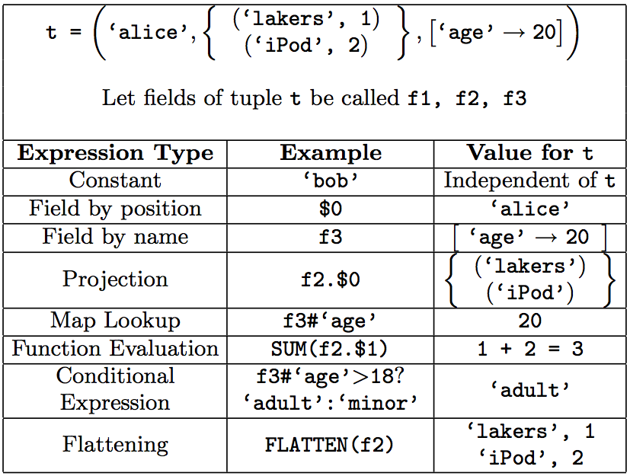
Expressions

Slide 11
User Defined Functions (UDFs)
To accommodate specialized data processing tasks, Pig Latin has extensive support for user-defined functions (UDFs).
All aspects of processing in Pig Latin including grouping, filtering, joining, and per-tuple processing can be customized through the use of UDFs.
Originally, only Java UDFs were supported, now Javascript and Python UDFs are supported as well.

Slide 12
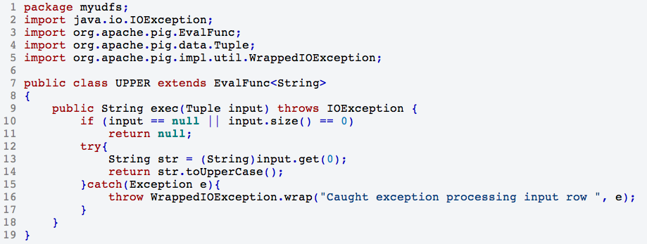
An Example of UDF
exp_q = FOREACH queries
GENERATE myudfs.UPPER(qString);

Slide 13
Specifying Input Data: LOAD
queries = LOAD ‘query_log.txt’
USING myLoad()
AS (userId,
queryString,
timestamp);
Question: do you think query_log is actually loaded when the command is accepted by the system?

Slide 14
Per-tuple Processing: FOREACH
exp_q = FOREACH queries
GENERATE Exp(qString);
Question: do you think exp_q is actually loaded when the command is accepted by the system?
GENERATE accepts Pig expressions.

Slide 15
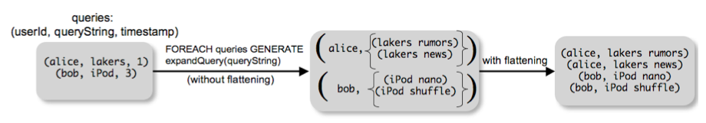
Tuple flattening: FLATTEN
Flattening operates on bags by extracting the fields of the tuples in the bag, and making them fields of the tuple being output by GENERATE, thus removing one level of nesting. For example, the output of the following command is shown as the second step in the figure below.
exp_q = FOREACH queries
GENERATE userID, FLATTEN(Exp(qString));

Slide 16
Discarding Unwanted Data: FILTER
While scanning a dataset we might need to filter out lines not matching a given boolean expression.
For example, to get rid of bot traffic in the bag queries:
real_q = FILTER queries
BY userID neq ‘bot’;
Using UDF:
real_q = FILTER queries
BY NOT isBot(userId);
Filtering conditions in Pig Latin can involve a combination of expressions, comparison operators such as ==, eq, !=, neq, and the logical connec- tors AND, OR, and NOT.

Slide 17
Getting Related Data Together: GROUP
If we want to merge together rows from a dataset we can use the GROUP command.
grouped_rev = GROUP revenue BY qString;
query_rev = FOREACH grouped_rev
GENERATE qString,
SUM(revenue.amount) AS totalRevenue;
To group all tuples of a data set together (e.g., to compute the overall total revenue), one uses the syntax
GROUP revenue ALL;

Slide 18
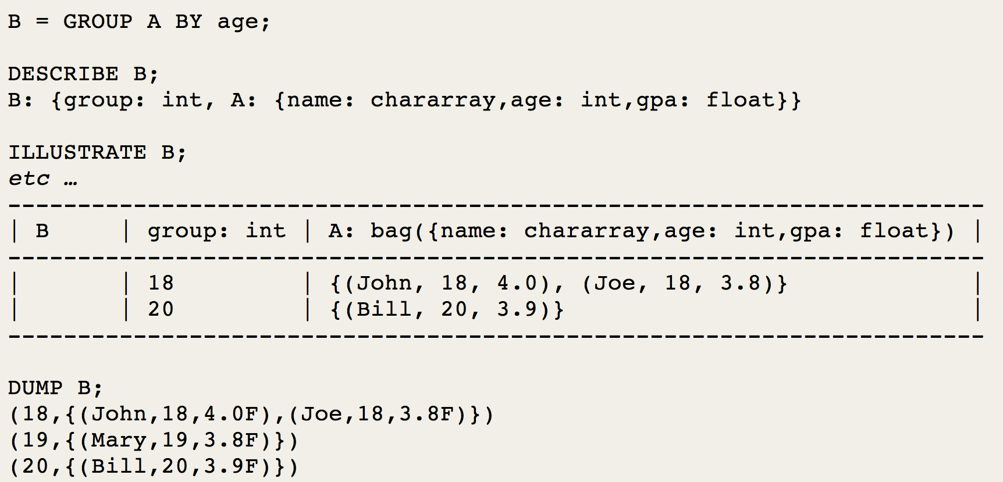
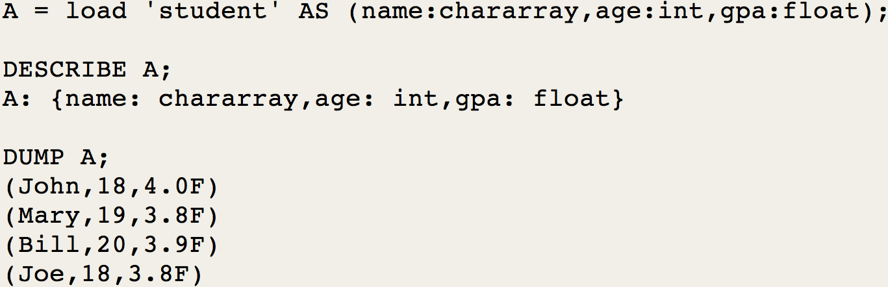
GROUP Results
Warning. Results of GROUP operations are non-intuitive.

Slide 19
Merging Datasets: JOIN
Given two datasets, normal equi-join operations can be carried out by the JOIN command.
join_result =
JOIN result BY qString,
revenue BY qString;

Slide 20
Stream Processing: STREAM
Sends data to an external script or program.
A = LOAD 'data';
B = STREAM A THROUGH 'stream.pl -n 5';

Slide 21
Asking for Output: STORE
Materialization of results is obtained through the Pig statement STORE:
STORE query_revenues INTO ‘output’ USING myStore();

Slide 22
Other Commands
UNION: Returns the union of two or more bags.
CROSS: Returns the cross product of two or more bags.
ORDER: Orders a bag by the specified field(s).
DISTINCT: Eliminates duplicate tuples in a bag. This command is just a shortcut for grouping the bag by all fields, and then projecting out the groups.
COGROUP: More general than GROUP allows grouping two distinct datasets.

Slide 23
Nested Operations
grouped_revenue = GROUP revenue BY qString;
query_revenues =
FOREACH grouped_revenue{
top_slot = FILTER revenue BY adSlot eq ‘top’;
GENERATE queryString,
SUM(top_slot.amount),
SUM(revenue.amount);
};

Slide 24
Map-Reduce in Pig Latin
Pig statements can be combined to generate Map-Reduce programs through the use of UDFs.
map_result = FOREACH input GENERATE FLATTEN(map(*));
key_groups = GROUP map_result BY $0;
output = FOREACH key_groups GENERATE reduce(*);

Slide 25
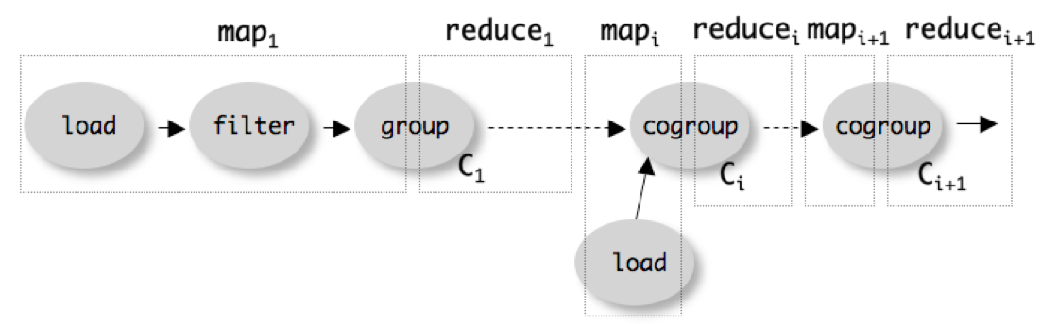
Compiling Pig on Hadoop

Slide 26
PageRank on Pig
Input format:
www.A.com 1 {(www.B.com),(www.C.com),(www.D.com),(www.E.com)}
www.B.com 1 {(www.D.com),(www.E.com)}
www.C.com 1 {(www.D.com)}
www.D.com 1 {(www.B.com)}
www.E.com 1 {(www.A.com)}
www.F.com 1 {(www.B.com),(www.C.com)}
We use python scripts with Pig embedded. Useful for implementing iterative Pig scripts.

Slide 27
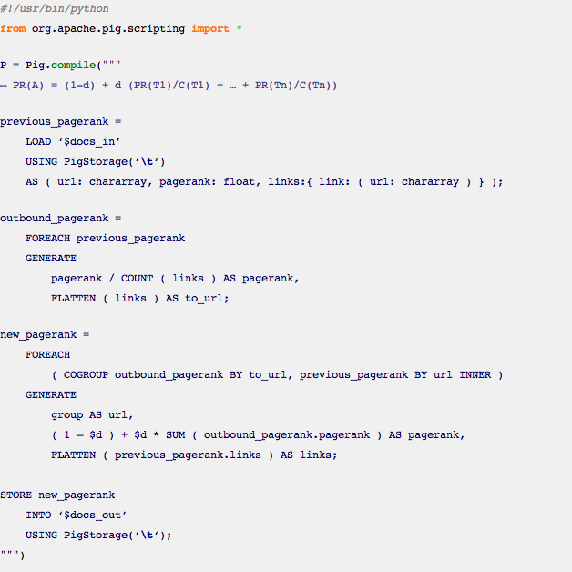
PageRank.py

Slide 28
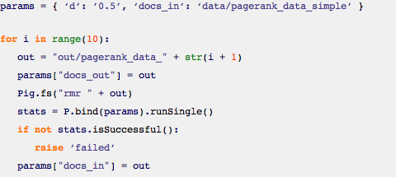
PageRank.py

Slide 29
LinkedIn’s DataFu
DataFu is a collection of user-defined functions for working with large-scale data in Hadoop and Pig. This library was born out of the need for a stable, well-tested library of UDFs for data mining and statistics. It is used at LinkedIn in many of our off-line workflows for data derived products like "People You May Know" and "Skills & Endorsements". It contains functions for:
  PageRank
  Quantiles (median), variance, etc.
  Sessionization
  Convenience bag functions (e.g., set operations, enumerating bags, etc)
  Convenience utility functions (e.g., assertions, easier writing of EvalFuncs)
https://github.com/linkedin/datafu

Slide 30
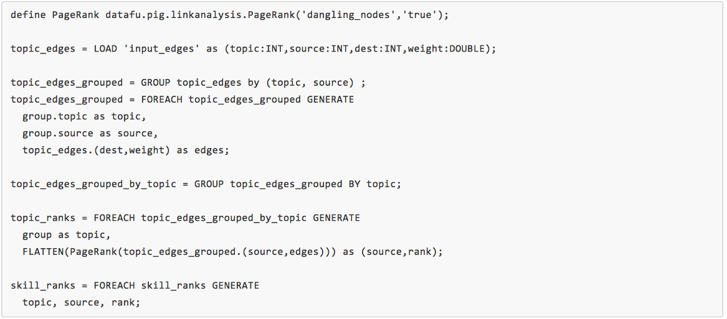
PageRank in DataFu

Slide 31
Is Map-Reduce Enough?
Map-Reduce is a functional-like easy-to-understand paradigm.
Complex programs are not easily portable in Map-Reduce.
Other programming models exists.

Slide 32
Is Map-Reduce Enough?
Many practical computing problems concern large graphs
Map-Reduce is ill-suited for graph processing
  Many iterations are needed for parallel graph processing
  Materializations of intermediate results at every Map-Reduce iteration
  harm performance
Large graph data
Graph algorithms
  Web graph
  Transportation routes
  Citation relationships
  Social networks
  PageRank
  Shortest path
  Connected components
  Clustering techniques

Slide 33

Bulk Synchronous Parallel (BSP) Model
Developed by during 80s by Leslie G. Valiant
(2010 Turing Award winner)
Published in 1990:
  Leslie G. Valiant, A bridging model for parallel computation, Communications of the ACM, Volume 33 Issue 8, Aug. 1990
Is a very simple, yet powerful, bridging model.
  A bridging model "is intended neither as a hardware nor a programming model but something in between”.
  It serves a purpose similar to the Parallel Random Access Machine (PRAM) model.
  BSP differs from PRAM by not taking communication and synchronization for granted.

Slide 34
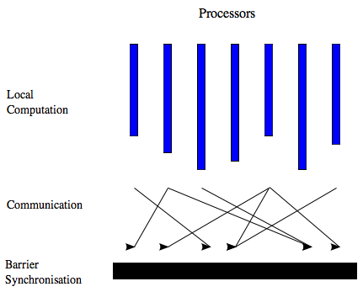
The BSP Computer
A BSP computer consists of processors
connected by a communication network.
Each processor has a fast local memory, and
may follow different threads of computation.
A BSP computation proceeds in a series of
global supersteps.
A superstep consists of three components:
  Local (concurrent) computation: Several compu-
  tations take place on every participating processor
  Each process only uses values stored in the local
  memory of the processor. The computations are
  independent in the sense that they occur
  asynchronously of all the others.
  Communication: The processes exchange data
  between themselves. This exchange takes the form of one-sided put and get calls, rather than two-sided send and receive calls.
  Barrier synchronization: When a process reaches this point (the barrier), it waits until all other processes have finished their communication actions.
The computation and communication actions do not have to be ordered in time. The barrier synchronization concludes the superstep: it has the function of ensuring that all one-sided communications are properly concluded. This global synchronization is not needed in models based on two-sided communication, since these synchronize processes implicitly.

Slide 35
Cost of Communications
The BSP model considers communication actions en masse.
  All messages have fixed size
  Communications happen at the beginning and at the end of a superstep
The maximum number of incoming or outgoing messages for a superstep is denoted by h.
The ability of a communication network to deliver data is captured by a parameter g, defined such that it takes time hg for a processor to deliver h messages of size 1.
  A message of length m obviously takes longer to send than a message of size 1. However, the BSP model does not make a distinction between a message length of m or m messages of length 1. In either case the cost is said to be mgh.

Slide 36

The Cost of a BSP Algorithm
The cost of a superstep is determined as the sum of three terms:
  the cost of the longest running local computation w
  the cost of global communication between the processors hg
  the cost of the barrier synchronization at the end of the superstep l
Hence, the total cost of a BSP program is given by

Slide 37
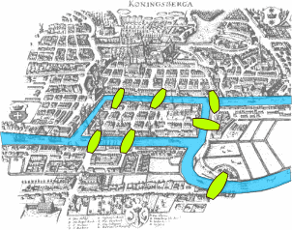
Why BSP?
Google’s Pregel is based on the BSP model:
  G. Malewicz, M. H. Austern, A. J.C Bik, J. C. Dehnert, I. Horn, N. Leiser, and G. Czajkowski. 2010. Pregel: a system for large-scale graph processing. In Proceedings of the 2010 ACM SIGMOD International Conference on Management of data (SIGMOD '10).
Pregel is suitable for computations on graph.
  In Pregel vertexes of a graph are abstracted as processors.
  Vertex-centric approach.
Pregel computations consist of a sequence of iterations, called supersteps.

Slide 38
What’s in a Pregel’s Superstep?
During a superstep the framework invokes a user-defined function for each vertex, conceptually in parallel.
  The function specifies behavior at a single vertex V and a single superstep S.
  It can read messages sent to V in superstep S − 1, send messages to other vertices that will be received at superstep S + 1, and modify the state of V and its outgoing edges.
  Messages are typically sent along outgoing edges, but a message may be sent to any vertex whose identifier is known.

Slide 39
Why Vertex-centric for Massive Graphs?
One node per processor
Only two processors

Slide 40
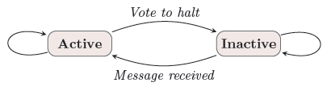
Recap: Model of Computation
Superstep: the vertices compute in parallel
  Each vertex
    Receives messages sent in the previous superstep
    Executes the same user-defined function
    Modifies its value or that of its outgoing edges
    Sends messages to other vertices (to be received in the next superstep)
    Mutates the topology of the graph
    Votes to halt if it has no further work to do
  Termination condition
    All vertices are simultaneously inactive
    There are no messages in transit

Slide 41
Example: SSSP – Parallel BFS in Pregel
∞
∞
1
10
0
2
3
9
4
6
5
7
∞
∞
2

Slide 42
Example: SSSP – Parallel BFS in Pregel
∞
∞
∞
1
10
10
∞
∞
∞
0
∞
2
3
9
4
6
5
∞
7
∞
5
∞
∞
2
∞

Slide 43
Example: SSSP – Parallel BFS in Pregel
10
∞
1
10
0
2
3
9
4
6
5
7
5
∞
2

Slide 44
Example: SSSP – Parallel BFS in Pregel
10
11
∞
1
14
10
8
0
2
3
9
4
6
5
12
7
5
∞
2
7

Slide 45
Example: SSSP – Parallel BFS in Pregel
8
11
1
10
0
2
3
9
4
6
5
7
5
7
2

Slide 46
Example: SSSP – Parallel BFS in Pregel
8
9
11
1
10
13
0
14
2
3
9
4
6
5
7
15
5
7
2

Slide 47
Example: SSSP – Parallel BFS in Pregel
8
9
1
10
0
2
3
9
4
6
5
7
5
7
2

Slide 48
Example: SSSP – Parallel BFS in Pregel
8
9
1
10
0
2
3
9
4
6
5
7
13
5
7
2

Slide 49
Example: SSSP – Parallel BFS in Pregel
8
9
1
10
0
2
3
9
4
6
5
7
5
7
2

Slide 50
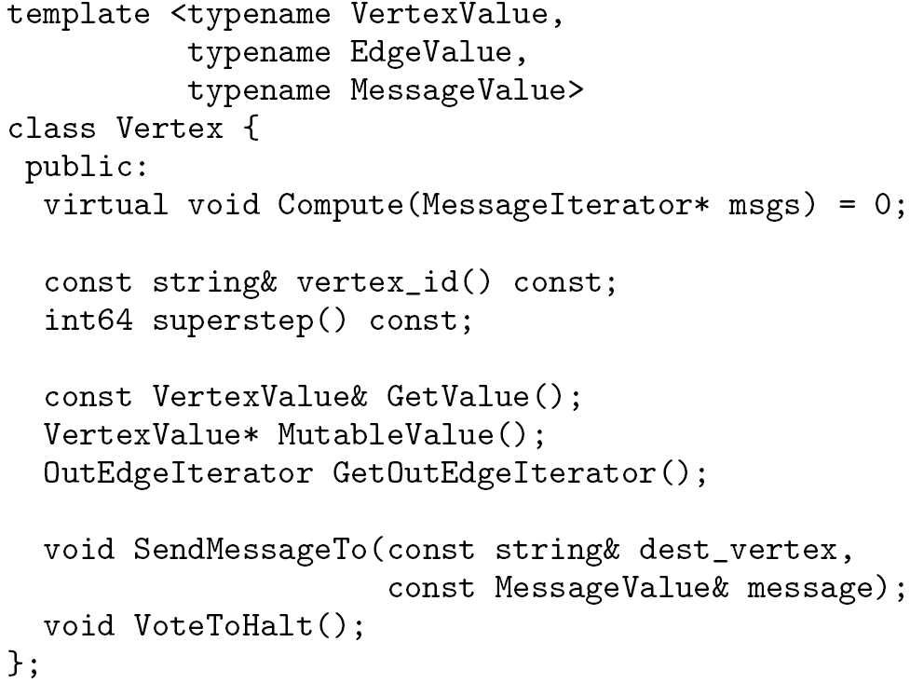
Writing a Pregel Program: C++ API
  Subclassing the predefined Vertex class
Override this!
in msgs
out msg

Slide 51
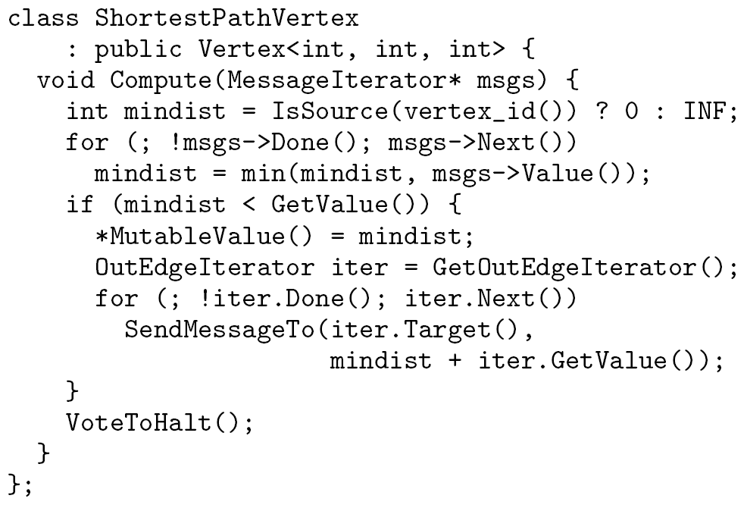
Example: Vertex Class for SSSP

Slide 52
System Architecture
Pregel system also uses the master/worker model
  Master
    Maintains worker
    Recovers faults of workers
    Provides Web-UI monitoring tool of job progress
  Worker
    Processes its task
    Communicates with the other workers
Persistent data is stored as files on a distributed storage system (such as GFS or BigTable)
Temporary data is stored on local disk

Slide 53
Execution of a Pregel Program
Many copies of the program begin executing on a cluster of machines
The master assigns a partition of the input to each worker
  Each worker loads the vertices and marks them as active
The master instructs each worker to perform a superstep
  Each worker loops through its active vertices & computes for each vertex
  Messages are sent asynchronously, but are delivered before the end of the superstep
  This step is repeated as long as any vertices are active, or any messages are in transit
After the computation halts, the master may instruct each worker to save its portion of the graph

Slide 54
Fault Tolerance
Checkpointing
  The master periodically instructs the workers to save the state of their partitions to persistent storage
    e.g., Vertex values, edge values, incoming messages
Failure detection
  Using regular “ping” messages
Recovery
  The master reassigns graph partitions to the currently available workers
  The workers all reload their partition state from most recent available checkpoint

Slide 55

Apache Giraph
Warning!
  Giraph is currently in Apache incubator
  Modifications are continuous:
    Some of them might cause a complete program rewrite…
      … it happened to me! :)

Slide 56
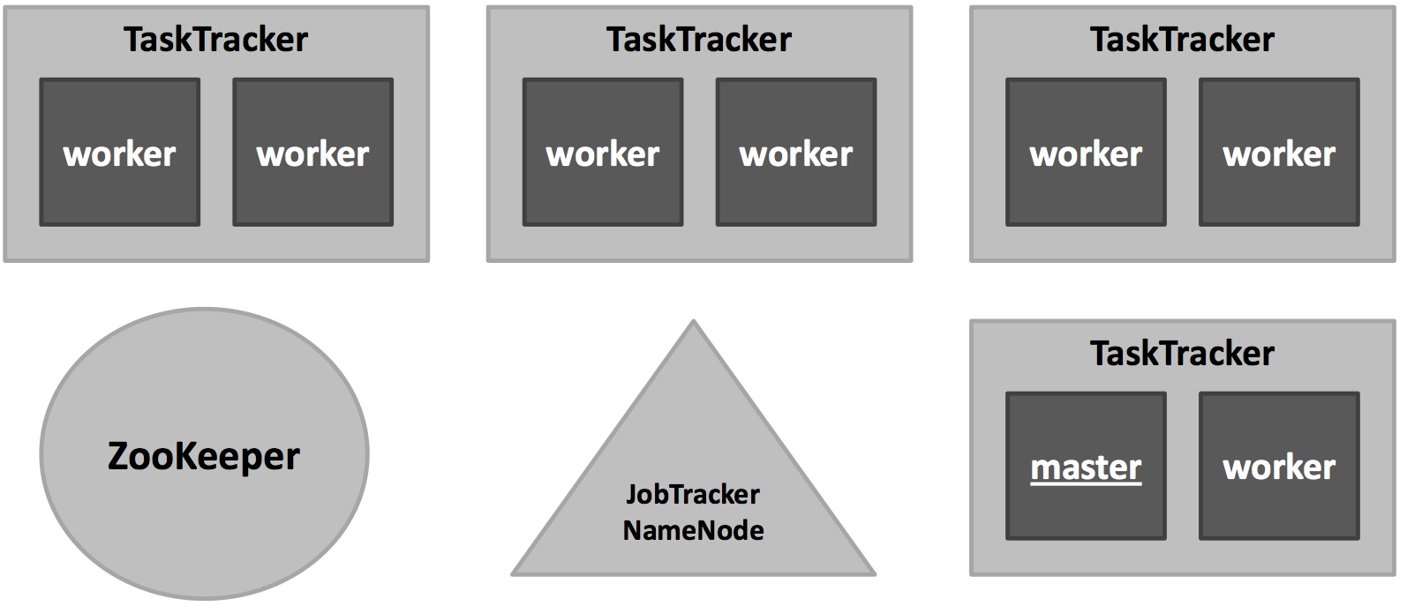
Giraph Framework

Slide 57
Task Assignment
ZooKeeper: responsible for computation state
  partition/worker mapping
  global state: #superstep
  checkpoint paths, aggregator values, statistics
Master: responsible for coordination
  assigns partitions to workers
  coordinates synchronization
  requests checkpoints
  aggregates aggregator values
  collects health statuses
Worker: responsible for vertices
  invokes active vertices compute() function
  sends, receives and assigns messages
  computes local aggregation values

Slide 58
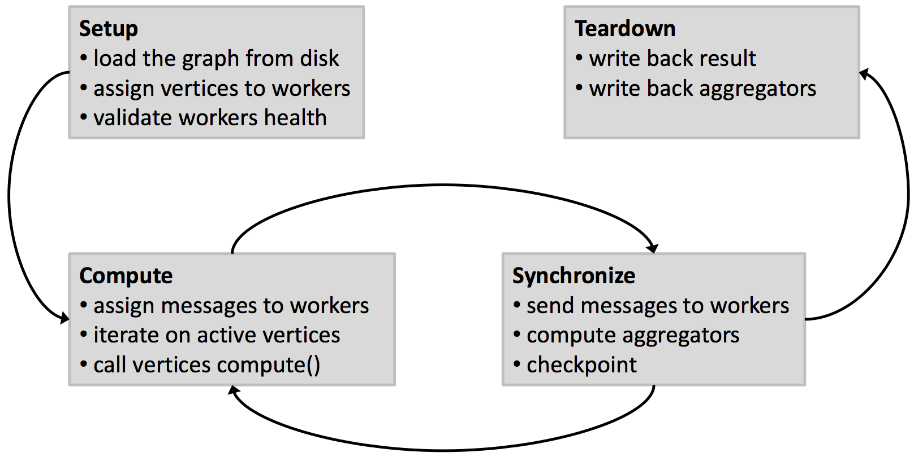
Anatomy of an Execution

Slide 59
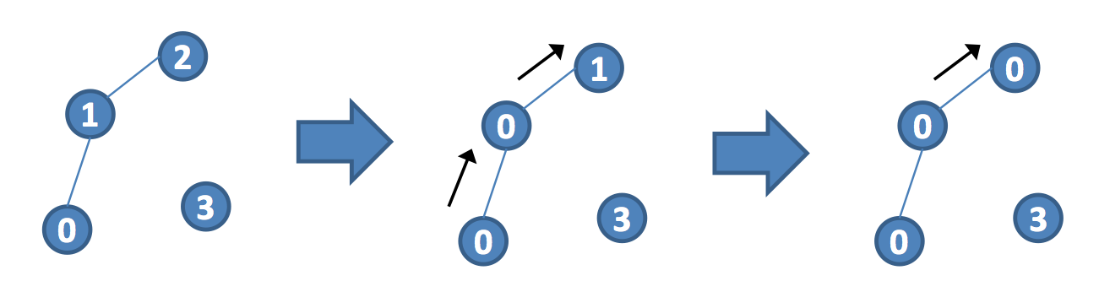
Giraph Ex: Connected Components of an Undirected Graph
algorithm: propagate smallest vertex label to neighbors until convergence
in the end, all vertices of a component will have the same label

Slide 60
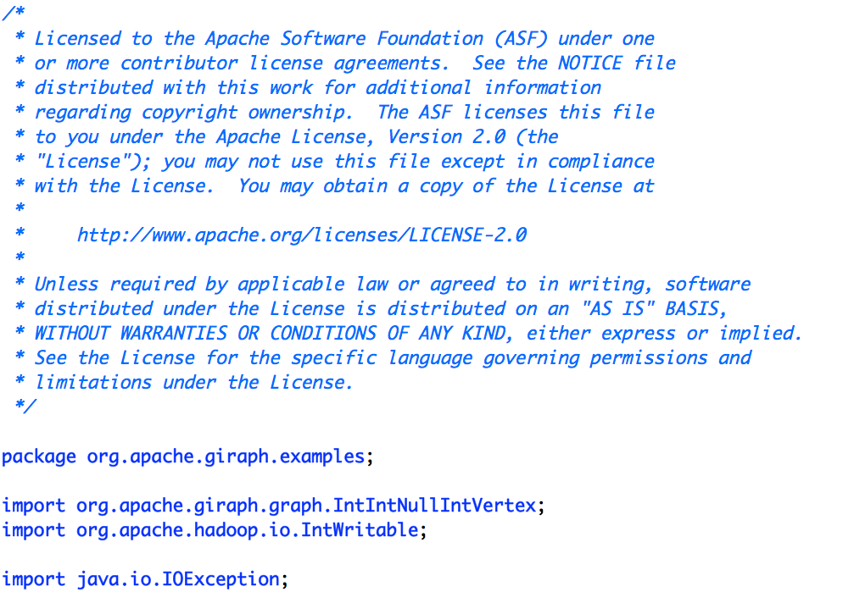
Create a Custom Vertex

Slide 61
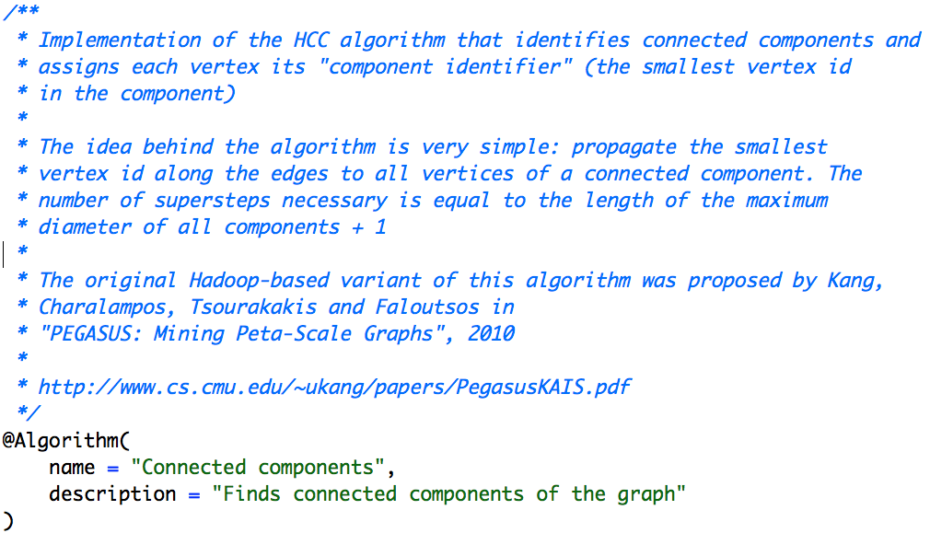
Create a Custom Vertex

Slide 62
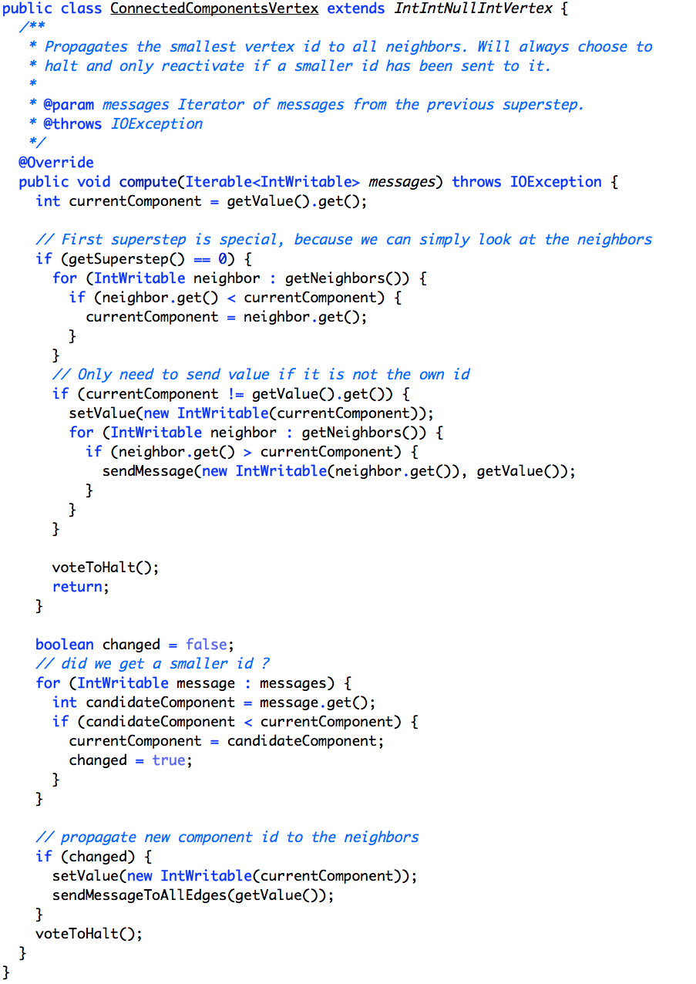
Create a Custom Vertex

Slide 63
Additional Stuff
To read a custom data format we need to create a custom input format class extending an input format class available in Giraph, e.g.,
  public class ConnectedComponentsInputFormat extends TextVertexInputFormat<IntWritable, IntWritable, NullWritable, IntWritable>
To output using a custom data format we need to create a custom outpu format class extending an output format class available in Giraph, e.g.,
  public class VertexWithComponentTextOutputFormat extends TextVertexOutputFormat<IntWritable, IntWritable, NullWritable>

Slide 64
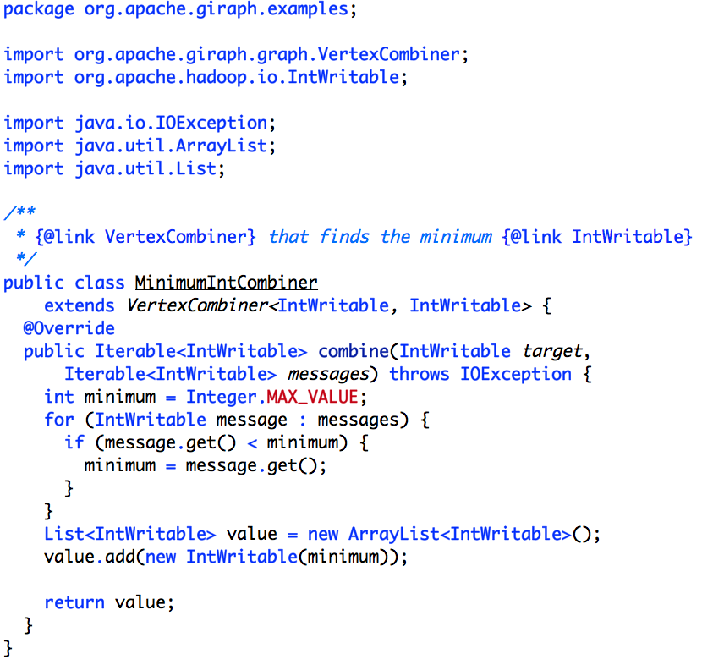
Combiners

Slide 65
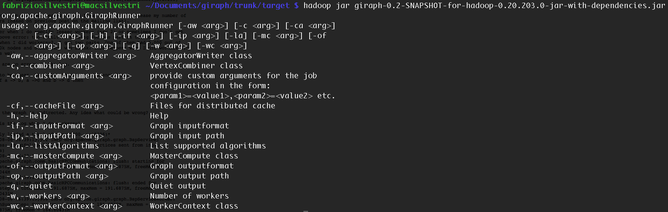
How To Run a Giraph Job

Slide 66
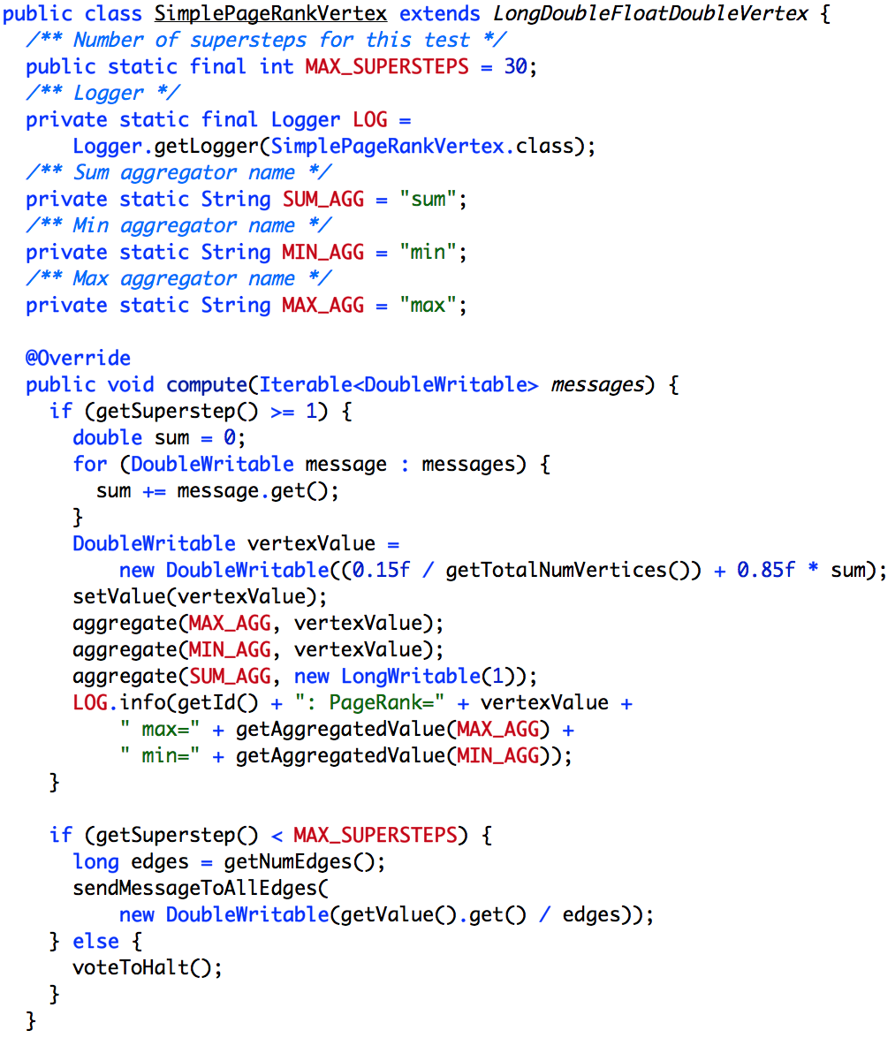
A PageRank Vertex

Slide 67
HomeWork
Modify SimplePageRankVertex class to include:
  Dangling nodes processing
  More sophisticated stop criterion
    Stop the iterations when getSuperstep() > MAX_SUPERSTEP or when the L₁ norm of
    p^{(i+1)} – p^{(i)} < d.

Slide 68
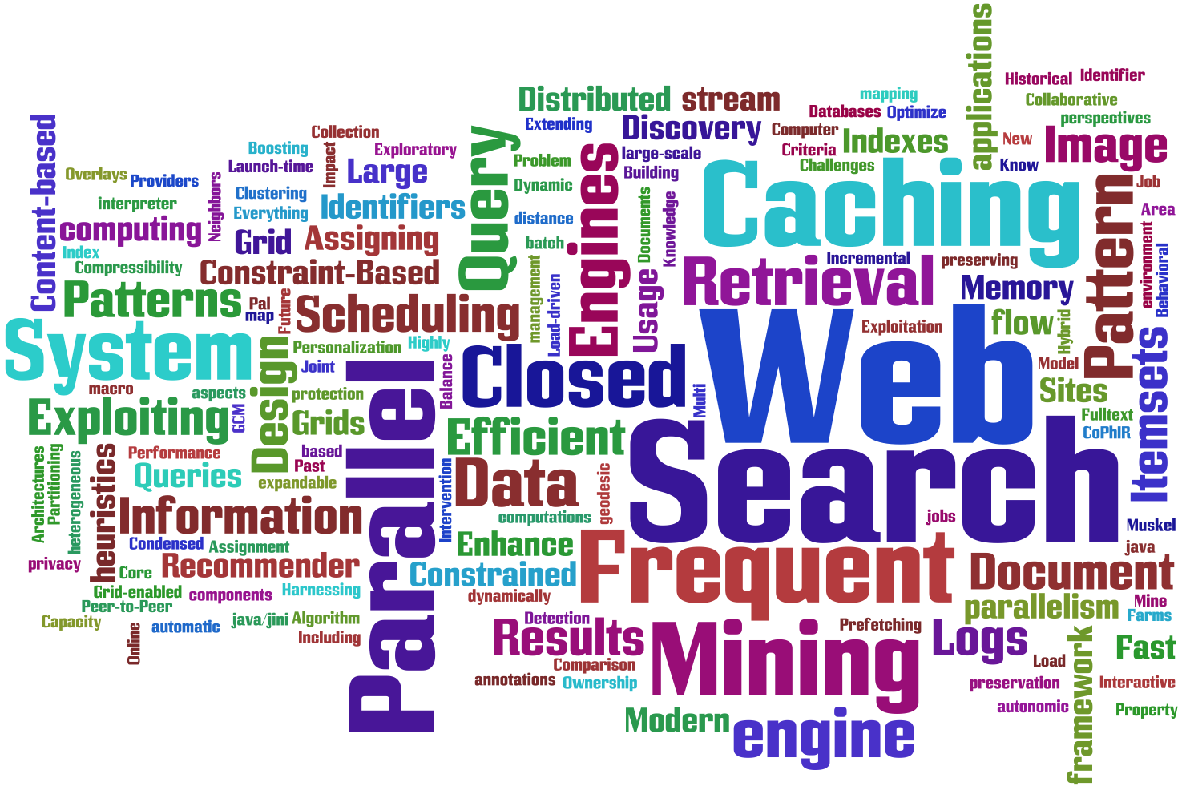
Thanks for Attending!
Fabrizio Silvestri
fabrizio.silvestri@isti.cnr.it
Thesis available at our group:
  HPCLab@ISTI
  http://hpc.isti.cnr.it

