Slide 1
Text Indexing
The Suffix Array

Slide 2
Basic notation and facts
Pattern P occurs at position i of T
iff P is a prefix of the i-th suffix of T (ie. T[i,N])
i
P
T
T[i,N]
Occurrences of P in T = All suffixes of T having P as a prefix
T = mississippi
mississippi
P = si
4,7
Reduction
SUF(T) = Sorted set of suffixes of T
From substring search
To prefix search

Slide 3
The Suffix Array
Prop 1. All suffixes in SUF(T) having prefix P are contiguous.
Prop 2. Starting position is the lexicographic one of P.
Θ(N²) space
5
T = mississippi#
T = mississippi#
SA
SUF(T)
12
11
8
5
2
1
10
9
7
4
6
3
#
i#
ippi#
issippi#
ississippi#
mississippi#
pi#
ppi#
sippi#
sissippi#
ssippi#
ssissippi#
suffix pointer
P=si
Suffix Array
SA: Θ(N log₂ N) bits
Text T: N chars
⇨ In practice, a total of 5N bytes

Slide 4
Searching a pattern
Indirected binary search on SA: O(p) time per suffix cmp
T = mississippi#
SA
12
11
8
5
2
1
10
9
7
4
6
3
P is larger
2 accesses per step
P = si

Slide 5
Searching a pattern
Indirected binary search on SA: O(p) time per suffix cmp
T = mississippi#
SA
12
11
8
5
2
1
10
9
7
4
6
3
P is smaller
Suffix Array search
O(log₂ N) binary-search steps
Each step takes O(p) char cmp
⇨ overall, O(p log₂ N) time
P = si

Slide 6
Listing of the occurrences
T = mississippi#
4 7
SA
Suffix Array search
O (p * log₂ N + occ) time
can be reduced…
12
11
8
5
2
1
10
9
7
4
6
3
12
11
8
5
2
1
10
9
7
4
6
3
12
11
8
5
2
1
10
9
7
4
6
3
where # < Σ < $
si#
occ=2
sippi
sissippi
si$

Slide 7
Text mining
T = mississippi#
4 6 7 9
Lcp
SA
0
0
1
4
0
0
1
0
2
1
3
12
11
8
5
2
1
10
9
7
4
6
3
issippi
ississippi
How long is the common prefix between T[i,...] and T[j,...] ?
Min of the subarray Lcp[h,k] s.t. SA[h]=i and SA[k]=j.
Does it exist a repeated substring of length ≥ L ?
Search for Lcp[i] ≥ L
Does it exist a substring of length ≥ L occurring ≥ C times ?
Search for Lcp[i,i+C-2] whose entries are ≥ L

Slide 8
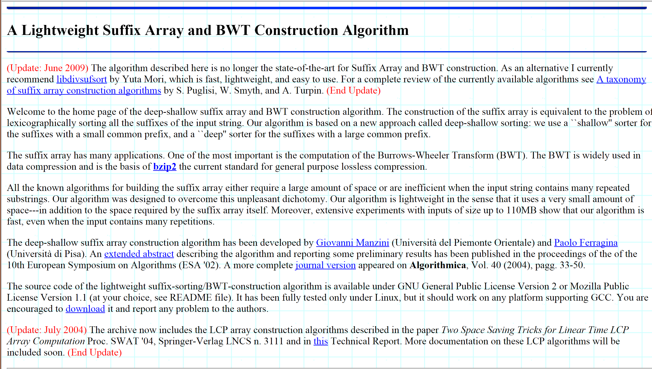
Giovanni Manzini’s page

Slide 9
Data Compression
Can we use simpler
Repetition detectors?

Slide 10
Simple compressors: too simple?
Move-to-Front (MTF):
As a freq-sorting approximator
As a caching strategy
As a compressor
Run-Length-Encoding (RLE):
FAX compression

Slide 11
Move to Front Coding
Transforms a char sequence into an integer sequence, that can then be var-length coded
Start with the list of symbols L=[a,b,c,d,…]
For each input symbol s
output the position of s in L
move s to the front of L
L=[a,b,c,l] and S = cabala → mtf(S) = 3 2 3 2 4 2
Properties:
It is a dynamic code, with memory (unlike Arithmetic)

Slide 12
Run Length Encoding (RLE)
If spatial locality is very high, then
abbbaacccca => (a,1),(b,3),(a,2),(c,4),(a,1)
In case of binary strings → just numbers and one bit
Properties:
It is a dynamic code, with memory (unlike Arithmetic)

Slide 13
Data Compression
Burrows-Wheeler Transform

Slide 14
The Burrows-Wheeler Transform (1994)
Let us given a text T = mississippi#
F
L
mississippi#
# mississipp i
ississippi#m
i #mississip p
ssissippi#mi
i ppi#missis s
sissippi#mis
i ssippi#mis s
issippi#miss
Sort the rows
i ssissippi# m
ssippi#missi
m ississippi #
T
sippi#missis
ippi#mississ
ppi#mississi
pi#mississip
i#mississipp
#mississippi
p i#mississi p
p pi#mississ i
s ippi#missi s
s issippi#mi s
s sippi#miss i
s sissippi#m i

Slide 15
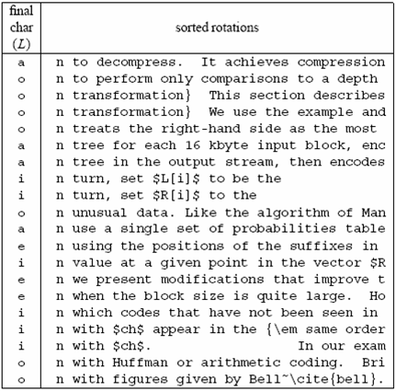
A famous example
Much
longer...

Slide 16
Compressing L seems promising...
Key observation:
L is locally homogeneous
L is highly compressible
Algorithm Bzip :
Move-to-Front coding of L
Run-Length coding
Statistical coder
Bzip vs. Gzip: 20% vs. 33%, but it is slower in (de)compression !

Slide 17
How to compute the BWT ?
SA
BWT matrix
L
We said that: L[i] precedes F[i] in T
12
11
8
5
2
1
10
9
7
4
6
3
#mississipp
i#mississip
ippi#missis
issippi#mis
ississippi#
mississippi
pi#mississi
ppi#mississ
sippi#missi
sissippi#mi
ssippi#miss
ssissippi#m
#mississipp
i#mississip
ippi#missis
issippi#mis
ississippi#
mississippi
pi#mississi
ppi#mississ
sippi#missi
sissippi#mi
ssippi#miss
ssissippi#m
i
p
s
s
m
#
p
i
s
s
i
i
L[3] = T[ 8 - 1 ]
Given SA and T, we have L[i] = T[SA[i]-1]
This is one of the main reasons for
the number of pubblications spurred
in ‘94-’10 on Suffix Array construction

Slide 18
A useful tool: L → F mapping
F
unknown
L
# mississipp i
i #mississip p
i ppi#missis s
i ssippi#mis s
i ssissippi# m
m ississippi #
Can we map L’s chars onto F’s chars ?
p i#mississi p
p pi#mississ i
s ippi#missi s
s issippi#mi s
s sippi#miss i
s sissippi#m i
... Need to distinguish equal chars...
Take two equal L’s chars
Rotate rightward their rows
Same relative order !!
Rank_{char}(pos) and Select_{char}(pos) are key operations nowadays

Slide 19
The BWT is invertible
F
unknown
L
# mississipp i
Two key properties:
i #mississip p
1. LF-array maps L’s to F’s chars
i ppi#missis s
2. L[ i ] precedes F[ i ] in T
i ssippi#mis s
i ssissippi# m
Reconstruct T backward:
m ississippi #
p
p
i
T = .... #
i
p i#mississi p
p pi#mississ i
s ippi#missi s
s issippi#mi s
s sippi#miss i
s sissippi#m i
Several issues about efficiency in time and space

Slide 20
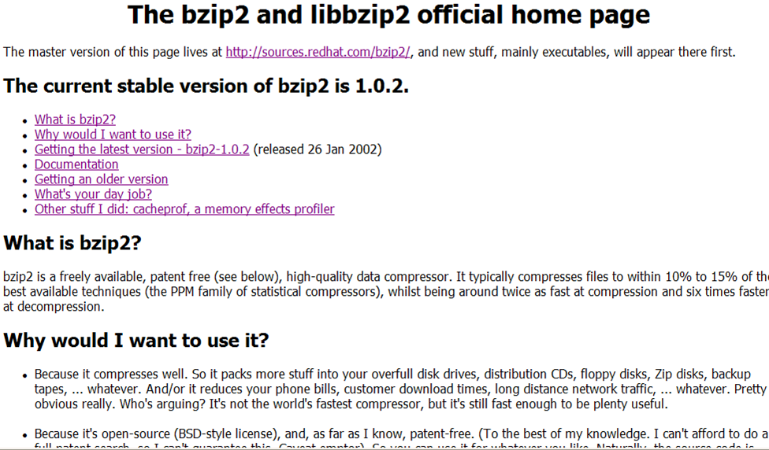
You find this in your Linux distribution

Slide 21
Decompress any substring
Search is possible,
not in these lectures...
F
unknown
L
Recall that LF-mapping means:
# mississipp i
k-th occurrence of σ in L
corresponds to
k-th occurrence of σ in F
i #mississip p
i ppi#missis s
i ssippi#mis s
i ssissippi# m
T = mississippi#
m ississippi #
m
i
s
1 4 8 12
p i#mississi p
p pi#mississ i
s ippi#missi s
s issippi#mi s
s sippi#miss i
s sissippi#m i
sampling step is 4
Trade-off between space (n log n/S bits) and decompression time of an L-long substring (S+ L time) due to the sampling step S
You can reconstruct any substring
backward IF you know the row of
its last character
How do we know where to start ? Keep sampled positions
Generalised Rank-Select over the column L

