Slide 1
Soccer Data
The dataset contains data of soccer games
Each game is a JSON file of soccer logs
Soccer logs describe each ball-related event that occurs on the field (e.g, passes, shots, tackles, …)
You will have an aggregation of such data (i.e. players positions, total number of events, depending on the task)
Link: http://data.d4science.org/ctlg/ResourceCatalogue/soccer_events (password for the zip file: AlvaroRecoba19)
Contacts: paolo.cintia@gmail.com, luca.pappalardo1984@gmail.com

Slide 2
Soccer data

Slide 3
Soccer data
pass
simple pass
accurate

Slide 4
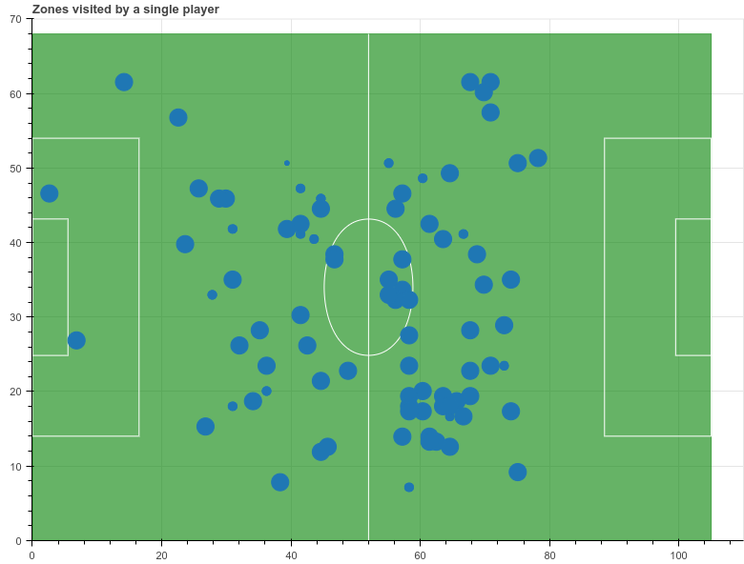
1) Distribution of events
given a player, verify whether the spatial distribution of his events is Gaussian
Locations visited by a single player on a single game, reported on a 1x1 grid. Dot size is according to visits number.

Slide 5
2) Distribution of events over time
given a player, verify whether the spatial distribution of his events, aggregated by shorter time slice w.r.t an entire game, is Gaussian.
Is there a minimal time threshold where the spatial distributions are the same as considering the whole game?

Slide 6
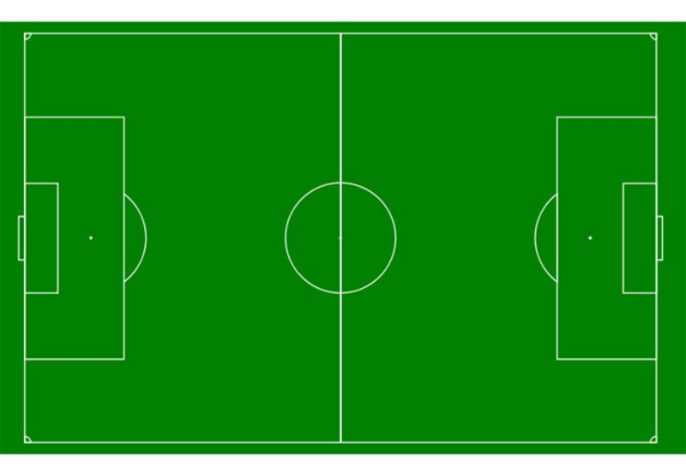
3) Fill trajectories
Infer the movements from “close” events and
How this enrichment affects results of points 1-2?
Insigne
Insigne
Hamsik
Red line represents locations visited by a player but not retrievable from the dataset.
See https://arxiv.org/abs/1603.05583 (Analyzing In-Game Movements of Soccer Players at Scale)

Slide 7
4) Performance velocity
Compute the velocity and accelleration of a sequence of forward events and which players participate and in which moment (start, middle, end)
Derive a feature about the propensity of a soccer player to participate into a fast forward sequence of events.
Insigne
Albiol
Hamsik

Slide 8
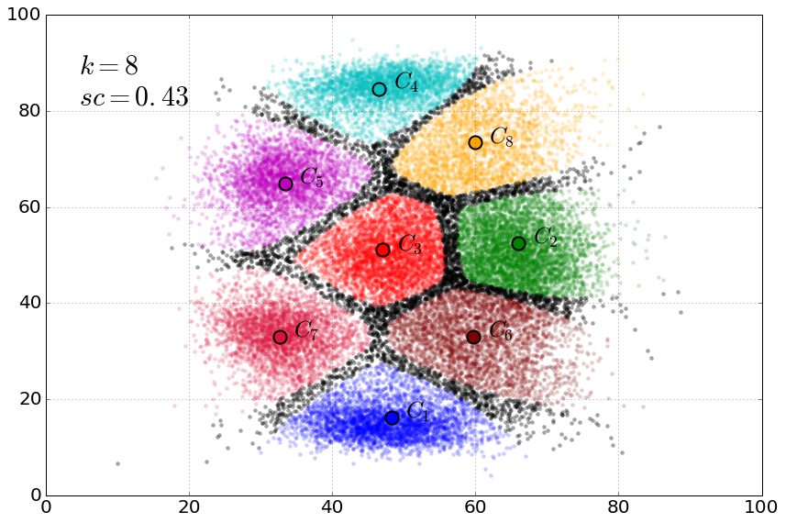
5) Versatility of players
Starting from our role detection algorithm (PClustering) investigate the tendency of players to change role during the season or during the single game

Slide 9
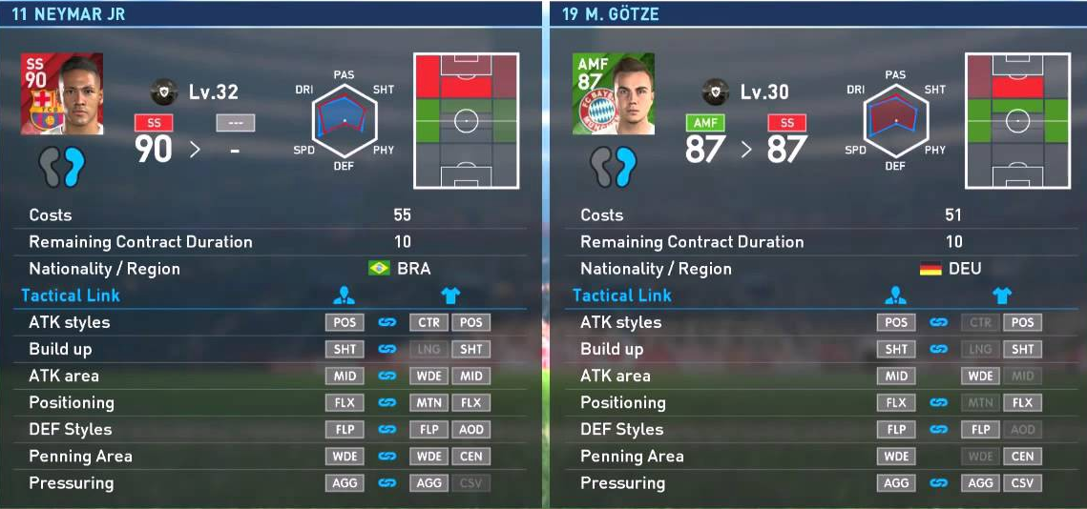
6) Querying of players
Given a set of requirements (either technical or spatial) specified by a user, find players that better satisfy such requirements

