Slide 1
A new era: Topic-based Annotators

Slide 2
Classical approach
“Diego Maradona won against Mexico”
Dictionary of terms
against
Diego
Maradona
Mexico
won
Term Vector
Vector Space model
2.2
5.1
9.1
1.0
0.1
t₃
v
α
w
t₂
t₁
Similarity(v,w) ≈ cos(α)
Mainly term-based:
polysemy and synonymy issues

Slide 3
Another issue: synonymy
He is using Microsoft’s browser
He is a fan of Internet Explorer

Slide 4
A typical issue: polysemy
the paparazzi photographed the star
the astronomer photographed the star

Slide 5
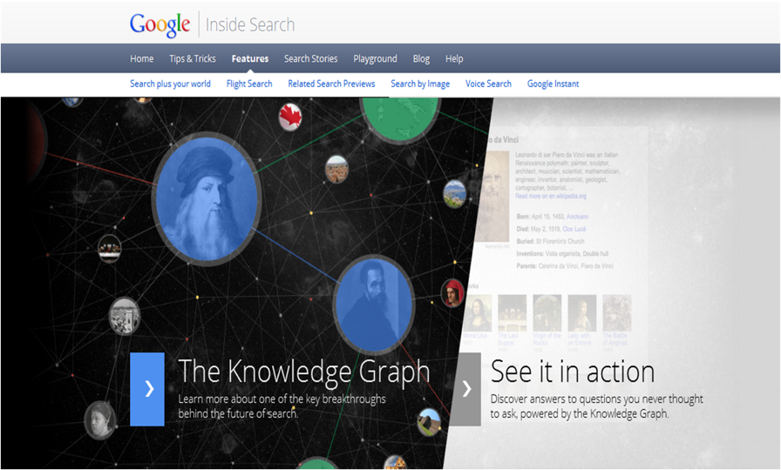
A new approach:
Massive graphs of entities and relations
May 2012
5

Slide 6
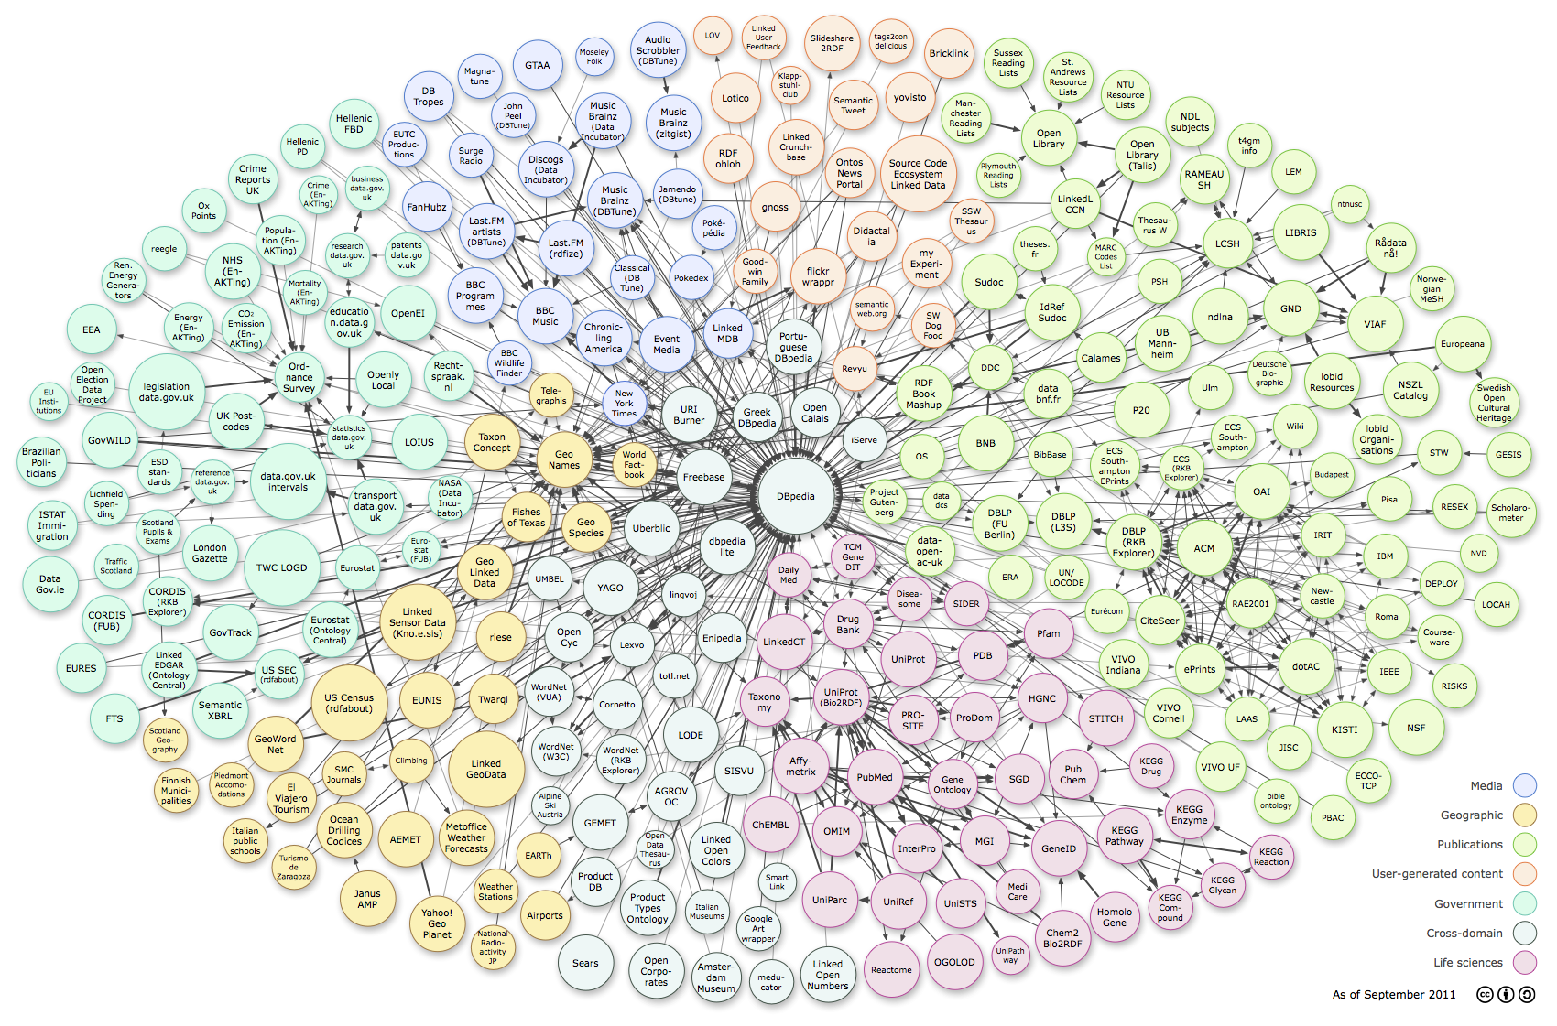
Web of Data: RDF, Tables, Microdata
Cyc
6
http://richard.cyganiak.de/2007/10/lod/lod-datasets_2011-09-19_colored.png
Thanks to G. Weikum, SIGMOD 2013

Slide 7
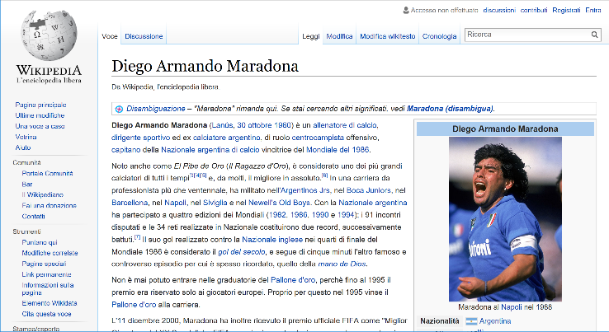
The Wikipedia Graph

Slide 8
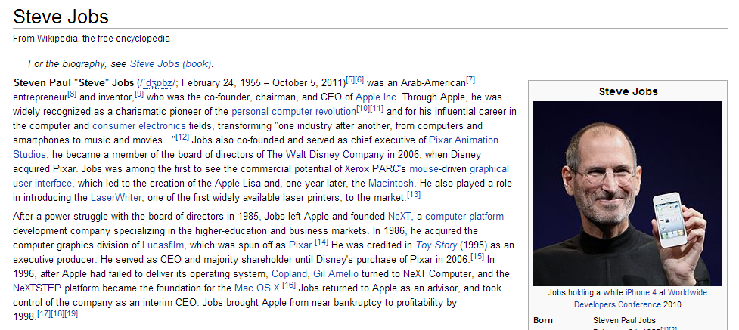
Wikipedia is a rich source of instances

Slide 9
Wikipedia's categories contain classes
Categories form a taxonomic DAG (not really…)

Slide 10
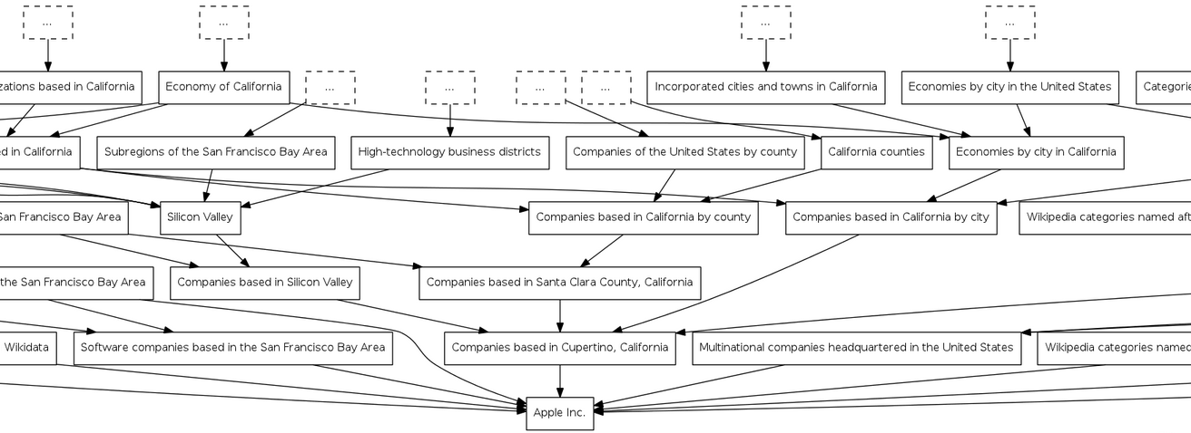
DAG of categories: http://toolserver.org/~dapete/catgraph/
10

Slide 11
A new approach: Topic-based annotation
“Diego Maradona won against Mexico”
Mexico’s football team
Ex-Argentina’s player
anchors
Find mentions and annotate them
with topics drawn from a catalog
articles
Wikipedia!

Slide 12
Polysemy
Celebrity is a person who is famou-sly recognized …
the paparazzi photographed the star
the astronomer photographed the star
Star is a massive, luminous ball of plasma …

Slide 13
Synonymy
Internet Explorer (IE o MSIE), oggi noto anche con il nome Windows Internet Explorer (WIE), è un browser web grafico proprietario sviluppato da Microsoft …
He is using Microsoft’s browser
She plays with Internet Explorer

Slide 14
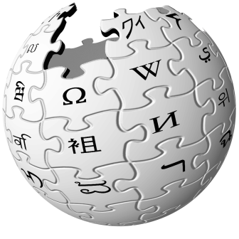
From words to concepts !
“Obama asks Iran for RQ-170 sentinel drone back”
Barack Obama
Iran
Lockheed Martin RQ-170 Sentinel
President of the United States
Mahmoud Ahmadinejad
Query = USA president Ahmadinejad

Slide 15
Why is it a difficult problem?
“Diego Maradona won against Mexico”
Ex-Argentina’s coach
His nephew
Maradona Stadium
Maradona Movie
…
Mexico nation
Mexico state
Mexico football team
Mexico baseball team
…
Don’t annotate!

Slide 16
Features used to link a → p
Commonness of a page p wrt an anchor a
Context of a around the mention
T = …w₁ w₂ w₃ a w₄ w₅ w₆ …
and the content of a page/entity
Page p = z₁ z₂ z₃ z₄ z₅ z₆ …
Link probability of an anchor a
Graph-based features
a is a mention-node
p is an entity-node
Links a ◻ p and paths between pages

Slide 17
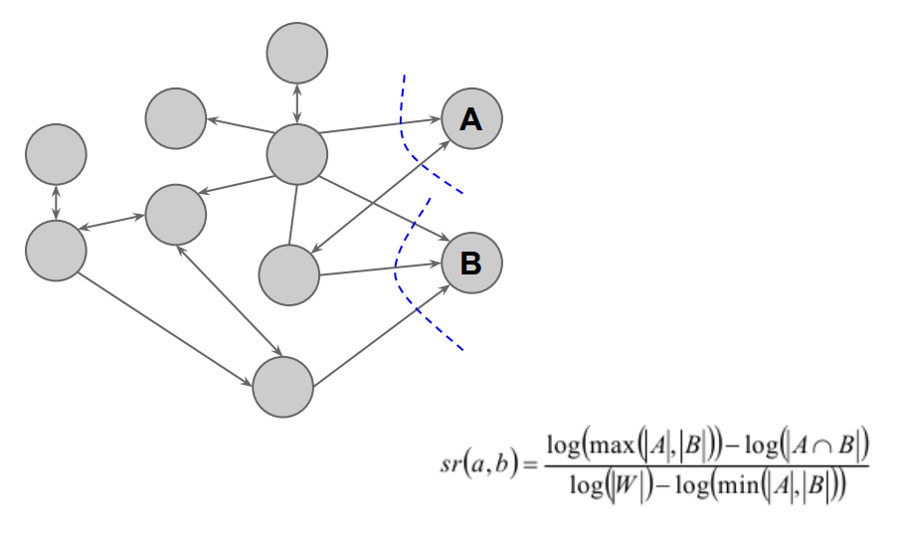
Relatedness between pages

Slide 18
How TAGME works
“Diego Maradona won against Mexico”
Diego A. Maradona
Diego Maradona jr.
Maradona Stadium
Maradona Film
…
…
Mexico nation
Mexico state
Mexico football team
Mexico baseball team
…
…
No Annotation
DISAMBIGUATION
by a voting scheme
PRUNING
2 simple features
PARSING

Slide 19
Disambiguation: The voting scheme
Collective agreement among topics via voting
“Diego Maradona won against Mexico”
b
a
p_{b}
Diego A. Maradona
Diego Maradona jr.
Maradona Stadium
Maradona Film
…
Wiki-articles | Votes
Mexico | 0.09
State of Mexico | 0
Mexico National Football Team | 0.29
Mexico National Baseball Team | 0
p_{a}

Slide 20
Disambiguation: all steps
τ = trade-off speed vs. recall
Commonness of a page p wrt an anchor a
Pruning by commonness < τ
Voting scheme
Select top-ε pages
Select the best in commonness
t = 2%
ε = 30%

Slide 21
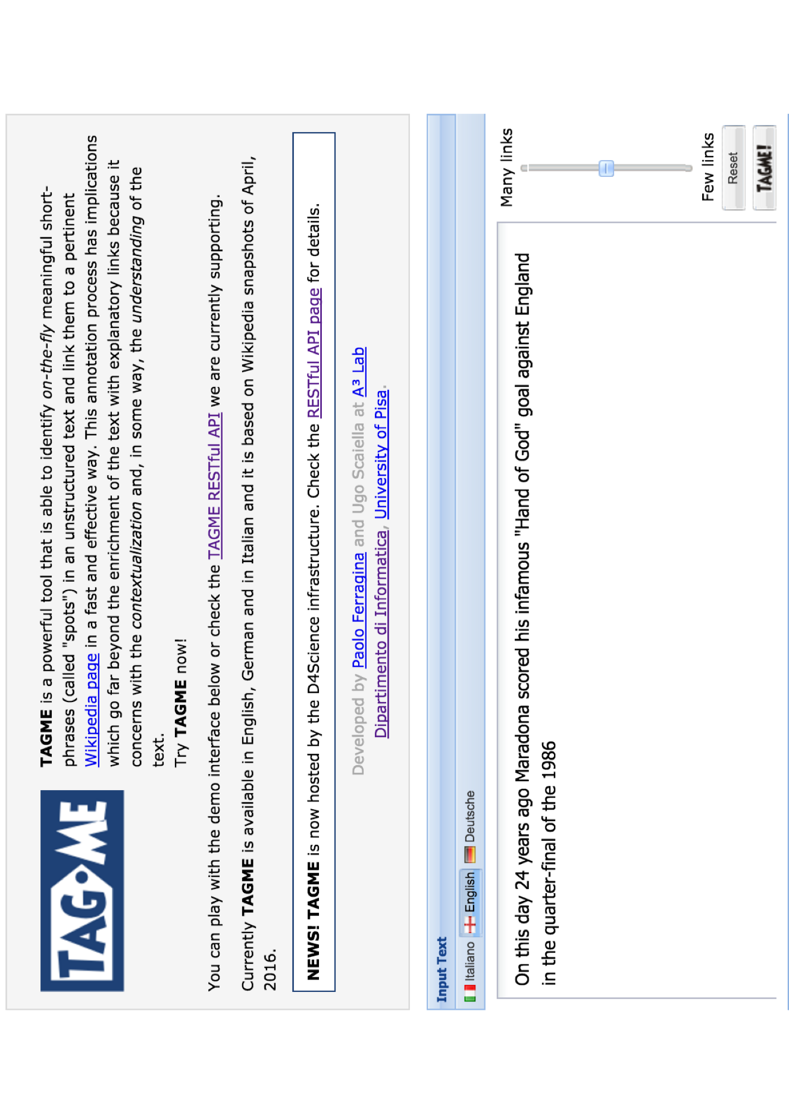

Slide 22
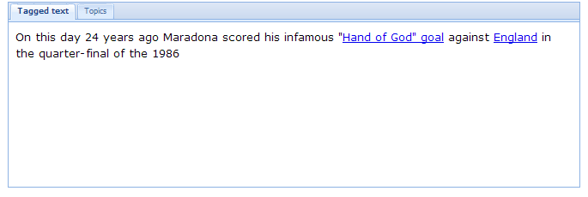
Less links
More links

Slide 23
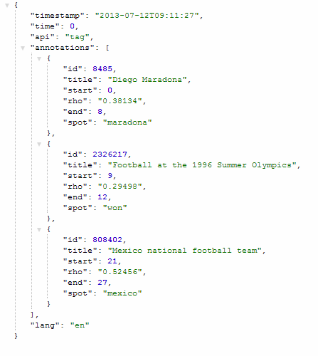
Useful for relating topics
NLP ?

Slide 24
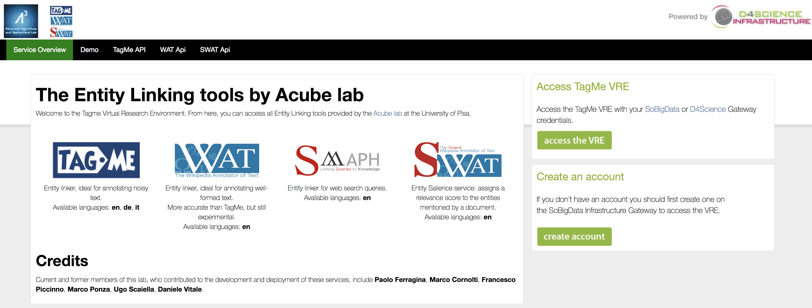
https://services.d4science.org/web/tagme

Slide 26
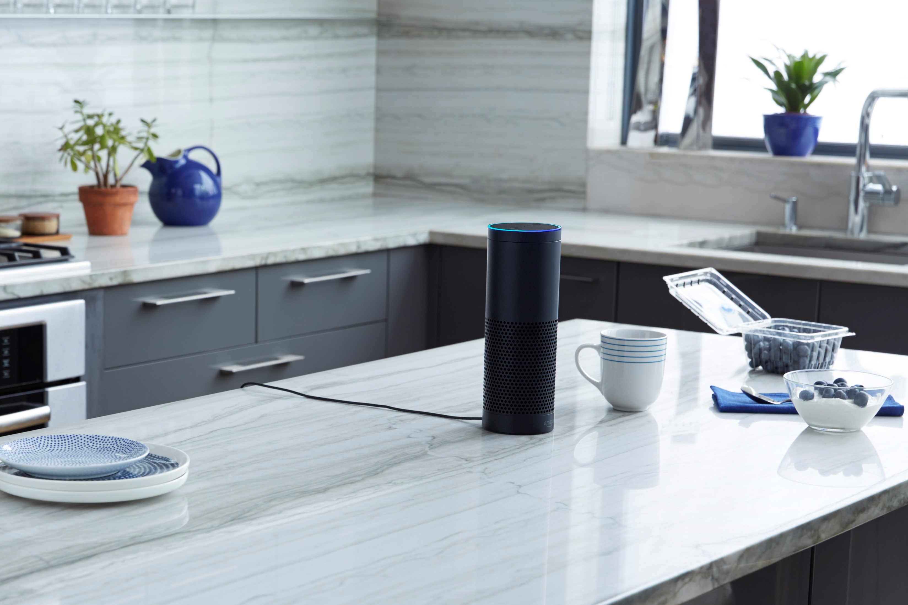
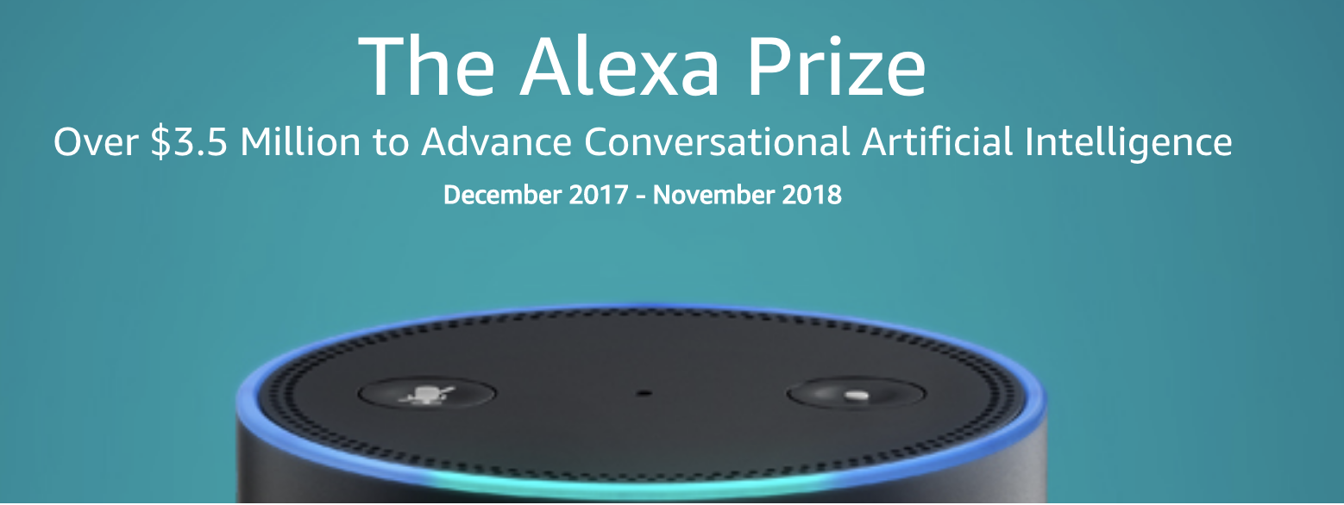
RubyStar

