Slide 1
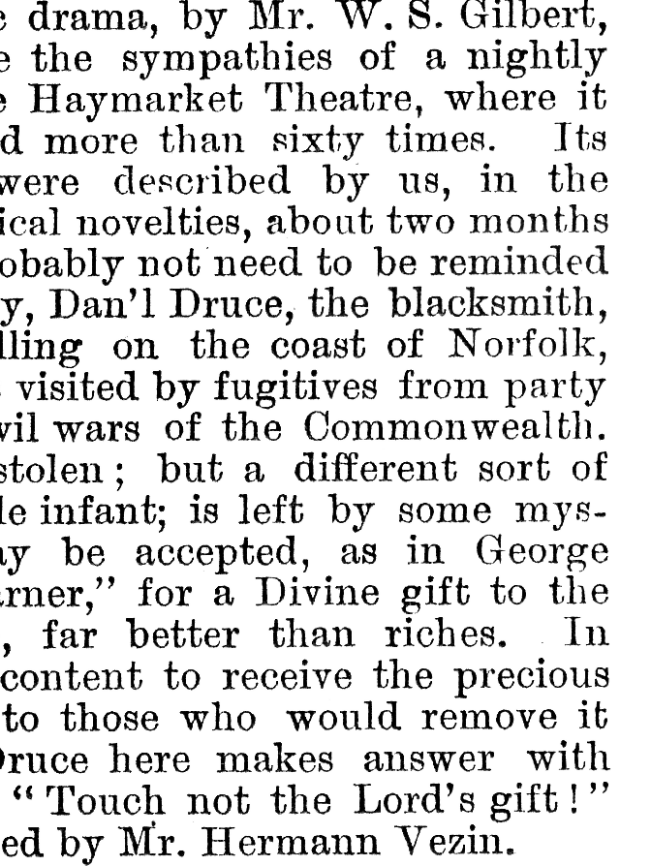
Information Retrieval LAB
2023/2024
Indexing TEXTS with ElasticSearch
lorenzo.bellomo@sns.it

Slide 2
Elastic Search
A customizable, open source, search engine
It allows to:
Index documents in a collection
Search in such collection
Much more
REST-ful API allows for easy interoperability
Based on Lucene

Slide 3
Indexing
Doc1
Renzi, Zaia, Rossi, Government
Doc2
Salvini, Zaia, Lega, Bossi
Doc3
Samantha, Cristoforetti, esa, Space
DocN
…

Slide 4
Search Process
User Query
Internal Representation: token List
Search Algorithm
Sorted Resulting Documents
ESA and Renzi
ESA,Renzi
Search Algorithm
Doc3
Doc1
Doc2

Slide 5
Analyzers
The internal representation of the document depends on the analyzer we choose to use for parsing the documents.
Some examples include:
whitespace: separates on spaces
simple: separates on non-letters + lowercase
standard: separates on some rules (non-letters) + lowercase (default choice)
english: like standard + stopwords removal + normalization (stemming)
italian: like english but in Italian
keyword: treats input like it’s a single token (does not perform tokenization)

Slide 6
Analyzers – example
Perché | Trump, | il | presidente | U.S.A., | ha | parlato | alla | NATO?
whitespace
perché | trump | il | presidente | u | s | a | ha | parlato | alla | nato
Perché Trump, il presidente U.S.A., ha parlato alla NATO?
simple
standard
perché | trump, | il | presidente | u.s.a. | ha | parlato | alla | nato
italian
trump | president | u.s.a. | parlat | nato

Slide 7
Create file config.json
Put this file in the root folder of the repository
{
"host": "kddrtserver15.isti.cnr.it",
"port": 7777,
"username": "ir2023",
"psw": "ferragina",
"surname": "<YOUR SURNAME HERE>",
"d4science_KEY": "6ab7daea-c174-4254-a9d2-d85f6117bf20-843339462"
}

Slide 8
Python Library
Create the file: create_index.py:
from elasticsearch import Elasticsearch
INDEX_HOST = 'kddrtserver15.isti.cnr.it'
INDEX_PORT = 7777
INDEX_URL = 'http://{}:{}/'.format(INDEX_HOST, INDEX_PORT)
# TODO: insert the provided credentials here!
INDEX_USER = ‘INSERT USERNAME HERE'
INDEX_PASS = ‘INSERT PSW HERE'
# TODO: write your surname here
# (each student will have their own index)
INDEX_NAME = ‘INSERT SURNAME HERE'
Install the python library with
python –m pip install elasticsearch<7.14.0
The credentials to insert will be provided during lectures and in the code

Slide 9
Creating an index
[...]
def index_create():
es = Elasticsearch(INDEX_URL, http_auth=(INDEX_USER, INDEX_PASS))
if es.indices.exists(index=INDEX_NAME):
es.indices.delete(index=INDEX_NAME)
es.indices.create(index=INDEX_NAME)
return es

Slide 10
Creating an index
[...]
es = index_create()
for i in range(0, 3):
line = input('Write some text: ‘)
document = {'line_content': line.strip()}
es.index(index=INDEX_NAME, body=document)

Slide 11
Test your index
Input documents are retrieved via command line
To check the content, on the Web Browser search
http://kddrtserver15.isti.cnr.it:7777/<index>/_search?pretty
change <index> with your surname
Insert the input credentials

Slide 12
Search in the index
Create the file search_index.py:
import json
from elasticsearch import Elasticsearch
es = Elasticsearch(INDEX_URL, http_auth=(INDEX_USER, INDEX_PASS))
input_query = input('Insert a query: ').strip()
query_body = {'query': {'match': {'line_content': input_query}}}
res = es.search(index=INDEX_NAME, body=query_body)
for hit in res['hits']['hits']:
print('score: {} - line: {}'.format(hit['_score'], hit['_source']['line_content']))

Slide 13
Test on some documents
INSERT IN THE INDEX
TRY SEARCHING
Trump u.s.a. NATO
trump usa N.A.T.O.
the cat sleeps
She is sleeping
I am sleeping
I live in the u.s.a.
TRUMP

Slide 14
Change the analyzer
modify create_index.py:
[...]
es = index_create()
mapping = {"properties":
{ "line_content":
{
"type": "text",
"analyzer": "english"
} } }
es.indices.put_mapping(index=INDEX_NAME, body=mapping)
[...]

Slide 15
Exploiting Fields
Effectively, they are the properties of the documents
We can specifically search on fields
Each field can have its own specific analyzer
News article:
Title
Maintext
Author
Topic
Date
Product
Name
Description
Brand
ID
english
english
whitespace
keyword
keyword

Slide 16
Add fields to your code
modify create_index.py:
[...]
es = index_create()
mapping = {
"properties":{
"maintext": {
"type": "text",
"analyzer": "english"
},
"source": {
"type": "text",
"analyzer": "whitespace"
} } }
es.indices.put_mapping(index=INDEX_NAME, body=mapping)
Assign analyzers to the specific fields here in the properties

Slide 17
Search on fields
import json
from elasticsearch import Elasticsearch
es = Elasticsearch(INDEX_URL, http_auth=(INDEX_USER, INDEX_PASS))
author = input("Insert a news source: ").strip()
terms = input("Insert text terms: ").strip()
query_body = {
"query": {
"bool": {
"should": [
{"match": {"article_body": terms}},
{"match": {"source" : source}}
]
} } }
res = es.search(index=INDEX_NAME, body=query_body)
print ("Found {} results.".format(res['hits']['total']['value']))
for hit in res['hits']['hits']:
print ("score: {} source: {}".format(hit["_score"], hit["_source"]["source"]))
print ("body: {}".format(hit["_source"]["maintext"])[:100])
Can also have soft constraints

Slide 18
Work with dates
When creating the index
When searching
mapping = {
"properties":{
[...]
"pub-date": {
"type": "date"
} } }
query_body = {
"query": {
"bool": {
"should": [
{"match": {"maintext": terms}},
{"match": {"source": source}},
],
"minimum_should_match": 1,
"must": [
{"range":
{"pub-date": {"gte":"2019-01-01"}}
},
]
} } }

Slide 19
How to boost the importance of a field
query_body = {
"query": {
"bool": {
"should": [
{"match":
{"maintext": {"query": terms}}
},
{"match":
{"source": {
"query": terms,
"boost": 3,
}}},],}}}
Boosts the importance when scoring by 3 times

Slide 20
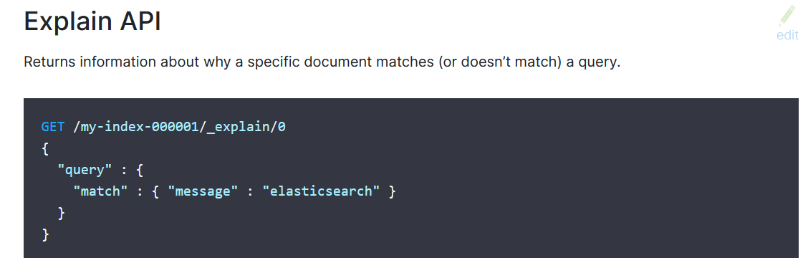
Why does my score seem weird?
Ask Elastic Search directly!

Slide 21
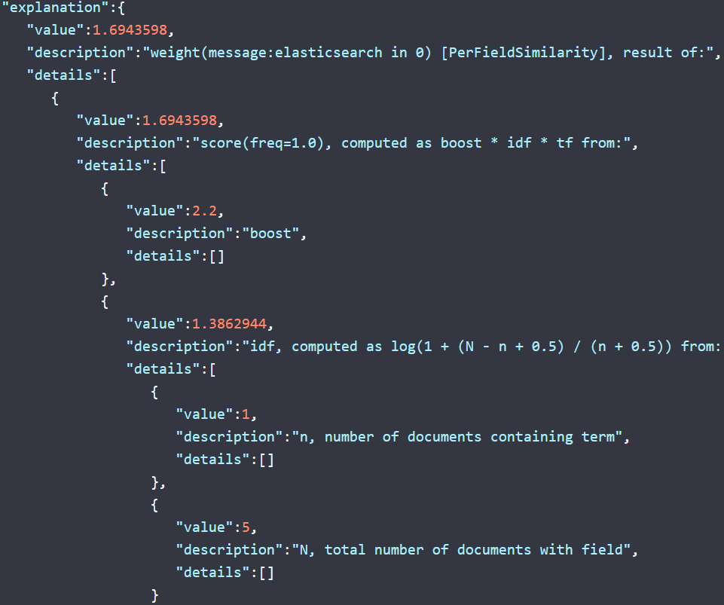

Slide 22

How scoring works
$$\text{score}\left(q, d\right)=$$
$\text{queryNorm}\left(q\right)$
$∗\text{coord}\text{(}q, d)$
$∗(\text{TF}\text{(}t, d)+{\text{IDF}\text{(}t)}^{2}+t.\text{getBoost}()\text{ + }\text{NORM}(t,d))$

Slide 23
Base Scoring - Fields
Term frequency (tf): square root of the number of times the term appears in the field of a document
Inverse document frequency (idf): 1 plus the natural log of the documents in the index divided by the number of documents that contain the term
Coordination (coord): number of terms from the query that appear in the document
Field length normalization (norm) inverse square root of the number of terms in the field
Query normalization (queryNorm): sum of squared weights for the terms in the query
Index boost: percentage or absolute number used to boost any field at index time.
Query boost: same but used to boost any query clause at query time.

Slide 24
Exercise:
Tell me the number of articles that were written by "Caterina de Luca" OR published by "Rai News", written in the time ranging from the 5th of December 2019 to the 25th of January 2020 (both included), and it contains the word "world“.

Slide 25
Some references
ElasticSearch Python library
  https://elasticsearch-py.readthedocs.io/en/master/api.html
Query formatting:
  https://www.elastic.co/guide/en/elasticsearch/reference/current/query-dsl.html
Analyzer:
  https://www.elastic.co/guide/en/elasticsearch/reference/current/analysis-analyzers.html
Two options to install ElasticSearch:
Direct Installation
  https://www.elastic.co/guide/en/elasticsearch/reference/current/install-elasticsearch.html
Docker installation + ElasticSearch Docker image
  https://docs.docker.com/get-docker/
  https://www.elastic.co/guide/en/elasticsearch/reference/7.11/docker.html

