Slide 1
Random Walks
Paolo Ferragina
Dipartimento di Informatica
Università di Pisa

Slide 2


Definitions
Adjacency matrix A
Transition matrix P
2
2
1
1/2
1
1
1
Any edge
weigthing
is possible
3
1/2
3

Slide 3
About sink nodes
We assume the graph has no sink nodes
Otherwise, connect each sink node to all other nodes
2
2
1
1
3
3
0 | 1 | 1
0 | 0 | 1
0 | 0 | 0
0 | 1 | 1
0 | 0 | 1
1 | 1 | 1
0 | ½ | ½
0 | 0 | 1
⅓ | ⅓ | ⅓
A =
A =
P =

Slide 4

What is a random walk
t=0
1
1/2
1
1/2

Slide 5
What is a random walk
t=0
t=1
1
1
1/2
1/2
1
1
1/2
1/2

Slide 6

What is a random walk
t=0
t=1
1
1/2
1
1
1/2
1
1/2
1/2
t=2
1
1/2
1
1/2

Slide 7


What is a random walk
t=0
t=1
1
1
1/2
1/2
1
1
1/2
1/2
t=2
t=3
1
1/2
1
1
1/2
1
1/2
1/2

Slide 8
Probability Distributions
x_{t}(i) = probability that surfer is at node i at time t
x_{t+1}(i) = ∑_{j}(Probability of being at node j)*Pr(j->i) = ∑_{j} x_{t}(j)*P(j,i) = x_{t} * P
t=2
2
1
0 0 1
1/2
=
½ ½ 0
1
1
x_{t}
x_{t+1}
1/2
3
Transition matrix P

Slide 9
Probability Distributions
Recall that:
x_{t}(i) = probability that surfer is at node i at time t
x_{t+1}(i) = ∑_{j}(Probability of being at node j)*Pr(j->i) = ∑_{j} x_{t}(j)*P(j,i) = x_{t} * P
We can write:
x_{t+1} = x_{t} * P = (x_{t-1}* P) * P = (x_{t-2}* P) * P * P=…= x₀ P^{t+1}
What happens when the surfer keeps walking for a long time? Called Stationary distribution

Slide 10
Stationary Distribution
The stationary distribution at a node is related to the amount of time a random walker spends visiting that node.
It is when the distribution does not change:
x_{T+1} = x_{T} → x_{T} P = 1 * x_{T} (left eigenvector, with eigenvalue 1)

Slide 11
Interesting questions
Does a stationary distribution always exist? Is it unique?
  Yes, if the graph is “well-behaved”, namely the Markov chain is irreducible and aperiodic.
  For “well-behaved” graphs, the stationary distribution does not depend on the start distribution x₀ (next slide def. “well behaved”)
How fast will the random surfer approach this stationary distribution?
  Mixing Time!

Slide 12
Well behaved graphs
Irreducible: There is a path from every node to every other node (→ it is an SCC).
Irreducible
Not irreducible

Slide 13
Well behaved graphs
Aperiodic: The GCD of all cycle lengths is 1. The GCD is also called period.
Periodicity is 3
Aperiodic

Slide 14
Ranking
Link-based Ranking
(2° generation)

Slide 15
The Web as a Directed Graph
Sec. 21.1
Page A
Page B
hyperlink
Anchor
Assumption 1: A hyperlink between pages denotes author perceived relevance (quality signal)
Assumption 2: The text in the anchor of the hyperlink describes the target page (textual context)

Slide 16
Query-independent ordering
First generation: using link counts as simple measures of popularity.
  Undirected popularity:
    Each page gets a score given by the number of in-links plus the number of out-links (es. 3+2=5).
  Directed popularity:
    Score of a page = number of its in-links (es. 3).
Easy to SPAM

Slide 17
Second generation: PageRank
Each link has its own importance!!
PageRank is
  independent of the query
  many interpretations…
Notes:
Tries to capture the notion of “Importance of a page”.
Uses Backlinks for ranking.
Avoids trivial spamming: Distributes pages’ “voting power” among the pages they are linking to.
“Important” page linking to a page will raise it’s rank more the “Not Important” one.

Slide 18
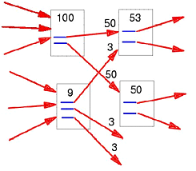
The (classic) PageRank
If we make these values flow,
Do they stabilize?
Various interpretations: linear system of equations with billion variables and billion constraints
Random walks

Slide 19
PageRank, as a Random Walk on the Web Graph
Jump uniformly at random at any page (node) in the Web
1−α
1/4
Jump uniformly
at random on
one nighborhood
1/4
α
1/4
1/4
PageRank of a node is the «frequency of visit» that node by assuming an infinite random walk
A «measure of centrality» of a node in a (directed) graph

Slide 20
PageRank, as a Linear System of Equations
= 0.85
N = # nodes in graph
a
i
r(i) = α (r(a) / 3 +
r(b) / 1 +
r(c) / 2 )
+ (1- α) / N
b
c
It is «related» to the eigenvalues of the matrix describing the linear system of equations

Slide 21
As matrix interpretation…
Random jump
Principal
eigenvector
r = r * [ α P + (1- α) * 1/N * e e^{T} ]
P[j,i] = 1/#out(j)
#out(j) : number of outgoing links from j
B(i) : set of pages linking to i
e : vector whose components are 1
e * e^{T}: matrix whose elements are all 1/N

Slide 22
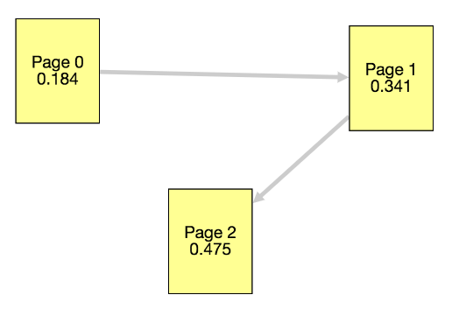
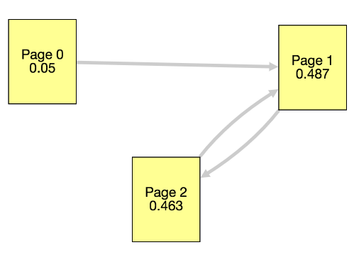
Hands-on test
https://bit.ly/36RBKcU
http://computerscience.chemeketa.edu/cs160Reader/_static/pageRankApp/index.html

Slide 23
Pagerank: use in Search Engines
Preprocessing:
  Given graph, build P
  Compute r = [1/N, …, 1/N] * P^{t} for t=0, 1, …
  r[i] is the pagerank of page i
We are interested in the relative order
Query processing:
  Retrieve pages containing query terms
  Rank them by their Pagerank
The final order is query-independent

Slide 24
Personalized Pagerank
Bias the random jump substituting the uniform jump to all nodes with the jump to one specific node (second term is (1-α) only for that node, the others are 0)
… or uniform jump to some set S of preferred nodes (second term is (1-α)/|S| only for that set of nodes, the others are 0)
Possibly not a uniform jump (change 1/#out(j) with the proper weight of the edge (j,i))

Slide 25
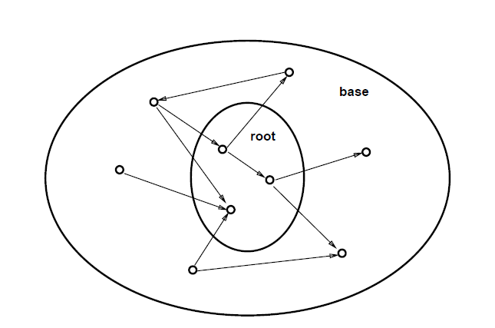
HITS: Hypertext Induced Topic Search

Slide 26
Calculating HITS
It is query-dependent
Produces two scores per page:
  Authority score: a good authority page for a topic is pointed to by many good hubs for that topic.
  Hub score: A good hub page for a topic points to many authoritative pages for that topic.

Slide 27
Authority and Hub scores
2
5
3
1
1
6
4
7
a(1) = h(2) + h(3) + h(4)
h(1) = a(5) + a(6) + a(7)

Slide 28
HITS: Link Analysis Computation
Where
a: Vector of Authority’s scores
h: Vector of Hub’s scores.
A: Adjacency matrix in which a_{i,j} = 1 if i→j
Symmetric
matrices
Thus, h is an eigenvector of AA^{t}
a is an eigenvector of A^{t}A

Slide 29
Weighting links
Weight more if the query occurs in the neighborhood of the link (e.g. anchor text).

Slide 30

Nowadays
Relevance is a not well defined mathematical concept, which is actually not even depending on the single user because its needs may change over time too
For every page we compute a series of features:
TF-IDF of tokens
PageRank
Their proximity in the page
Their occurrence in URL
Their occurrence in the title
…
there are > 200 «features»…

Slide 31
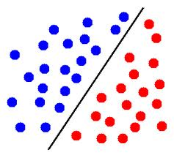
Computing the Ranking
Strong use of AI e Machine Learning
feature 2
≅ frequency
Not relevant
page
Relevant
page
feature 1
≅ Position in doc
Notes:
Chi decide la funzione da ottimizzare e quindi le posizioni delle curve

Slide 32


Summarization via Random Walks
Paolo Ferragina

Slide 33
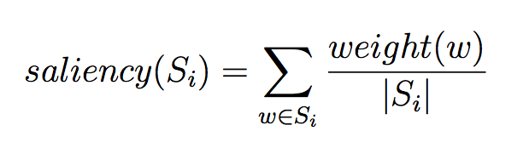
The key simple idea
Rank (and select) sentences by saliency score of their constituting words w , computed as:
  TF-IDF for weight(w)
  Centrality over proper graphs: PageRank, HITS, or other measures

Slide 34
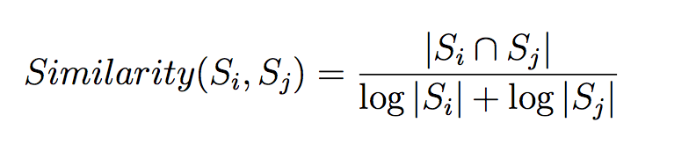
TextRank
The key issue is how the GRAPH is built
  Nodes = terms or sentences
  Edges = similarity relation between nodes
  Use PageRank over weighted graph (directed by S’s position) and compute the score of the nodes

Slide 35
Lexical PageRank (LexRank)
The main difference with TextRank resides in the way they compute edge weights:
  Cosine similarity via Tf-Idf between sentences, so it is not pure content overlap (binary)
  Edges are pruned if weight < threshold
Scoring of nodes via weigthed HITS to ensure a mutual reinforcement between words and sentences
Do exist more sophisticate construction of graphs
What about multi-topic documents?

