Slide 1
NodeJS Tutorial
Davide Morelli and Giuseppe Attardi
Università di Pisa

Slide 2
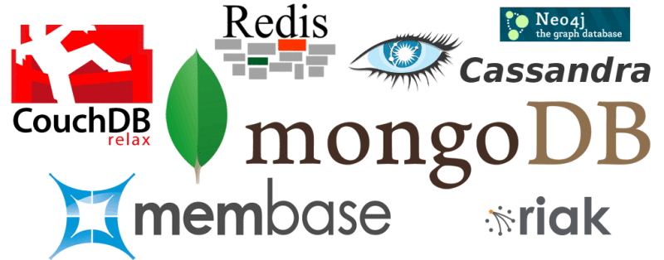
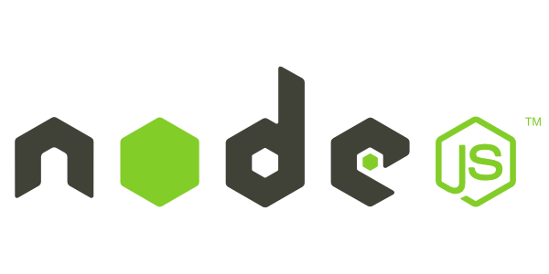
one language to rule them all
Browser: JavaScript
NoSQL: JSON
Server: JavaScript

Slide 3
TODO list
let’s build a TODO list
just:
list items
add item
complete item
all AJAX/AJAJ

Slide 4
TODO list
nodejs + jQuery + mongoDB
nodejs:
build on top of Google's V8 VM
https://code.google.com/p/v8/
developed by Google for Chrome
open source
compiles to machine code
https://developers.google.com/v8/design

Slide 5
setup the server
go to http://nodejs.org and install
go to http://www.mongodb.org and install
run mongod
mongodb –logpath mongodb.log &
run mongo, create a db
use todoapp

Slide 6
NodeJS Hello World
create a file helloworld.js
var http = require('http');
var server = http.createServer(function(req, res) {
res.writeHead(200);
res.end('Hello World!');
});
server.listen(8080);
run it
node helloworld.js
http is a module, createServer is an exposed function

Slide 7
nodeJS: the module system
create a file hello.js
exports.world = function() {
console.log('Hello World');
}
use the module
var hello = require('./hello');
hello.world();

Slide 8
functions as parameters
createServer takes 1 parameter:
a function that handles requests
var http = require("http");
function onRequest(request, response) {
response.writeHead(200,
{"Content-Type": "text/plain"});
response.write("Hello World");
response.end();
}
http.createServer(onRequest).listen(8080);

Slide 9
Why passing functions around?
I/O is expensive

Slide 10
Why passing functions around?
I/O is expensive
synchronous: one at a time. simple. what if a request takes a long time to complete?
fork a new process: heavy load leads to hundreds of processes
threads: requests spawn threads (Apache). memory expensive. multithreading is complicated.

Slide 11
Why passing functions around?
I/O is expensive
nodejs:
single thread for your code
I/O runs in parallel
your code gets called when I/O is ready
use callbacks whenever you have to wait
node expects your code to finish quickly
use WebWorker or separate process if not

Slide 12
Event-driven asynchronous callbacks
event loop
at an I/O call nodejs will:
save your callback
start the I/O call asynchronously
return control to the nodejs environment (serving the next request)
all user code is on same thread!
in the background I/O calls on separate threads
internally uses libev for the event loop

Slide 13
node: modules
package manager: npm
install express globally:
npm install -g express
npm install -g express-generator
create a website with express template
we’ll use the pug template engine
express --sessions --css stylus pa_todoapp
install dependancies
cd pa_todoapp
npm install

Slide 14
let’s prepare the stubs
list items:
app.get('/list', function(req, res) {
res.json([{'id': ‘A’, 'text':'compra pane'}, {'id’: ’B’, 'text': 'compra latte'}]);
});
add item:
app.post('/add', function(req, res) {
console.log("add " + req.body.text);
res.end();
});
complete item:
app.post('/complete', function(req, res) {
console.log("complete " + req.body.id);
res.end();
});

Slide 15
let’s test the stubs
list items:
curl http://localhost:3000/list
add item:
curl -X POST --data "text=ciao" http://localhost:3000/add
complete item:
curl -X POST --data "id=A" http://localhost:3000/complete

Slide 16
let’s prepare the client
load jQuery. add this to the jade layout header
script(src='http://code.jquery.com/jquery-1.12.3.js')
script(src='/javascripts/todoapp.js’)
add an empty todoapp.js file in /public/javascripts
and modify index.jade to
h1 = title
p Things to do:
ul#list
div.additem
form(action=”add”)
input(id="text", type="text", name="text")
input(id="add_submit", type=”submit", value="add")

Slide 17
Client
several frameworks:
JQuery, Dojo, MooTools, Prototype, Raphael, etc..
Why?
uniform layer on browser’s craziness
easier DOM manipulation and event handling
easier AJAX/AJAJ
easier RIA

Slide 18
jQuery
see slides..
.. open browser developer console and try

Slide 19
Let’s write the client
Here the page in PUG notation:
head
title ToDo List
script(type='text/javascript' src='https://ajax.googleapis.com/ajax/libs/jquery/2.1.3/jquery.min.js')
script(type='text/javascript’ src='js/todoapp.js')
body
h1= title
p Things to do:
ul#list
div.additem
form(action='add')
input(id="text", type="text", name="text")
button(id="add_submit", type='submit') Add

Slide 20
let’s write the client
add to todoapp.js: show item
function addTodoElement(TODOElement) {
$('#list').append("<li id='" + TODOElement.id + "'>"+TODOElement.text+" - <a href='javascript:complete(\""+ TODOElement.id + "\")'>complete</a></li>");
}

Slide 21
let’s write the client
add to todoapp.js: complete an item
function complete(id) {
$.post( "/complete", {'id':id}, function( data ) {
loadList();
});
}

Slide 22
let’s write the client
add to todoapp.js: add an item
function add(text) {
$.post( "/add", {'text':text}, function( data ) {
loadList();
});
}

Slide 23
let’s write the client
add to todoapp.js: load the list
function loadList() {
// clear the list
$('#list').empty();
// load list from server
$.getJSON("/list", function (data) {
for (var x in data) {
addTodoElement(x);
};
});
}

Slide 24
let’s write the client
add to todoapp.js:
$(document).ready(function() {
loadList();
$("#add_submit").click(function() {
add($("#text").val());
})
});

Slide 25
time to implement the server
let’s connect to the db
let’s add mongoose:
http://mongoosejs.com
npm install mongoose (or add it to the packages.json file)
add this to app.js to connect to the db
var mongoose = require('mongoose');
mongoose.connect('mongodb://localhost/todoapp');

Slide 26
the db schema
var todoItemSchema = mongoose.Schema({
text: String,
completed: Boolean
});
var todoItem = mongoose.model('TODOItem', todoItemSchema);

Slide 27
implement /list
app.get('/list', function(req, res) {
todoItem.find({completed: false}, function(err, todoitems) {
if (err) {
res.json([]);
} else {
var items = [];
for (todoitem in todoitems) {
items.push({
id: todoitem._id,
text: todoitem.text
});
};
res.json(items);
}
});
});

Slide 28
implement /add
app.post('/add', function(req, res){
var text = req.body.text;
console.log("adding " + text);
var newItem = new todoItem({
text: text,
completed: false});
newItem.save(function(e) {
console.log("added " + text);
res.end();
});
});

Slide 29
implement /complete
app.post('/complete', function(req, res){
var id = req.body.id;
console.log("calling complete " + id);
todoItem.findOne({_id: id}, function (err, item) {
if (err) {
console.log("found element with id " + id);
res.end();
} else {
item.completed = true;
item.save(function (err, item) {
if (err) {
console.log("error saving element with id " + id);
} else {
console.log("saved element with id " + id);
}
res.end();
})
}
});
});

Slide 30
TODO app
source code available at
https://github.com/attardi/pa_todoapp/

Slide 31
what’s wrong?
function findTotals(){
var elements = [];
db.customers.find({ country: 'UK' }, function(err, customers) {
for ( var i=0; i<customers.length; i++) {
db.cart.find({ customerid: customer[i].id}, function (err, cart){
for (var j = 0; j<cart.length; j++) {
elements.push(cart[j].total);
}
});
}
return elements;
});
}

Slide 32
solution
function findTotals() {
db.customers.find({ country: 'UK' }, function(customers) {
var elements = [];
var iterator = function(i) {
if (I >= customers.length) {
return elements;
}
db.cart.find({ customerid: customer[i].id}, function (cart) {
for (var j = 0; j<cart.length; j++) {
elements.push(cart[j].total);
}
iterator(i+1);
});
}
iterator(0);
});
}
closure
recursive call

