Slide 1
Advanced Algorithms for Massive DataSets
Data Compression

Slide 2
Prefix Codes
A prefix code is a variable length code in which no codeword is a prefix of another one
e.g a = 0, b = 100, c = 101, d = 11
Can be viewed as a binary trie
0
1
0
1
a
0
1
d
b
c

Slide 3
Huffman Codes
Invented by Huffman as a class assignment in ‘50.
Used in most compression algorithms
  gzip, bzip, jpeg (as option), fax compression,…
Properties:
  Generates optimal prefix codes
  Fast to encode and decode

Slide 4
Running Example
p(a) = .1, p(b) = .2, p(c ) = .2, p(d) = .5
a(.1)
b(.2)
c(.2)
d(.5)
0
1
1
(.3)
1
0
(.5)
0
(1)
a=000, b=001, c=01, d=1
There are 2^{n-1} “equivalent” Huffman trees

Slide 5
Entropy (Shannon, 1948)
For a source S emitting symbols with probability p(s), the self information of s is:
bits
Lower probability → higher information
Entropy is the weighted average of i(s)
i(s)
0-th order empirical entropy of string T

Slide 6
Performance: Compression ratio
Compression ratio =
#bits in output / #bits in input
Compression performance: We relate entropy against compression ratio.
Empirical H vs Compression ratio
Shannon
Avg cw length
In practice
p(A) = .7, p(B) = p(C) = p(D) = .1
H ≈ 1.36 bits
Huffman ≈ 1.5 bits per symb

Slide 7
Problem with Huffman Coding
We can prove that (n=|T|):
n H(T) ≤ |Huff(T)| < n H(T) + n
which looses < 1 bit per symbol on avg!!
This loss is good/bad depending on H(T)
  Take a two symbol alphabet Σ = {a,b}.
  Whichever is their probability, Huffman uses 1 bit for each symbol and thus takes n bits to encode T
  If p(a) = .999, self-information is:
  bits << 1
Notes:
It might seem like we cannot do better than this.
Assuming Huffman codes, how could we improve this?
Assuming there is only one possible other message (with prob. .001), what would the
Expected length be for sending 1000 messages picked from this distribution? (about 10bits + 1.44 bits = 11.44 bits)

Slide 8
Data Compression
Huffman coding

Slide 9
Huffman Codes
Invented by Huffman as a class assignment in ‘50.
Used in most compression algorithms
  gzip, bzip, jpeg (as option), fax compression,…
Properties:
  Generates optimal prefix codes
  Cheap to encode and decode
  L_{a}(Huff) = H if probabilities are powers of 2
    Otherwise, L_{a}(Huff) < H +1 → < +1 bit per symb on avg!!

Slide 10
Running Example
p(a) = .1, p(b) = .2, p(c ) = .2, p(d) = .5
a(.1)
b(.2)
c(.2)
d(.5)
0
1
1
(.3)
1
0
(.5)
0
(1)
a=000, b=001, c=01, d=1
There are 2^{n-1} “equivalent” Huffman trees
What about ties (and thus, tree depth) ?

Slide 11
Encoding and Decoding
Encoding: Emit the root-to-leaf path leading to the symbol to be encoded.
Decoding: Start at root and take branch for each bit received. When at leaf, output its symbol and return to root.
0
1
abc... →00000101
(.5)
d(.5)
0
1
101001... → dcb
(.3)
c(.2)
0
1
a(.1)
b(.2)

Slide 12
Huffman’s optimality
Average length of a code = Average depth of its binary trie
Reduced tree = tree on (k-1) symbols
  substitute symbols x,z with the special “x+z”
T
RedT
d
d
+1
+1
“x+z”
x
z
L_{RedT} = …. + d *(p_{x} + p_{z})
L_{T} = …. + (d+1)*p_{x} + (d+1)*p_{z}
L_{T} = L_{RedT} + (p_{x} + p_{z})

Slide 13
Huffman’s optimality
Clearly Huffman is optimal for k=1,2 symbols
By induction: assume that Huffman is optimal for k-1 symbols, hence
L_{RedH} (p₁, …, p_{k-2}, p_{k-1} + p_{k} ) is minimum
Now, take k symbols, where p₁ ≥ p₂ ≥ p₃ ≥ … p_{k-1} ≥ p_{k}
Clearly L_{opt} (p₁, …, p_{k-1} , p_{k} ) = L_{RedOpt} (p₁, …, p_{k-2}, p_{k-1} + p_{k} ) + (p_{k-1} + p_{k})
optimal on k-1 symbols (by induction), here they are (p₁, …, p_{k-2}, p_{k-1} + p_{k} )
L_{Opt} = L_{RedOpt} [p₁, …, p_{k-2}, p_{k-1} + p_{k} ] + (p_{k-1} + p_{k})
≥ L_{RedH} [p₁, …, p_{k-2}, p_{k-1} + p_{k} ] + (p_{k-1} + p_{k})
= L_{H}

Slide 14
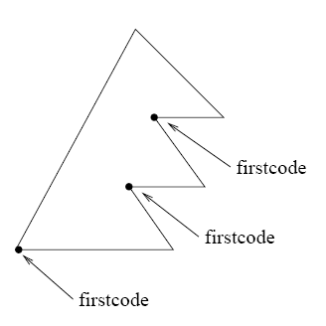
Model size may be large
Huffman codes can be made succinct in the representation of the codeword tree, and fast in (de)coding.
Canonical Huffman tree
We store for any level L:
firstcode[L]
Symbols[L], for each level L
= 00.....0
Notes:
Normal huffman codes are static.
To be applied in a dynamic model, we need a

Slide 15
Canonical Huffman
(.4)
(.1)
(.6)
(.04)
(.02)
(.02)
1(.3)
2(.01)
3(.01)
4(.06)
5(.3)
6(.01)
7(.01)
1(.3)
2 5 5 3 2 5 5 2

Slide 16
Canonical Huffman: Main idea..
Symb Level
1 2
2 5
3 5
4 3
5 2
6 5
7 5
8 2
We want a tree with this form
WHY ??
1 5 8
4
2 3 6 7
It can be stored succinctly using two arrays:
firstcode[]= [--,01,001,00000] = [--,1,1,0] (as values)
Symbols[][]= [ [], [1,5,8], [4], [], [2,3,6,7] ]

Slide 17
Canonical Huffman: Main idea..
Symb Level
1 2
2 5
3 5
4 3
5 2
6 5
7 5
8 2
1 5 8
4
sort
2 3 6 7
numElem[] = [0, 3, 1, 0, 4]
Symbols[][]= [ [], [1,5,8], [4], [], [2,3,6,7] ]
Firstcode[5] = 0
Firstcode[4] = ( Firstcode[5] + numElem[5] ) / 2 = (0+4)/2
= 2 (= 0010 since it is on 4 bits)

Slide 18
Canonical Huffman: Main idea..
Symb Level
1 2
2 5
3 5
4 3
5 2
6 5
7 5
8 2
Value 2
1 5 8
4
Value 2
sort
2 3 6 7
numElem[] = [0, 3, 1, 0, 4]
Symbols[][]= [ [], [1,5,8], [4], [], [2,3,6,7] ]
firstcode[]= [2, 1, 1, 2, 0]
T=...00010...

Slide 19

Canonical Huffman: Decoding
Value 2
1 5 8
Succint and fast in decoding
4
Firstcode[]= [2, 1, 1, 2, 0]
Symbols[][]= [ [], [1,5,8], [4], [], [2,3,6,7] ]
Value 2
2 3 6 7
T=...00010...
Decoding procedure
Symbols[5][2-0]=6

Slide 20
Problem with Huffman Coding
Take a two symbol alphabet Σ = {a,b}.
Whichever is their probability, Huffman uses 1 bit for each symbol and thus takes n bits to encode a message of n symbols
This is ok when the probabilities are almost the same, but what about p(a) = .999.
The optimal code for a is bits
So optimal coding should use n *.0014 bits, which is much less than the n bits taken by Huffman
Notes:
It might seem like we cannot do better than this.
Assuming Huffman codes, how could we improve this?
Assuming there is only one possible other message (with prob. .001), what would the
Expected length be for sending 1000 messages picked from this distribution? (about 10bits + 1.44 bits = 11.44 bits)

Slide 21
What can we do?
Macro-symbol = block of k symbols
  1 extra bit per macro-symbol = 1/k extra-bits per symbol
  Larger model to be transmitted: |Σ|^{k} (k * log |Σ|) + h² bits (where h might be |Σ|)
Shannon took infinite sequences, and k → ∞ !!
Notes:
It might seem like we cannot do better than this.
Assuming Huffman codes, how could we improve this?
Assuming there is only one possible other message (with prob. .001), what would the
Expected length be for sending 1000 messages picked from this distribution? (about 10bits + 1.44 bits = 11.44 bits)

Slide 22
Data Compression
Dictionary-based compressors

Slide 23
LZ77
Algorithm’s step:
  Output <dist, len, next-char>
  Advance by len + 1
A buffer “window” has fixed length and moves
a
a
c
a
a
c
a
b
c
a
a
a
a
a
a
a
c
Dictionary
(all substrings starting here)
<6,3,a>
a
a
c
a
a
c
a
b
c
a
a
a
a
a
a
a
c
c
<3,4,c>

Slide 24
LZ77 Decoding
Decoder keeps same dictionary window as encoder.
  Finds substring and inserts a copy of it
What if l > d? (overlap with text to be compressed)
E.g. seen = abcd, next codeword is (2,9,e)
Simply copy starting at the cursor
for (i = 0; i < len; i++)
out[cursor+i] = out[cursor-d+i]
Output is correct: abcdcdcdcdcdce

Slide 25
LZ77 Optimizations used by gzip
LZSS: Output one of the following formats
  (0, position, length) or (1,char)
Typically uses the second format if length < 3.
Special greedy: possibly use shorter match so that next match is better
Hash Table for speed-up searches on triplets
Triples are coded with Huffman’s code

Slide 26
LZ-parsing (gzip)
0
#
s
i
1
12
si
1
p
i
ssi
3
mississippi#
2
ppi#
1
ppi#
ssippi#
4
#
ppi#
ssippi#
i#
6
3
ppi#
ssippi#
pi#
11
8
7
4
5
2
1
10
9
<m><i><s><si><ssip><pi>
T = mississippi#
1 2 4 6 8 10

Slide 27
LZ-parsing (gzip)
It is on the path to 6
0
#
s
By maximality check only nodes
i
1
12
1
p
Leftmost occ
= 3 < 6
i
si
ssi
3
mississippi#
2
ppi#
1
ppi#
ssippi#
4
#
ppi#
ssippi#
Leftmost occ
= 3 < 6
i#
6
3
ppi#
ssippi#
pi#
11
8
7
4
5
2
1
10
9
<ssip>
T = mississippi#
1 2 4 6 8 10
Longest repeated prefix of T[6,...]
Repeat is on the left of 6

Slide 28
LZ-parsing (gzip)
min-leaf
≅ Leftmost copy
0
#
s
i
3
1
12
2
si
Parsing:
Scan T
Visit ST and stop when
min-leaf ≥ current pos
1
p
3
i
ssi
4
3
mississippi#
9
2
2
ppi#
1
ppi#
ssippi#
4
#
ppi#
ssippi#
i#
6
3
ppi#
ssippi#
pi#
11
8
7
4
5
2
1
10
9
<m><i><s><si><ssip><pi>
Precompute the min descending leaf
at every node in O(n) time.
T = mississippi#
1 2 4 6 8 10

Slide 29
LZ78
Possibly better for cache effects
Dictionary:
substrings stored in a trie (each has an id).
Coding loop:
find the longest match S in the dictionary
Output its id and the next character c after the match in the input string
Add the substring Sc to the dictionary
Decoding:
builds the same dictionary and looks at ids

Slide 30
LZ78: Coding Example
Output
Dict.
a
a
b
a
a
c
a
b
c
a
b
c
b
(0,a)
1 = a
a
a
b
a
a
c
a
b
c
a
b
c
b
(1,b)
2 = ab
a
a
b
a
a
c
a
b
c
a
b
c
b
(1,a)
3 = aa
a
a
b
a
a
c
a
b
c
a
b
c
b
(0,c)
4 = c
a
a
b
a
a
c
a
b
c
a
b
c
b
(2,c)
5 = abc
a
a
b
a
a
c
a
b
c
a
b
c
b
(5,b)
6 = abcb

Slide 31
LZ78: Decoding Example
Input
Dict.
(0,a)
a
1 = a
(1,b)
a
a
b
2 = ab
(1,a)
a
a
b
a
a
3 = aa
(0,c)
a
a
b
a
a
c
4 = c
(2,c)
a
a
b
a
a
c
a
b
c
5 = abc
(5,b)
a
a
b
a
a
c
a
b
c
a
b
c
b
6 = abcb

Slide 32
Lempel-Ziv Algorithms
Keep a “dictionary” of recently-seen strings.
The differences are:
How the dictionary is stored
How it is extended
How it is indexed
How elements are removed
How phrases are encoded
LZ-algos are asymptotically optimal, i.e. their compression ratio goes to H(T) for n → ∞ !!
No explicit
frequency estimation

Slide 33
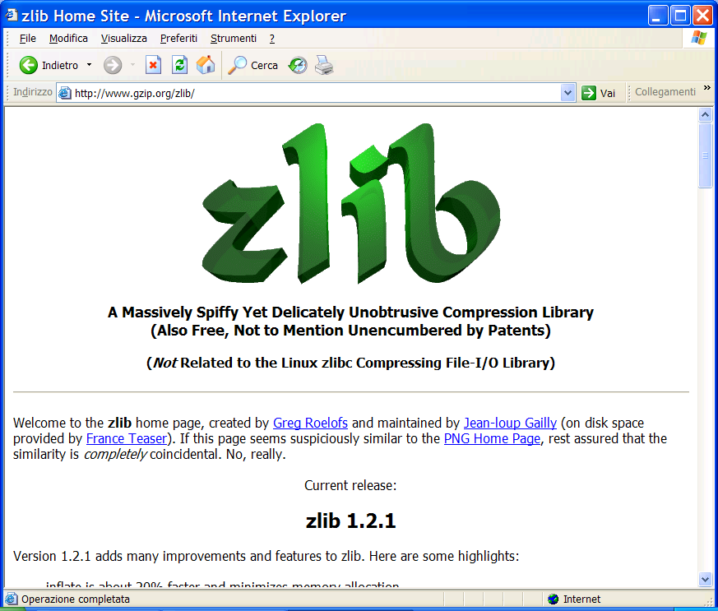
You find this at: www.gzip.org/zlib/

Slide 34
Web Algorithmics
File Synchronization

Slide 35
File synch: The problem
request
f_new
f_old
update
Server
Client
client wants to update an out-dated file
server has new file but does not know the old file
update without sending entire f_new (using similarity)
rsync: file synch tool, distributed with Linux
Notes:
Prof. Paolo Ferragina, Algoritmi per "Information Retrieval"

Slide 36
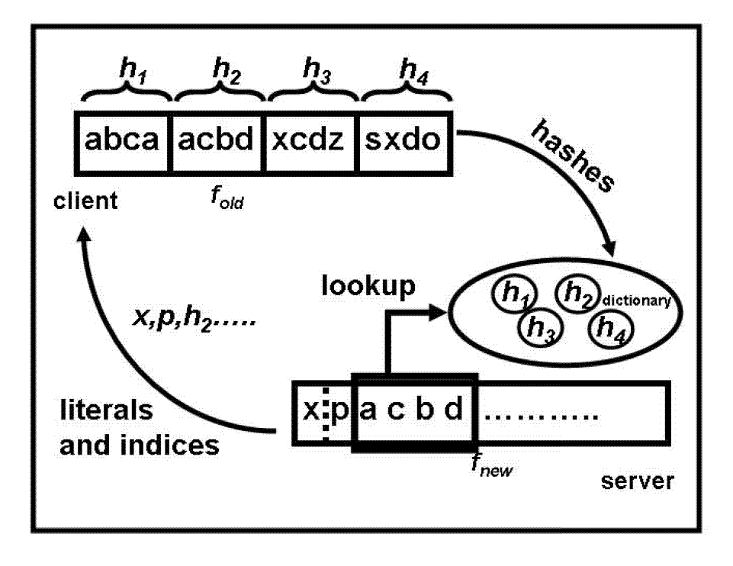
The rsync algorithm
hashes
f_new
f_old
encoded file
Server
Client
Notes:
Prof. Paolo Ferragina, Algoritmi per "Information Retrieval"

Slide 37
The rsync algorithm (contd)
Gzip
simple, widely used, single roundtrip
optimizations: 4-byte rolling hash + 2-byte MD5, gzip for literals
choice of block size problematic (default: max{700, √n} bytes)
not good in theory: granularity of changes may disrupt use of blocks

Slide 38
Simple compressors: too simple?
Move-to-Front (MTF):
  As a freq-sorting approximator
  As a caching strategy
  As a compressor
Run-Length-Encoding (RLE):
  FAX compression
Notes:
Normal huffman codes are static.
To be applied in a dynamic model, we need a

Slide 39
Move to Front Coding
Transforms a char sequence into an integer sequence, that can then be var-length coded
Start with the list of symbols L=[a,b,c,d,…]
For each input symbol s
  output the position of s in L
  move s to the front of L
Properties:
Exploit temporal locality, and it is dynamic
X = 1^{n} 2^{n} 3^{n…} n^{n} → Huff = O(n² log n), MTF = O(n log n) + n²
There is a memory

Slide 40
Run Length Encoding (RLE)
If spatial locality is very high, then
abbbaacccca => (a,1),(b,3),(a,2),(c,4),(a,1)
In case of binary strings → just numbers and one bit
Properties:
Exploit spatial locality, and it is a dynamic code
X = 1^{n} 2^{n} 3^{n…} n^{n} →
Huff(X) = O(n² log n) > Rle(X) = O( n (1+log n) )
There is a memory
Notes:
Should each character have its own frequency distribution, or the same for all of them?

Slide 41
Data Compression
Burrows-Wheeler Transform

Slide 42
The big (unconscious) step...

Slide 43
The Burrows-Wheeler Transform (1994)
Let us given a text T = mississippi#
F
L
mississippi#
# mississipp i
ississippi#m
i #mississip p
ssissippi#mi
i ppi#missis s
sissippi#mis
i ssippi#mis s
issippi#miss
Sort the rows
i ssissippi# m
ssippi#missi
m ississippi #
T
sippi#missis
ippi#mississ
ppi#mississi
pi#mississip
i#mississipp
#mississippi
p i#mississi p
p pi#mississ i
s ippi#missi s
s issippi#mi s
s sippi#miss i
s sissippi#m i

Slide 44
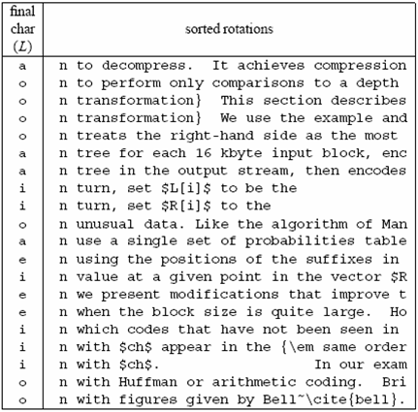
A famous example
Much
longer...

Slide 45
Compressing L seems promising...
Key observation:
L is locally homogeneous
L is highly compressible
Algorithm Bzip :
Move-to-Front coding of L
Run-Length coding
Statistical coder
Bzip vs. Gzip: 20% vs. 33%, but it is slower in (de)compression !

Slide 46
How to compute the BWT ?
SA
BWT matrix
L
We said that: L[i] precedes F[i] in T
12
11
8
5
2
1
10
9
7
4
6
3
#mississipp
i#mississip
ippi#missis
issippi#mis
ississippi#
mississippi
pi#mississi
ppi#mississ
sippi#missi
sissippi#mi
ssippi#miss
ssissippi#m
#mississipp
i#mississip
ippi#missis
issippi#mis
ississippi#
mississippi
pi#mississi
ppi#mississ
sippi#missi
sissippi#mi
ssippi#miss
ssissippi#m
i
p
s
s
m
#
p
i
s
s
i
i
L[3] = T[ 7 ]
Given SA and T, we have L[i] = T[SA[i]-1]

Slide 47
A useful tool: L → F mapping
F
unknown
L
# mississipp i
i #mississip p
i ppi#missis s
i ssippi#mis s
i ssissippi# m
m ississippi #
How do we map L’s onto F’s chars ?
p i#mississi p
p pi#mississ i
s ippi#missi s
s issippi#mi s
s sippi#miss i
s sissippi#m i
... Need to distinguish equal chars in F...
Take two equal L’s chars
Rotate rightward their rows
Same relative order !!

Slide 48
The BWT is invertible
F
unknown
L
# mississipp i
Two key properties:
i #mississip p
1. LF-array maps L’s to F’s chars
i ppi#missis s
2. L[ i ] precedes F[ i ] in T
i ssippi#mis s
i ssissippi# m
Reconstruct T backward:
m ississippi #
p
p
i
T = .... #
i
p i#mississi p
p pi#mississ i
s ippi#missi s
s issippi#mi s
s sippi#miss i
s sissippi#m i
InvertBWT(L)
Compute LF[0,n-1];
r = 0; i = n;
while (i>0) {
T[i] = L[r];
r = LF[r]; i--;
}

Slide 49
An encoding example
T = mississippimississippimississippi
# at 16
L = ipppssssssmmmii#pppiiissssssiiiiii
Mtf = [i,m,p,s]
Mtf = 020030000030030 300100300000100000
Mtf = 030040000040040 400200400000200000
Bin(6)=110, Wheeler’s code
Alphabet
|Σ|+1
RLE0 = 03141041403141410210
Bzip2-output = Huffman on |Σ|+1 symbols...
... plus γ(16), plus the original Mtf-list (i,m,p,s)

Slide 50
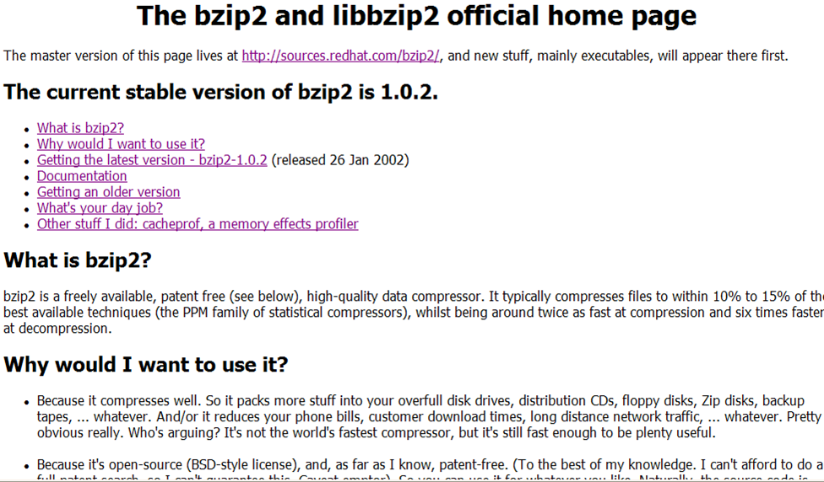
You find this in your Linux distribution

