Slide 1
Advanced Algorithms for Massive DataSets
Data Compression

Slide 2
Prefix Codes
A prefix code is a variable length code in which no codeword is a prefix of another one
e.g a = 0, b = 100, c = 101, d = 11
Can be viewed as a binary trie
0
1
0
1
a
0
1
d
b
c

Slide 3
Huffman Codes
Invented by Huffman as a class assignment in ‘50.
Used in most compression algorithms
  gzip, bzip, jpeg (as option), fax compression,…
Properties:
  Generates optimal prefix codes
  Fast to encode and decode

Slide 4
Running Example
p(a) = .1, p(b) = .2, p(c ) = .2, p(d) = .5
a(.1)
b(.2)
c(.2)
d(.5)
0
1
1
(.3)
1
0
(.5)
0
(1)
a=000, b=001, c=01, d=1
There are 2^{n-1} “equivalent” Huffman trees

Slide 5
Entropy (Shannon, 1948)
For a source S emitting symbols with probability p(s), the self information of s is:
bits
Lower probability → higher information
Entropy is the weighted average of i(s)
i(s)
0-th order empirical entropy of string T

Slide 6
Performance: Compression ratio
Compression ratio =
#bits in output / #bits in input
Compression performance: We relate entropy against compression ratio.
Empirical H vs Compression ratio
Shannon
Avg cw length
In practice
p(A) = .7, p(B) = p(C) = p(D) = .1
H ≈ 1.36 bits
Huffman ≈ 1.5 bits per symb

Slide 7
Problem with Huffman Coding
We can prove that (n=|T|):
n H(T) ≤ |Huff(T)| < n H(T) + n
which looses < 1 bit per symbol on avg!!
This loss is good/bad depending on H(T)
  Take a two symbol alphabet Σ = {a,b}.
  Whichever is their probability, Huffman uses 1 bit for each symbol and thus takes n bits to encode T
  If p(a) = .999, self-information is:
  bits << 1
Notes:
It might seem like we cannot do better than this.
Assuming Huffman codes, how could we improve this?
Assuming there is only one possible other message (with prob. .001), what would the
Expected length be for sending 1000 messages picked from this distribution? (about 10bits + 1.44 bits = 11.44 bits)

Slide 8
Huffman’s optimality
Average length of a code = Average depth of its binary trie
Reduced tree = tree on (k-1) symbols
  substitute symbols x,z with the special “x+z”
T
RedT
d
d
+1
+1
“x+z”
x
z
L_{RedT} = …. + d *(p_{x} + p_{z})
L_{T} = …. + (d+1)*p_{x} + (d+1)*p_{z}
L_{T} = L_{RedT} + (p_{x} + p_{z})

Slide 9
Huffman’s optimality
Clearly Huffman is optimal for k=1,2 symbols
By induction: assume that Huffman is optimal for k-1 symbols, hence
L_{RedH} (p₁, …, p_{k-2}, p_{k-1} + p_{k} ) is minimum
Now, take k symbols, where p₁ ≥ p₂ ≥ p₃ ≥ … p_{k-1} ≥ p_{k}
Clearly L_{opt} (p₁, …, p_{k-1} , p_{k} ) = L_{RedOpt} (p₁, …, p_{k-2}, p_{k-1} + p_{k} ) + (p_{k-1} + p_{k})
optimal on k-1 symbols (by induction), here they are (p₁, …, p_{k-2}, p_{k-1} + p_{k} )
L_{Opt} = L_{RedOpt} [p₁, …, p_{k-2}, p_{k-1} + p_{k} ] + (p_{k-1} + p_{k})
≥ L_{RedH} [p₁, …, p_{k-2}, p_{k-1} + p_{k} ] + (p_{k-1} + p_{k})
= L_{H}

Slide 10
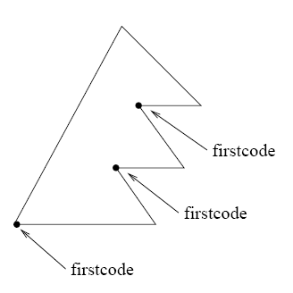
Model size may be large
Huffman codes can be made succinct in the representation of the codeword tree, and fast in (de)coding.
Canonical Huffman tree
We store for any level L:
firstcode[L]
Symbols[L], for each level L
= 00.....0
Notes:
Normal huffman codes are static.
To be applied in a dynamic model, we need a

Slide 11
Canonical Huffman
(.4)
(.1)
(.6)
(.04)
(.02)
(.02)
1(.3)
2(.01)
3(.01)
4(.06)
5(.3)
6(.01)
7(.01)
1(.3)
2 5 5 3 2 5 5 2

Slide 12
Canonical Huffman: Main idea..
Symb Level
1 2
2 5
3 5
4 3
5 2
6 5
7 5
8 2
We want a tree with this form
WHY ??
1 5 8
4
2 3 6 7
It can be stored succinctly using two arrays:
firstcode[]= [--,01,001,--, 00000] = [--,1,1,--, 0] (as values)
Symbols[][]= [ [], [1,5,8], [4], [], [2,3,6,7] ]

Slide 13
Canonical Huffman: Main idea..
Symb Level
1 2
2 5
3 5
4 3
5 2
6 5
7 5
8 2
How do we compute FirstCode
without building the tree ?
1 5 8
4
sort
2 3 6 7
numElem[] = [0, 3, 1, 0, 4]
Symbols[][]= [ [], [1,5,8], [4], [], [2,3,6,7] ]
Firstcode[5] = 0
Firstcode[4] = ( Firstcode[5] + numElem[5] ) / 2 = (0+4)/2
= 2 (= 0010 since it is on 4 bits)

Slide 14
Some comments
Symb Level
1 2
2 5
3 5
4 3
5 2
6 5
7 5
8 2
Value 2
1 5 8
4
Value 2
sort
2 3 6 7
numElem[] = [0, 3, 1, 0, 4]
Symbols[][]= [ [], [1,5,8], [4], [], [2,3,6,7] ]
firstcode[]= [2, 1, 1, 2, 0]

Slide 15

Canonical Huffman: Decoding
Value 2
1 5 8
Succint and fast in decoding
4
Firstcode[]= [2, 1, 1, 2, 0]
Symbols[][]= [ [], [1,5,8], [4], [], [2,3,6,7] ]
Value 2
2 3 6 7
T=...00010...
Decoding procedure
Symbols[5][2-0]=6

Slide 16
Can we improve Huffman ?
Macro-symbol = block of k symbols
  1 extra bit per macro-symbol = 1/k extra-bits per symbol
  Larger model to be transmitted: |Σ|^{k} (k * log |Σ|) + h² bits (where h might be |Σ|)
Shannon took infinite sequences, and k → ∞ !!
Notes:
It might seem like we cannot do better than this.
Assuming Huffman codes, how could we improve this?
Assuming there is only one possible other message (with prob. .001), what would the
Expected length be for sending 1000 messages picked from this distribution? (about 10bits + 1.44 bits = 11.44 bits)

Slide 17
Data Compression
Arithmetic coding

Slide 18
Introduction
Allows using “fractional” parts of bits!!
Takes 2 + nH₀ bits vs. (n + nH₀) of Huffman
Used in PPM, JPEG/MPEG (as option), Bzip
More time costly than Huffman, but integer implementation is not too bad.

Slide 19
Symbol interval
Assign each symbol to an interval range from 0 (inclusive) to 1 (exclusive).
e.g.
1.0
c = .3
0.7
b = .5
f(a) = .0, f(b) = .2, f(c) = .7
0.2
a = .2
0.0
The interval for a particular symbol will be called
the symbol interval (e.g for b it is [.2,.7))
Notes:
We are going to make a distinction between message, sequence, and code intervals.
It is important to keep them straight.
Also I will give different meanings to p(I) and p_{i} and it is important to keep these straight

Slide 20
Sequence interval
Coding the message sequence: bac
The final sequence interval is [.27,.3)
1.0
0.7
0.3
c = .3
c = .3
(0.7-0.2)*0.3=0.15
(0.3-0.2)*0.3=0.03
c = .3
0.7
0.55
0.27
b = .5
b = .5
(0.7-0.2)*0.5 = 0.25
b = .5
(0.3-0.2)*0.5 = 0.05
0.2
0.3
0.22
a = .2
a = .2
(0.7-0.2)*0.2=0.1
(0.3-0.2)*0.2=0.02
a = .2
0.0
0.2
0.2
Notes:
If the notation gets confusing, the intuition is still clear, as shown by this example.

Slide 21
The algorithm
To code a sequence of symbols with probabilities
p_{i} (i = 1..n) use the following algorithm:
Each message narrows the interval by a factor of p_{i}.
0.3
c = .3
0.27
b = .5
0.22
a = .2
0.2
Notes:
How does the interval size relate to the probability of that message sequence?

Slide 22
The algorithm
Each message narrows the interval by a factor of p[T_{i}]
Final interval size is
Sequence interval
[ l_{n} , l_{n} + s_{n} ]
A number inside
Notes:
How does the interval size relate to the probability of that message sequence?

Slide 23
Decoding Example
Decoding the number .49, knowing the message is of length 3:
The message is bbc.
1.0
0.7
0.55
c = .3
c = .3
c = .3
0.49
0.7
0.55
0.475
0.49
0.49
b = .5
b = .5
b = .5
0.2
0.3
0.35
a = .2
a = .2
a = .2
0.0
0.2
0.3
Notes:
Basically we are running the coding example but instead of paying attention to the symbol names,
We pay attention to the number.

Slide 24
How do we encode that number?
If x = v/2^{k} (dyadic fraction) then the encoding is equal to bin(x) over k digits (possibly pad with 0s in front)
Notes:
It is not a prefix code.

Slide 25
How do we encode that number?
Binary fractional representation:
FractionalEncode(x)
x = 2 * x
If x < 1 output 0
x = x - 1; output 1
2 * (1/3) = 2/3 < 1, output 0
2 * (2/3) = 4/3 > 1, output 1
→ 4/3 – 1 = 1/3
Incremental Generation
Notes:
It is not a prefix code.

Slide 26
Which number do we encode?
Truncate the encoding to the first d = ⎡log (2/s_{n})⎤ bits
Truncation gets a smaller number… how much smaller?
l_{n} + s_{n}
l_{n} + s_{n}/2
Compression = Truncation
l_{n}
=0
Notes:
It is not a prefix code.

Slide 27
Bound on code length
Theorem: For a text of length n, the Arithmetic encoder generates at most
⎡log₂ (2/s_{n})⎤ < 1 + log₂ 2/s_{n} = 1 + (1 - log₂ s_{n})
= 2 - log₂ (∏ _{i=1,n} p(T_{i}))
= 2 - ∑ _{i=1,n} (log₂ p(T_{i}))
= 2 - ∑_{σ=1,|Σ|} n*p(σ) log p(σ)
= 2 + n * ∑_{σ=1,|Σ|} p(σ) log (1/p(σ))
= 2 + n H(T) bits
T = aaba
s_{n} = p(a) * p(a) * p(b) * p(a)
log₂ s_{n} = 3 * log p(a) + 1 * log p(b)
nH₀ + 0.02 n bits in practice
because of rounding
Notes:
The 1 + log s is from previous slide based on truncating to -log(s/2) bits.
Note that s is overloaded (size of sequence interval, and self information of message). I apologize.

Slide 28
Data Compression
Integers compression

Slide 29
From text to integer compression
T = ab b a ab c, ab b b c abc a a, b b ab.
Encode : 3121431561312121517141461212138
Terms | Num. occurrences | Rank
space | 14 | 1
b | 5 | 2
ab | 4 | 3
a | 3 | 4
c | 2 | 5
, | 2 | 6
abc | 1 | 7
. | 1 | 8
Compress terms by
encoding their ranks
with var-len encodings
Golden rule of
data compression
holds: frequent
words get small
integers and thus
will be encoded
with fewer bits

Slide 30
γ−code for integer encoding
Length-1
x > 0 and Length = ⎣log₂ x⎦ +1
e.g., 9 represented as <000,1001>.
γ−code for x takes 2 ⎣log₂ x⎦ +1 bits
(ie. factor of 2 from optimal)
  Optimal for Pr(x) = 1/2x², and i.i.d integers

Slide 31
It is a prefix-free encoding…
Given the following sequence of γ−coded integers, reconstruct the original sequence:
0001000001100110000011101100111
8
6
3
59
7

Slide 32
δ−code for integer encoding
Use γ-coding to reduce the length of the first field
Useful for medium-sized integers
e.g., 19 represented as <00,101,10011>.
δ−coding x takes about
⎣log₂ x⎦ + 2 ⎣log₂( ⎣log₂ x⎦ +1)⎦ + 2 bits.
  Optimal for Pr(x) = 1/2x(log x)², and i.i.d integers

Slide 33
Rice code (simplification of Golomb code)
[q times 0s] 1
Log k bits
It is a parametric code: depends on k
Quotient q=⎣(v-1)/k⎦, and the rest is r= v – k * q – 1
Useful when integers concentrated around k
How do we choose k ?
  Usually k ≈ 0.69 * mean(v) [Bernoulli model]
  Optimal for Pr(v) = p (1-p)^{v-1}, where mean(v)=1/p, and i.i.d ints

Slide 34
Variable-byte codes
Wish to get very fast (de)compress → byte-align
e.g., v=2¹⁴+1 → binary(v) = 100000000000001
1 0000000 0000001
Note: We waste 1 bit per byte, and avg 4 for the first byte.
We know where to stop, before reading next codeword.
0000001 0000000 0000001
10000001 10000000 00000001

Slide 35
(s,c)-dense codes
A new concept, good for skewed distr
: Continuers vs Stoppers
  Variable-byte is using: s = c = 128
It is a prefix-code
The main idea is:
  s + c = 256 (we are playing with 8 bits)
  Thus s items are encoded with 1 byte
  And s*c with 2 bytes, s * c² on 3 bytes, s * c³ on 4 bytes...
An example
  5000 distinct words
  Var-byte encodes 128 + 128² = 16512 words on 2 bytes
  (230,26)-dense code encodes 230 + 230*26 = 6210 on 2 bytes, hence more on 1 byte and thus better on skewed...
Notes:
Normal huffman codes are static.
To be applied in a dynamic model, we need a

Slide 36
PForDelta coding
Use b (e.g. 2) bits to encode 128 numbers or create exceptions
3
42
2
3
3
1
1
…
3
3
23
1
2
11
10
11
11
01
01
…
11
11
01
10
42
23
a block of 128 numbers
Translate data: [base, base + 2^{b}-1] → [0,2^{b}-1]
Encode exceptions: ESC or pointers
Choose b to encode 90% values, or trade-off:
b↑ waste more bits, b↓ more exceptions
Notes:
Normal huffman codes are static.
To be applied in a dynamic model, we need a

Slide 37
Data Compression
Dictionary-based compressors

Slide 38
LZ77
Algorithm’s step:
  Output <dist, len, next-char>
  Advance by len + 1
A buffer “window” has fixed length and moves
a
a
c
a
a
c
a
b
c
a
a
a
a
a
a
a
c
Dictionary
(all substrings starting here)
<6,3,a>
a
a
c
a
a
c
a
b
c
a
a
a
a
a
a
a
c
c
<3,4,c>

Slide 39
LZ77 Decoding
Decoder keeps same dictionary window as encoder.
  Finds substring and inserts a copy of it
What if l > d? (overlap with text to be compressed)
E.g. seen = abcd, next codeword is (2,9,e)
Simply copy starting at the cursor
for (i = 0; i < len; i++)
out[cursor+i] = out[cursor-d+i]
Output is correct: abcdcdcdcdcdce

Slide 40
LZ77 Optimizations used by gzip
LZSS: Output one of the following formats
  (0, position, length) or (1,char)
Typically uses the second format if length < 3.
Special greedy: possibly use shorter match so that next match is better
Hash Table for speed-up searches on triplets
Triples are coded with Huffman’s code

Slide 41
LZ-parsing (gzip)
0
#
s
i
1
12
si
1
p
i
ssi
3
mississippi#
2
ppi#
1
ppi#
ssippi#
4
#
ppi#
ssippi#
i#
6
3
ppi#
ssippi#
pi#
11
8
7
4
5
2
1
10
9
<m><i><s><si><ssip><pi>
T = mississippi#
1 2 4 6 8 10

Slide 42
LZ-parsing (gzip)
It is on the path to 6
0
#
s
By maximality check only nodes
i
1
12
1
p
Leftmost occ
= 3 < 6
i
si
ssi
3
mississippi#
2
ppi#
1
ppi#
ssippi#
4
#
ppi#
ssippi#
Leftmost occ
= 3 < 6
i#
6
3
ppi#
ssippi#
pi#
11
8
7
4
5
2
1
10
9
<ssip>
T = mississippi#
1 2 4 6 8 10
Longest repeated prefix of T[6,...]
Repeat is on the left of 6

Slide 43
LZ-parsing (gzip)
min-leaf
≅ Leftmost copy
0
#
s
i
3
1
12
2
si
Parsing:
Scan T
Visit ST and stop when
min-leaf ≥ current pos
1
p
3
i
ssi
4
3
mississippi#
9
2
2
ppi#
1
ppi#
ssippi#
4
#
ppi#
ssippi#
i#
6
3
ppi#
ssippi#
pi#
11
8
7
4
5
2
1
10
9
<m><i><s><si><ssip><pi>
Precompute the min descending leaf
at every node in O(n) time.
T = mississippi#
1 2 4 6 8 10

Slide 44
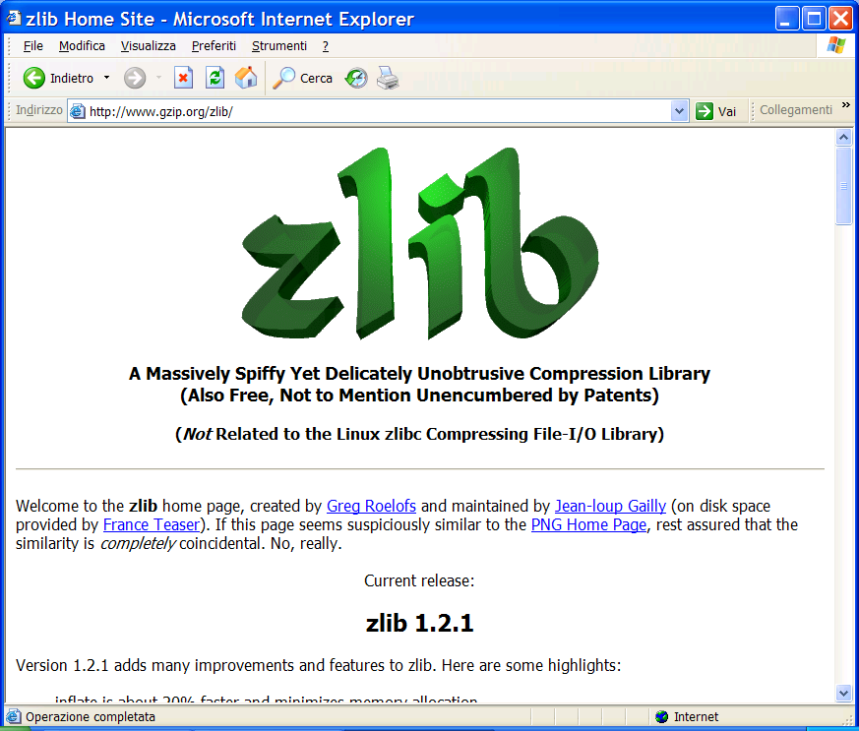
You find this at: www.gzip.org/zlib/

Slide 45
Web Algorithmics
File Synchronization

Slide 46
File synch: The problem
request
f_new
f_old
update
Server
Client
client wants to update an out-dated file
server has new file but does not know the old file
update without sending entire f_new (using similarity)
rsync: file synch tool, distributed with Linux
Notes:
Prof. Paolo Ferragina, Algoritmi per "Information Retrieval"

Slide 47
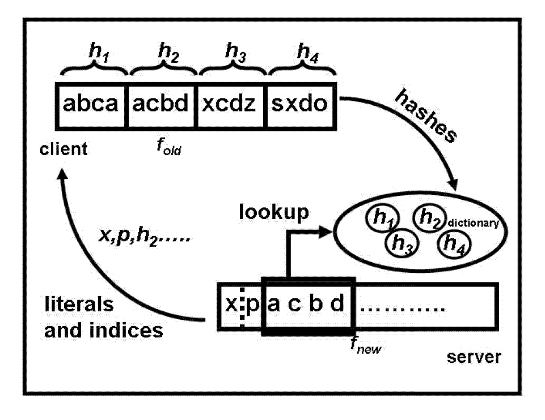
The rsync algorithm
hashes
f_new
f_old
encoded file
Server
Client
Notes:
Prof. Paolo Ferragina, Algoritmi per "Information Retrieval"

Slide 48
The rsync algorithm (contd)
Gzip
simple, widely used, single roundtrip
optimizations: 4-byte rolling hash + 2-byte MD5, gzip for literals
choice of block size problematic (default: max{700, √n} bytes)
not good in theory: granularity of changes may disrupt use of blocks

Slide 49
Simple compressors: too simple?
Move-to-Front (MTF):
  As a freq-sorting approximator
  As a caching strategy
  As a compressor
Run-Length-Encoding (RLE):
  FAX compression
Notes:
Normal huffman codes are static.
To be applied in a dynamic model, we need a

Slide 50
Move to Front Coding
Transforms a char sequence into an integer sequence, that can then be var-length coded
Start with the list of symbols L=[a,b,c,d,…]
For each input symbol s
  output the position of s in L
  move s to the front of L
Properties:
Exploit temporal locality, and it is dynamic
X = 1^{n} 2^{n} 3^{n…} n^{n} → Huff = O(n² log n), MTF = O(n log n) + n²
In fact Huff takes log n bits per symbol being them equiprob
MTF uses O(1) bits per symbol occurrence but first one by γ-code.
There is a memory

Slide 51
Run Length Encoding (RLE)
If spatial locality is very high, then
abbbaacccca => (a,1),(b,3),(a,2),(c,4),(a,1)
In case of binary strings → just numbers and one bit
Properties:
Exploit spatial locality, and it is a dynamic code
X = 1^{n} 2^{n} 3^{n…} n^{n} →
Huff(X) = O(n² log n) > Rle(X) = O( n (1+log n) )
RLE uses log n bits per symb-block using γ-code per its length.
There is a memory
Notes:
Should each character have its own frequency distribution, or the same for all of them?

Slide 52
Data Compression
Burrows-Wheeler Transform

Slide 53
The big (unconscious) step...

Slide 54
The Burrows-Wheeler Transform (1994)
Let us given a text T = mississippi#
F
L
mississippi#
# mississipp i
ississippi#m
i #mississip p
ssissippi#mi
i ppi#missis s
sissippi#mis
i ssippi#mis s
issippi#miss
Sort the rows
i ssissippi# m
ssippi#missi
m ississippi #
T
sippi#missis
ippi#mississ
ppi#mississi
pi#mississip
i#mississipp
#mississippi
p i#mississi p
p pi#mississ i
s ippi#missi s
s issippi#mi s
s sippi#miss i
s sissippi#m i

Slide 55
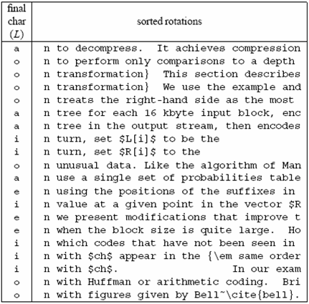
A famous example
Much
longer...

Slide 56
Compressing L seems promising...
Key observation:
L is locally homogeneous
L is highly compressible
Algorithm Bzip :
Move-to-Front coding of L
Run-Length coding
Statistical coder
Bzip vs. Gzip: 20% vs. 33%, but it is slower in (de)compression !

Slide 57
How to compute the BWT ?
SA
BWT matrix
L
We said that: L[i] precedes F[i] in T
12
11
8
5
2
1
10
9
7
4
6
3
#mississipp
i#mississip
ippi#missis
issippi#mis
ississippi#
mississippi
pi#mississi
ppi#mississ
sippi#missi
sissippi#mi
ssippi#miss
ssissippi#m
#mississipp
i#mississip
ippi#missis
issippi#mis
ississippi#
mississippi
pi#mississi
ppi#mississ
sippi#missi
sissippi#mi
ssippi#miss
ssissippi#m
i
p
s
s
m
#
p
i
s
s
i
i
L[3] = T[ 7 ]
Given SA and T, we have L[i] = T[SA[i]-1]

Slide 58
How to construct SA from T ?
SA
12
11
8
5
2
1
10
9
7
4
6
3
#
i#
ippi#
issippi#
ississippi#
mississippi
pi#
ppi#
sippi#
sissippi#
ssippi#
ssissippi#
Elegant but inefficient
Obvious inefficiencies:
Θ(n² log n) time in the worst-case
Θ(n log n) cache misses or I/O faults
Input: T = mississippi#

Slide 59
A useful tool: L → F mapping
F
unknown
L
# mississipp i
i #mississip p
i ppi#missis s
i ssippi#mis s
i ssissippi# m
m ississippi #
How do we map L’s onto F’s chars ?
p i#mississi p
p pi#mississ i
s ippi#missi s
s issippi#mi s
s sippi#miss i
s sissippi#m i
... Need to distinguish equal chars in F...
Take two equal L’s chars
Rotate rightward their rows
Same relative order !!

Slide 60
The BWT is invertible
F
unknown
L
# mississipp i
Two key properties:
i #mississip p
1. LF-array maps L’s to F’s chars
i ppi#missis s
2. L[ i ] precedes F[ i ] in T
i ssippi#mis s
i ssissippi# m
Reconstruct T backward:
m ississippi #
p
p
i
T = .... #
i
p i#mississi p
p pi#mississ i
s ippi#missi s
s issippi#mi s
s sippi#miss i
s sissippi#m i
InvertBWT(L)
Compute LF[0,n-1];
r = 0; i = n;
while (i>0) {
T[i] = L[r];
r = LF[r]; i--;
}

Slide 61
An encoding example
T = mississippimississippimississippi
# at 16
L = ipppssssssmmmii#pppiiissssssiiiiii
Mtf = [i,m,p,s]
Mtf = 020030000030030 300100300000100000
Mtf = 030040000040040 400200400000200000
Bin(6)=110, Wheeler’s code
Alphabet
|Σ|+1
RLE0 = 03141041403141410210
Bzip2-output = Arithmetic/Huffman on |Σ|+1 symbols...
... plus γ(16), plus the original Mtf-list (i,m,p,s)

Slide 62
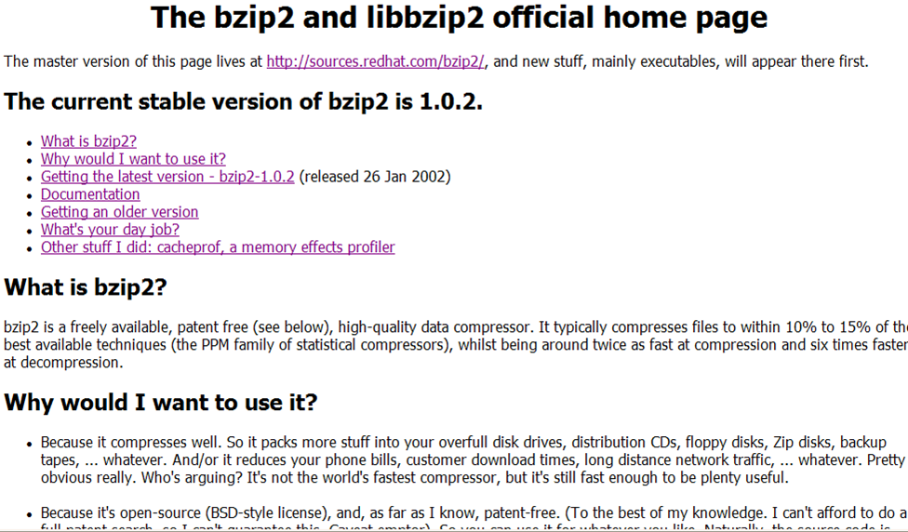
You find this in your Linux distribution

