Slide 1
Single-Source Shortest Paths
Chapter 24
Cormen Leiserson Rivest&Stein:
Introduction to Algorithms

Slide 2
Shortest path
Weighted Graphs G(V, E, w)
W: E R
If w=1 for all edges BFS is the solution.
Weight w(p) of a path p = {v₀, v₁, …, v_{k}) is the sum of weights of its edges:
w(p) = Σ _{i=1,k} w(v_{i-1},v_{i})
Shortest-Path distance is the shortest path with minimum w(p).

Slide 3
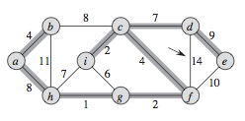
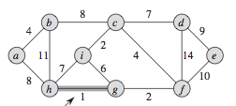
MST and Shortest path tree
MST
Starting from a minimizes the
global sum of weights of
the edges
SPT
Minimized the distances (sum
of weights) from
a to all the other nodes

Slide 4
Single-Source Shortest Paths
2 very important applications :
Geographical maps and satellite navigators.
Internet : Routing of messages

Slide 5
Representing Shortest Paths
Not only compute the value of min w(p) but also the path associated to this weight.
Use predecessor as in BSF
u, π(u) and the procedure PrintPath.
First build the Shortest path tree
For the Routing Problem:
Compute the shortest path from any source.
Routing tables: for each destination specifies the next hop in the shortest path.

Slide 6
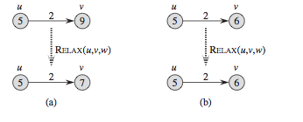
Relaxation
Typical operation of the computation of the SPT.
Update the value v.d of the SPT computed so far to a better value.
v.d > u.d +2 RELAX ! v.d < u.d +2 DO NOT RELAX !
UPDATE: v.d = u.d +2 NO UPDATE

Slide 7
Dijkstra’s algorithm
Assign to every node a tentative distance value: set it to zero for our initial node and to infinity for all other nodes.
Set the initial node as current. Mark all other nodes unvisited. Create a set of all the unvisited nodes called the unvisited set.
For the current node, consider all of its unvisited neighbors and calculate their tentative distances. Compare the newly calculated tentative distance to the current assigned value and assign the smaller one. ( Check Relaxation)

Slide 8
Dijkstra’s algorithm
4. When we are done considering all of the neighbors of the current node, mark the current node as visited and remove it from the unvisited set. A visited node will never be checked again.
5. If the destination node has been marked visited or if the smallest tentative distance among the nodes in the unvisited set is infinity then stop. The algorithm has finished.
6 Otherwise, select the unvisited node that is marked with the smallest tentative distance, set it as the new "current node", and go back to step 3.

Slide 9
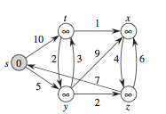

Slide 10
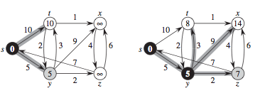

Slide 11
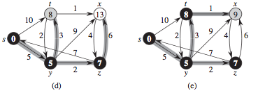
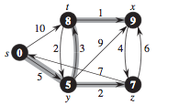

Slide 12
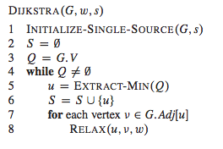
Dijkstra’s algorithm

Slide 13
Dijkstra’s algorithm correctness
Invariant: For each visited node v, v.d is the shortest distance from source to v.
For each unvisited node u, u.d is the shortest distance via visited nodes only, from source to u (if such a path exists, otherwise infinity);
Proof by induction

Slide 14
Correctness sketch
After processing u it will still be true that for each unvisited node w, w.d is the shortest distance from source to w using visited nodes only, since:
if there were a shorter path which doesn’t
visit u we would have found it previously;
if there is a shorter path using u we update it when processing u .

Slide 15
Dijkstra’s algorithm analysis
Instructions 1-3: O(V)
Instructions 4-8: O((V+E) log(V)) if Q is
implemented with a heap.
Total: : O((V+E) log(V))
Operation DECREASE KEY in a heap can be performed in O(logV) time.

Slide 16
Semi external algorithm for MST-Kruskal
Semi external: the cache is big enough to contain the Union –Find data structure but not Graph.
Sort the edges using any optimal external (2-level model) sorting algorithm.
Scan the edges in order of increasing weight, as for the normal algorithm.
If an edge is selected for the MST, output it.
Number of I/O’s operations as Sorting.

Slide 17
External algorithm for MST -Kruskal
Try to reduce the number of nodes!
Edge contraction:
Reduce the vertices from n to n’.
For v=1 to n-n’
find the lightest edge (u, v) incident to v and contract it
When after contraction n becomes n’ adopt semi-external algorithm.

Slide 18
Contraction
Edge (c, a, 6) is the cheapest incident in a. Contract it: merge a and c to c. Relink a: (a, b, 7) becomes (c,b, 7), (a,d,9) becomes (c, d, 9). Output (b,d,2) …

Slide 19
Contraction
Contraction can be implemented using a priority queue both to find the cheapest edge incident to v and to relink the other edges incident to v.
For each edge e=(u,v) we have to store the additional information:
{min(u,v), max(u,v), w(e), original e}
Edges are sorted according to weight and according to the lower endpoint.
Contraction is proportional to sum of the degrees of the nodes encountered.
Complexity: worst case O(n²) I/O’s n=|V|, m=|E|
Expected : O(sort(m)log n/n’) I/O’s

