Slide 1
Introduction to Graphs
Chapter 22
Cormen Leiserson Rivest&Stein:
Introduction to Algorithms

Slide 2
Representation of graphs in memory
Graph G =(V, E) Adjacency-list Ajacency matrix
Θ(|V|+ |E|) Θ(|V|²)

Slide 3
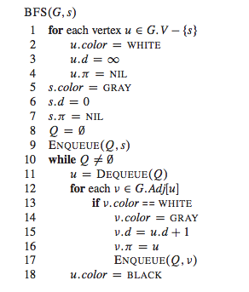
Algorithm BFS(G, s)

Slide 4
Algorithm BFS(G,s)

Slide 5
BFS tree of a graph from s
.
s
r v
v t x
u y
BFS tree gives the shortest paths from s to all the other nodes for uniform weight = 1 of the edges

Slide 6
Theorem: the shortest path between v and s equals the depth of v on the BFS tree
Depth of v = distance from s.
By induction.
Base: the only node at depth 0 is the source node s.
Inductive step:
Assume that for each node u at distance p’< p from s the depth is equal to p’. By contradiction assume there exists node v at distance d from s at depth p≠d in the BFS tree, That is the shortest path from s to v in the BFS tree has length d.
Let us consider node v’ preceding v the path and consider node u parent of v in BFS tree at depth p-1.
p<d is impossible otherwise the path from s to v passing through u would be shorter against the hypothesis that d is the length of the shortest path.
d<p is impossible otherwise the BFS visit would have reached v from v’
And v would have depth=d. It must be p=d.

Slide 7
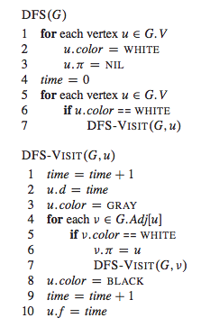
Depth First Search

Slide 8
Depth First Search
In each node: u.d/u.f. Color, π, d, f.
Global variable: time.
DFS visits all the nodes of the graph.

Slide 9
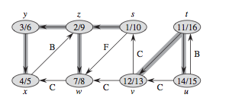
Depth First Search edge classification and timing

Slide 10
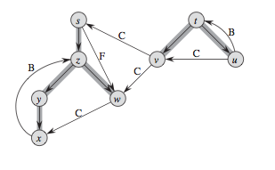
DFS-forest and edge classification
B
F (if u.d < v.d) or C
Each tree is a connected component of G

Slide 11
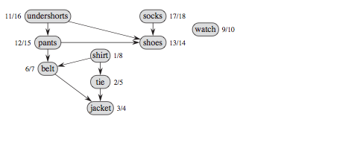
Topological Sort
The graph is a DAG Directed Acyclic graph
Find a sequence of operations respecting all the precedences = Topological Sort

Slide 12
Topological Sort

