Slide 1
Problem with Huffman Coding
We can prove that (n=|T|):
n H(T) ≤ |Huff(T)| < n H(T) + n
which looses < 1 bit per symbol on avg!!
This loss is good/bad depending on H(T)
  Take a two symbol alphabet Σ = {a,b}.
  Whichever is their probability, Huffman uses 1 bit for each symbol and thus takes n bits to encode T
  If p(a) = .999, self-information is:
  bits << 1
Notes:
It might seem like we cannot do better than this.
Assuming Huffman codes, how could we improve this?
Assuming there is only one possible other message (with prob. .001), what would the
Expected length be for sending 1000 messages picked from this distribution? (about 10bits + 1.44 bits = 11.44 bits)

Slide 2
What can we do?
Macro-symbol = block of k symbols
  1 extra bit per macro-symbol = 1/k extra-bits per symbol
  Larger model to be transmitted: |Σ|^{k} (k * log |Σ|) + h² bits (where h is the height of the Huffman tree and might be |Σ|)
Shannon took infinite sequences, and k → ∞ !!
Notes:
It might seem like we cannot do better than this.
Assuming Huffman codes, how could we improve this?
Assuming there is only one possible other message (with prob. .001), what would the
Expected length be for sending 1000 messages picked from this distribution? (about 10bits + 1.44 bits = 11.44 bits)

Slide 3
Performance: Compression ratio
Compression ratio =
#bits in output / #bits in input
Compression performance: We relate entropy against compression ratio.
Empirical H vs Compression ratio
Shannon
Avg cw length
In practice
p(A) = .7, p(B) = p(C) = p(D) = .1
H ≈ 1.36 bits
Huffman ≈ 1.5 bits per symb

Slide 4
Data Compression
Arithmetic coding

Slide 5
Introduction
Allows using “fractional” parts of bits!!
Takes 2 + nH(T) bits vs. (n + nH(T)) of Huffman
Used in PPM, JPEG/MPEG (as option), Bzip
More time costly than Huffman, but integer implementation is not too bad.

Slide 6
Symbol interval
Assign each symbol to an interval range from 0 (inclusive) to 1 (exclusive).
e.g.
1.0
c = .3
0.7
b = .5
f(a) = .0, f(b) = .2, f(c) = .7
0.2
a = .2
0.0
The interval for a particular symbol will be called
the symbol interval (e.g for b it is [.2,.7))
Notes:
We are going to make a distinction between message, sequence, and code intervals.
It is important to keep them straight.
Also I will give different meanings to p(I) and p_{i} and it is important to keep these straight

Slide 7
Sequence interval
Coding the message sequence: bac
The final sequence interval is [.27,.3)
1.0
0.7
0.3
c = .3
c = .3
(0.7-0.2)*0.3=0.15
(0.3-0.2)*0.3=0.03
c = .3
0.7
0.55
0.27
b = .5
b = .5
(0.7-0.2)*0.5 = 0.25
b = .5
(0.3-0.2)*0.5 = 0.05
0.2
0.3
0.22
a = .2
a = .2
(0.7-0.2)*0.2=0.1
(0.3-0.2)*0.2=0.02
a = .2
0.0
0.2
0.2
Notes:
If the notation gets confusing, the intuition is still clear, as shown by this example.

Slide 8
The algorithm
To code a sequence of symbols with probabilities
p_{i} (i = 1..n) use the following algorithm:
Each message narrows the interval by a factor of p_{i}.
0.3
c = .3
0.27
b = .5
0.22
a = .2
0.2
Notes:
How does the interval size relate to the probability of that message sequence?

Slide 9
The algorithm
Each message narrows the interval by a factor of p[T_{i}]
Final interval size is
Sequence interval
[ l_{n} , l_{n} + s_{n} ]
A number inside
Notes:
How does the interval size relate to the probability of that message sequence?

Slide 10
Decoding Example
Decoding the number .49, knowing the message is of length 3:
The message is bbc.
1.0
0.7
0.55
c = .3
c = .3
c = .3
0.49
0.7
0.55
0.475
0.49
0.49
b = .5
b = .5
b = .5
0.2
0.3
0.35
a = .2
a = .2
a = .2
0.0
0.2
0.3
Notes:
Basically we are running the coding example but instead of paying attention to the symbol names,
We pay attention to the number.

Slide 11
How do we encode that number?
If x = v/2^{k} (dyadic fraction) then the encoding is equal to bin(x) over k digits (possibly pad with 0s in front)
Notes:
It is not a prefix code.

Slide 12
How do we encode that number?
Binary fractional representation:
FractionalEncode(x)
x = 2 * x
If x < 1 output 0
x = x - 1; output 1
2 * (1/3) = 2/3 < 1, output 0
2 * (2/3) = 4/3 > 1, output 1
→ 4/3 – 1 = 1/3
Incremental Generation
Notes:
It is not a prefix code.

Slide 13
Which number do we encode?
Truncate the encoding to the first d = ⎡log (2/s_{n})⎤ bits
Truncation gets a smaller number… how much smaller?
l_{n} + s_{n}
l_{n} + s_{n}/2
Compression = Truncation
l_{n}
=0
Notes:
It is not a prefix code.

Slide 14
Bound on code length
Theorem: For a text of length n, the Arithmetic encoder generates at most
⎡log₂ (2/s_{n})⎤ < 1 + log₂ 2/s_{n} = 1 + (1 - log₂ s_{n})
= 2 - log₂ (∏ _{i=1,n} p(T_{i}))
= 2 - ∑ _{i=1,n} (log₂ p(T_{i}))
= 2 - ∑_{σ=1,|Σ|} n*p(σ) log p(σ)
= 2 + n * ∑_{σ=1,|Σ|} p(σ) log (1/p(σ))
= 2 + n H(T) bits
T = aaba
s_{n} = p(a) * p(a) * p(b) * p(a)
log₂ s_{n} = 3 * log p(a) + 1 * log p(b)
nH₀ + 0.02 n bits in practice
because of rounding
Notes:
The 1 + log s is from previous slide based on truncating to -log(s/2) bits.
Note that s is overloaded (size of sequence interval, and self information of message). I apologize.

Slide 15
Data Compression
Dictionary-based compressors

Slide 16
LZ77
Algorithm’s step:
  Output <dist, len, next-char>
  Advance by len + 1
A buffer “window” has fixed length and moves
a
a
c
a
a
c
a
b
c
a
a
a
a
a
a
a
c
Dictionary
(all substrings starting here)
<6,3,a>
a
a
c
a
a
c
a
b
c
a
a
a
a
a
a
a
c
c
<3,4,c>

Slide 17
LZ77 Decoding
Decoder keeps same dictionary window as encoder.
  Finds substring and inserts a copy of it
What if l > d? (overlap with text to be compressed)
E.g. seen = abcd, next codeword is (2,9,e)
Simply copy starting at the cursor
for (i = 0; i < len; i++)
out[cursor+i] = out[cursor-d+i]
Output is correct: abcdcdcdcdcdce

Slide 18
LZ77 Optimizations used by gzip
LZSS: Output one of the following formats
  (0, distance, length) or (1,char)
Typically uses the second format if length < 3.
Special greedy: possibly use shorter match so that next match is better
Hash Table for speed-up searches on triplets
Triples are coded with Huffman’s code

Slide 19
LZ-parsing (gzip)
0
#
s
i
1
12
si
1
p
i
ssi
3
mississippi#
2
ppi#
1
ppi#
ssippi#
4
#
ppi#
ssippi#
i#
6
3
ppi#
ssippi#
pi#
11
8
7
4
5
2
1
10
9
<m><i><s><si><ssip><pi>
T = mississippi#
1 2 4 6 8 10

Slide 20
LZ-parsing (gzip)
It is on the path to 6
0
#
s
By maximality check only nodes
i
1
12
1
p
Leftmost occ
= 3 < 6
i
si
ssi
3
mississippi#
2
ppi#
1
ppi#
ssippi#
4
#
ppi#
ssippi#
Leftmost occ
= 3 < 6
i#
6
3
ppi#
ssippi#
pi#
11
8
7
4
5
2
1
10
9
<ssip>
T = mississippi#
1 2 4 6 8 10
Longest repeated prefix of T[6,...]
Repeat is on the left of 6

Slide 21
LZ-parsing (gzip)
min-leaf
≅ Leftmost copy
0
#
s
i
3
1
12
2
si
Parsing:
Scan T
Visit ST and stop when
min-leaf ≥ current pos
1
p
3
i
ssi
4
3
mississippi#
9
2
2
ppi#
1
ppi#
ssippi#
4
#
ppi#
ssippi#
i#
6
3
ppi#
ssippi#
pi#
11
8
7
4
5
2
1
10
9
<m><i><s><si><ssip><pi>
Precompute the min descending leaf
at every node in O(n) time.
T = mississippi#
1 2 4 6 8 10

Slide 22
LZ78
Possibly better for cache effects
Dictionary:
substrings stored in a trie (each has an id).
Coding loop:
find the longest match S in the dictionary
Output its id and the next character c after the match in the input string
Add the substring Sc to the dictionary
Decoding:
builds the same dictionary and looks at ids

Slide 23
LZ78: Coding Example
Output
Dict.
a
a
b
a
a
c
a
b
c
a
b
c
b
(0,a)
1 = a
a
a
b
a
a
c
a
b
c
a
b
c
b
(1,b)
2 = ab
a
a
b
a
a
c
a
b
c
a
b
c
b
(1,a)
3 = aa
a
a
b
a
a
c
a
b
c
a
b
c
b
(0,c)
4 = c
a
a
b
a
a
c
a
b
c
a
b
c
b
(2,c)
5 = abc
a
a
b
a
a
c
a
b
c
a
b
c
b
(5,b)
6 = abcb

Slide 24
LZ78: Decoding Example
Input
Dict.
(0,a)
a
1 = a
(1,b)
a
a
b
2 = ab
(1,a)
a
a
b
a
a
3 = aa
(0,c)
a
a
b
a
a
c
4 = c
(2,c)
a
a
b
a
a
c
a
b
c
5 = abc
(5,b)
a
a
b
a
a
c
a
b
c
a
b
c
b
6 = abcb

Slide 25
LZW (Lempel-Ziv-Welch) [‘84]
Don’t send next character c, but still add Sc to the dictionary.
The dictionary is initialized with byte values being the first 256 entries (e.g. a = 112, ascii), otherwise there is no way to start it up.
The decoder is one step behind the coder since it does not know c
There is an issue for strings of the form
SSc where S[0] = c, and these are handled specially!!!

Slide 26
LZW: Encoding Example
Output
Dict.
a
a
b
a
a
c
a
b
a
b
a
c
b
112
256=aa
a
a
b
a
a
c
a
b
a
b
a
c
b
112
257=ab
a
a
b
a
a
c
a
b
a
b
a
c
b
113
258=ba
a
a
b
a
a
c
a
b
a
b
a
c
b
256
259=aac
a
a
b
a
a
c
a
b
a
b
a
c
b
114
260=ca
a
a
b
a
a
c
a
b
a
b
a
c
b
257
261=aba
a
a
b
a
a
c
a
b
a
b
a
c
b
261
262=abac

Slide 27
LZW: Decoding Example
Input
Dict
112
a
one
step
later
112
a
a
256=aa
113
a
a
b
257=ab
256
a
a
b
a
a
258=ba
114
a
a
b
a
a
c
259=aac
257
a
a
b
a
a
c
a
b
260=ca
261
?
261
a
a
b
a
a
c
a
b
a
b
261=aba
Next phrase to add = Previous phrase + its first char

Slide 28
LZ78 and LZW issues
How do we keep the dictionary small?
Throw the dictionary away when it reaches a certain size (used in GIF)
Throw the dictionary away when it is no longer effective at compressing (e.g. compress)
Throw the least-recently-used (LRU) entry away when it reaches a certain size (used in BTLZ, the British Telecom standard)

Slide 29
Lempel-Ziv Algorithms
Keep a “dictionary” of recently-seen strings.
The differences are:
How the dictionary is stored
How it is extended
How it is indexed
How elements are removed
How phrases are encoded
LZ-algos are asymptotically optimal, i.e. their compression ratio goes to H(T) for n → ∞ !!
No explicit
frequency estimation

Slide 30
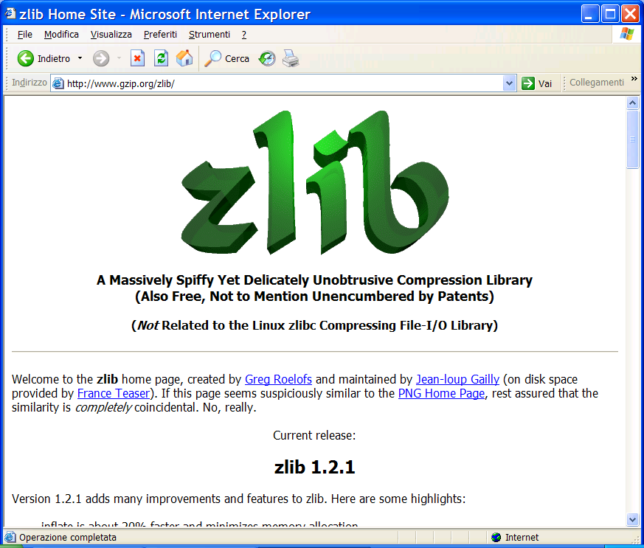
You find this at: www.gzip.org/zlib/

Slide 31
Simple compressors: too simple?
Move-to-Front (MTF):
  As a freq-sorting approximator
  As a caching strategy
  As a compressor
Run-Length-Encoding (RLE):
  FAX compression
Notes:
Normal huffman codes are static.
To be applied in a dynamic model, we need a

Slide 32
Move to Front Coding
Transforms a char sequence into an integer sequence, that can then be var-length coded
Start with the list of symbols L=[a,b,c,d,…]
For each input symbol s
  output the position of s in L
  move s to the front of L
Properties:
Exploit temporal locality, and it is dynamic
X = 1^{n} 2^{n} 3^{n…} n^{n} → Huff = O(n² log n), MTF = O(n log n) + n²
There is a memory

Slide 33
MTF: how good is it ?
No much worse than Huffman
...but it may be far better
Encode the integers via γ-coding:
|γ(i)| ≅ 2 * log i + 1
Put Σ in the front and consider the cost of encoding:

Slide 34
Run Length Encoding (RLE)
If spatial locality is very high, then
abbbaacccca => (a,1),(b,3),(a,2),(c,4),(a,1)
In case of binary strings → just numbers and one bit
Properties:
Exploit spatial locality, and it is a dynamic code
X = 1^{n} 2^{n} 3^{n…} n^{n} →
Huff(X) = O(n² log n) > Rle(X) = O( n (1+log n) )
There is a memory
Notes:
Should each character have its own frequency distribution, or the same for all of them?

Slide 35
Data Compression
Burrows-Wheeler Transform

Slide 36
The big (unconscious) step...

Slide 37
The Burrows-Wheeler Transform (1994)
Let us given a text T = mississippi#
F
L
mississippi#
# mississipp i
ississippi#m
i #mississip p
ssissippi#mi
i ppi#missis s
sissippi#mis
i ssippi#mis s
issippi#miss
Sort the rows
i ssissippi# m
ssippi#missi
m ississippi #
T
sippi#missis
ippi#mississ
ppi#mississi
pi#mississip
i#mississipp
#mississippi
p i#mississi p
p pi#mississ i
s ippi#missi s
s issippi#mi s
s sippi#miss i
s sissippi#m i

Slide 38
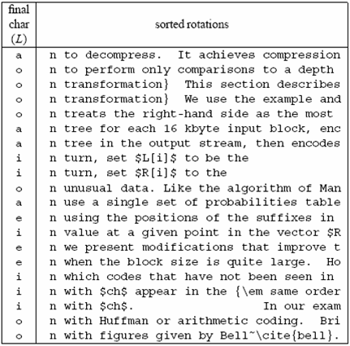
A famous example
Much
longer...

Slide 39
Compressing L seems promising...
Key observation:
L is locally homogeneous
L is highly compressible
Algorithm Bzip :
Move-to-Front coding of L
Run-Length coding
Statistical coder
Bzip vs. Gzip: 20% vs. 33%, but it is slower in (de)compression !

Slide 40
How to compute the BWT ?
SA
BWT matrix
L
We said that: L[i] precedes F[i] in T
12
11
8
5
2
1
10
9
7
4
6
3
#mississipp
i#mississip
ippi#missis
issippi#mis
ississippi#
mississippi
pi#mississi
ppi#mississ
sippi#missi
sissippi#mi
ssippi#miss
ssissippi#m
#mississipp
i#mississip
ippi#missis
issippi#mis
ississippi#
mississippi
pi#mississi
ppi#mississ
sippi#missi
sissippi#mi
ssippi#miss
ssissippi#m
i
p
s
s
m
#
p
i
s
s
i
i
L[3] = T[ 7 ]
Given SA and T, we have L[i] = T[SA[i]-1]

Slide 41
How to construct SA from T ?
SA
12
11
8
5
2
1
10
9
7
4
6
3
#
i#
ippi#
issippi#
ississippi#
mississippi
pi#
ppi#
sippi#
sissippi#
ssippi#
ssissippi#
Elegant but inefficient
Obvious inefficiencies:
Θ(n² log n) time in the worst-case
Θ(n log n) cache misses or I/O faults
Input: T = mississippi#

Slide 42
A useful tool: L → F mapping
F
unknown
L
# mississipp i
i #mississip p
i ppi#missis s
i ssippi#mis s
i ssissippi# m
m ississippi #
How do we map L’s onto F’s chars ?
p i#mississi p
p pi#mississ i
s ippi#missi s
s issippi#mi s
s sippi#miss i
s sissippi#m i
... Need to distinguish equal chars in F...
Take two equal L’s chars
Rotate rightward their rows
Same relative order !!

Slide 43
The BWT is invertible
F
unknown
L
# mississipp i
Two key properties:
i #mississip p
1. LF-array maps L’s to F’s chars
i ppi#missis s
2. L[ i ] precedes F[ i ] in T
i ssippi#mis s
i ssissippi# m
Reconstruct T backward:
m ississippi #
p
p
i
T = .... #
i
p i#mississi p
p pi#mississ i
s ippi#missi s
s issippi#mi s
s sippi#miss i
s sissippi#m i
InvertBWT(L)
Compute LF[0,n-1];
r = 0; i = n;
while (i>0) {
T[i] = L[r];
r = LF[r]; i--;
}

Slide 44
An encoding example
T = mississippimississippimississippi
# at 16
L = ipppssssssmmmii#pppiiissssssiiiiii
Mtf = [i,m,p,s]
Mtf = 020030000030030 300100300000100000
Mtf = 030040000040040 400200400000200000
Bin(6)=110, Wheeler’s code
Alphabet
|Σ|+1
RLE0 = 03141041403141410210
Bzip2-output = Arithmetic/Huffman on |Σ|+1 symbols...
... plus γ(16), plus the original Mtf-list (i,m,p,s)

Slide 45
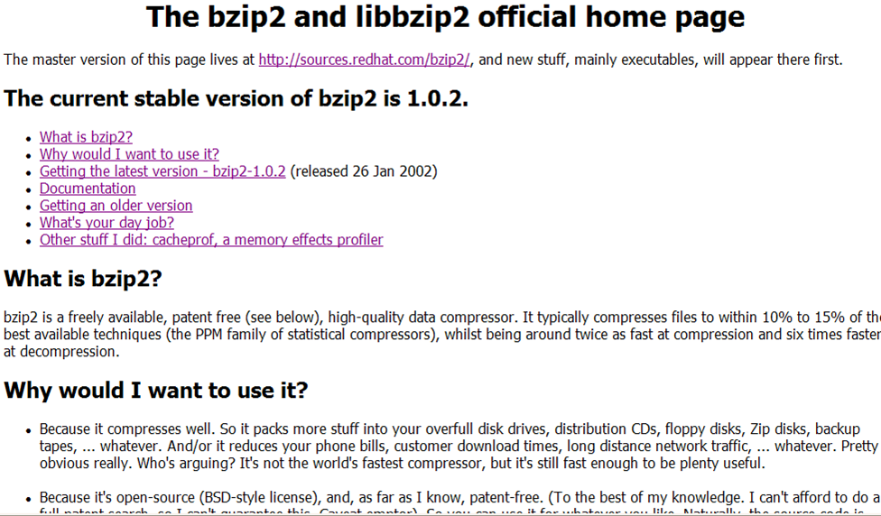
You find this in your Linux distribution

