Slide 1
List Ranking
Chapter 4

Slide 2
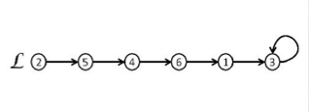
Problem on linked lists 2-level memory model
List Ranking problem
Given a (mono directional) linked list L of n items,
compute the distance of each item from the tail of L.
Id
Succ
Rank
1 | 2 | 3 | 4 | 5 | 6
3 | 5 | 3 | 6 | 4 | 1
1 | 5 | 0 | 3 | 4 | 2

Slide 3
List ranking
Easy sequential solution in the RAM model, O(n).
Compute the predecessor of I, such that Pred[Succ[i]] = i;
Scan the list starting from the tail, setting Rank[tail]=0
and incrementing the value at each item.
Recursive solution
ListRank(i):
if (Succ[i]==i) Rank[i]=0;
else Rank[i]=ListRank(Succ[i]) +1;
First call: ListRank(head)
. O(n) time
Space?

Slide 4
2-level model
Very bad in this model Θ(n) I/O accesses!!
far from the lower bound Ω(n/B).
Solution: use a technique coming from the theory of parallel algorithms, the pointer jumping, that can be done in parallel for every item.
At each iteration update the pointer with the pointer of the pointed item:
Succ[i]= Succ[succ[i]] and compute the rank
accordingly.

Slide 5
Parallel List ranking
1: for 1 ≤i ≤ n pardo
if Succ(i) ==i then
{Rank(i) = 0
Tail = i}
else Rank(i)= 1
2: for 1 ≤ i ≤ n pardo
while (Succ(i) ≠ tail ) do
Rank(i) := Rank(i) + Rank(Succ(i));
Succ(i) := Succ(Succ(i))
end

Slide 6
Parallel List ranking
Initial step:
Id
Succ
Rank
1 | 2 | 3 | 4 | 5 | 6
3 | 5 | 3 | 6 | 4 | 1
1 | 1 | 0 | 1 | 1 | 1

Slide 7
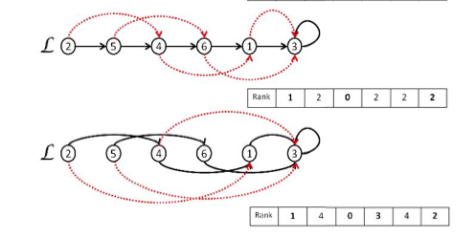
Pointer Jumping
Step 2 and 3 of the while:
At step 4 (last) only Rank[2] becomes 5.

Slide 8
Parallel List ranking
The parallel algorithm, using n processors, takes O(logn)
time and O(nlogn) operations.
Observation: The distances from the tail, at each step, of pointer jumping do not grow linearly, but duplicate. This means that the most distant item will take O(logn) steps to be ranked.
The overall operations are O(nlogn) because, at each step. O(n) processors are working in parallel.
Idea: Use the simulation of the pointer jumping technique for the 2-level model and Sort and Scan primitives for
Triples.

Slide 9
Parallel algorithm simulation in a 2-level model
The simulation is performed via a constant number of Sort and Scan primitives over n triples of integers.
Sort is very complicate in the 2-level model (see future
lectures). We use here a primitive of complexity Õ(n/B)
I/Os operations,
Õ : polylog factors (in M, n, B) are hidden.
Scan is easy and takes O(n/B) I/Os operations.

Slide 10
Parallel algorithm simulation in a 2-level model
Express the two basic parallel operations in the same way:
Rank (i) += Rank(Succ(i))
Succ(i) =Succ(Succ(i))
op is sum and a assignment for the Rank array (A=Rank)
op is a copy for the update of the Succ array (A=Succ)
A(ai) op A(bi)

Slide 11
Parallel simulation in a 2-level model
The simulation of A(ai) op A(bi) can be implemented simultaneously over all i=1,2…,n in 5 steps:
Scan the disk and create a triple <ai, bi, 0>.
Sort the triples according to the second component;
3. Scan the triples and array A to create the new triple
<ai, bi, A[bi]>. The coordinate scan allows to copy A[bi]
into the triple.
4. Sort the triples according to the first component (ai).
5. Scan the triples and the array A and, for every triple
update the memory content of cell A(ai).

Slide 12
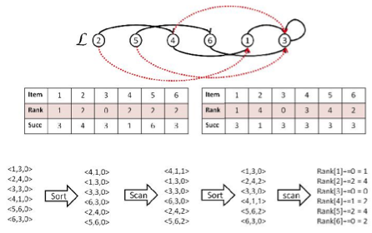
Parallel simulation in a 2-level model
Rank (i) += Rank(Succ(i))
Succ(i) =Succ(Succ(i))
Rank(Succ(i))

Slide 13
Parallel simulation in a 2-level model
More general result:
Every parallel algorithm using n processors and taking T steps can be simulated in a 2-level memory by a disk-aware sequential algorithm taking (Õ(n/B) T) I/Os operations, and O(n) space.
It is convenient when: T = o(B) that is sub-linear number of I/O’s.
Exploit algorithms for the PRAM model

Slide 14
Parallel simulation in a 2-level model: with Divide&Conquer
Divide&Conquer
Divide: Divide the problem in k sub-problems of size n₁, …,n_{k}.
Conquer: Solve the sub-problems recursively, or directly if n_{k}=O(1).
Combine: Combine the sub-problems to finds the solution to the original problem.
Complexity with recursion relation:
Master Theorem to solve recurrence of the kind:
T(n) = aT(n/b) + f(n)
With a≥1, b> 1, constant, f(n) be a function

Slide 15
Master Theorem for recurrence relations
T(n) = aT(n/b) + f(n)
With a≥1, b> 1, constant, f(n) a function.
T(n) can be bounded asymptotically as follows:
If f(n) =O(n^{log}_{b}^{a-ɛ}) for some constant ɛ>0, then
T(n) = Θ(n^{log}_{b}ª)
If f(n) = Θ(n^{log}_{b}ª) then T(n) =Θ(n^{log}_{b}ªlogn)
If f(n) = Ω (n^{log}_{b}^{a+ɛ}) for some constant ɛ>0, then
T(n) = Θ(f(n)) if the regolarity condition holds.
Regolarity c.: a(f(n/b)≤cf(n) for some constant c<1 and sufficiently large n.
Ex: T(n) = 4T(n/2)+n; T(n) = 4T(n/2)+n²; T(n) = 4T(n/2)+n³.

Slide 16
Master Theorem for recurrence relations
T(n) = aT(n/b) + f(n)
With a≥1, b> 1, constant, f(n) a function.
T(n) can be bounded asymptotically as follows:
If f(n) =O(n^{log}_{b}^{a-ɛ}) for some constant ɛ>0, then
T(n) = Θ(n^{log}_{b}ª)
If f(n) = Θ(n^{log}_{b}ª) then T(n) =Θ(n^{log}_{b}ªlogn)
If f(n) = Ω (n^{log}_{b}^{a+ɛ}) for some constant ɛ>0, then
T(n) = Θ(f(n)) if the regolarity condition holds.
Regolarity c.: a(f(n/b)≤cf(n) for some constant c<1 and sufficiently large n.
Ex: T(n) = 4T(n/2)+n; T(n) = 4T(n/2)+n²; T(n) = 4T(n/2)+n³.

Slide 17
Master Theorem for recurrence relations
T(n) = 4T(n/2)+n;
T(n) = 4T(n/2)+n²;
T(n) = 4T(n/2)+n³.
1) a=4. b=2, n^{log}_{b}ª = n², f(n) =n: f(n)=O(n^{log}_{b}^{a-ɛ}), per 0≤ɛ≤1
case 1 of Th T(n) = Θ (n²)
2) a=4, b=2, n^{log}_{b}ª = n², f(n)=n²: f(n)=Θ(n^{log}_{b}ª)
case 2 of Th T(n)= Θ (n²logn)
3) a=4, b=2, n^{log}_{b}ª = n²,f(n) =n3: f(n)=Ω (n^{log}_{b}^{a+ɛ}), per 0≤ɛ≤1
Case 3 of Th T(n)= Θ (n³)
se af(n/b)≤cf(n) 4 (n/2)²≤cn² n²≤cn², true for c<1.

Slide 18
A Divide&Conquer approach for List Ranking
1. Divide: Identify a set I of items from the list L, such that I is an independent set for L, that is the successor of each item in I does not belong to I.
|I|≤n/2. In the alg |I| is also kept ≥ n/c
2. Conquer: Form the list L* =L-I by pointer jumping on the predecessor of the items in I. At any step, rank[x] is the distance between x and the current succ[x] in the input list. Solve recursively on L*, where n/2≤|L*|≤ (1-1/c)/n.
3. Combine: Assume that the list rank is correctly been computed for all L*. Now derive the final rank of each item x in I as rank[x]=rank[x]+rank[succ[x]] as for pointer jumping.

Slide 19
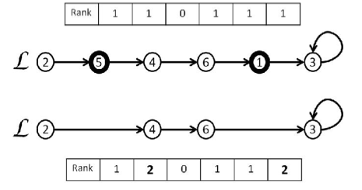
Divide&Conquer for List Ranking
I= {5, 1} Rank update su L*: Rank[2] = Rank[2]+Rank[Succ[5]]= 1 +Rank[4]=2
Rank[6] = Rank[6]+Rank[Succ[6]] =1+Rank[1] = 2

Slide 20
Correctness of rank computation
The independent set property on I assures that Succ[i] ε L*, so its rank is available.
By induction: Rank(Succ[x]] accounts for the distance of Succ[x] from the tail of L and Rank[x] accounts for number of items between x and Succ(x) in the input list.
Pointer Jumping is applied only to the predecessors of the removed items and the others have their Succ pointer unchanged.
The I/O efficiency of the algorithm depends onto the Divide step.

Slide 21
List ranking over L of n elements
I/O’s complexity via Divide&Conquer:
T(n) = I(n) + T((1-1/c))n + Õ(n/B)
Where I(n) is the cost of selecting the independent set;
Õ(n/B) is for the recombine step that can be solved by a costant number of Sort and Scan as before.
Identify a large independent set I from L avoiding many I/Os :
Randomized solution
Deterministic coin tossing

Slide 22
Select an independent set from L by randomized solution
Algorithm: toss a fair coin for each item i of L.
If coin(i) = H select item i if Coin(Succ(i))=T.
Probability: item I is selected with prob. ¼ (this happens
for the configuration HT)
Algorithm repeats the coin tossing until |I|≥n/c, for some c > 4. By Chernoff bound it can be proved that the repetition is executed a small number of time.
The check for the coin values, for selecting the I’s items, can be simulated via Sort and Scan primitives in Õ(n/B) I/O’s on average.
Hence: T(n) = Õ(n/B)+ T(3/4n) and by Master Th:
T(n) = Õ(n/B) on average.

Slide 23
Select an independent set from L by deterministic coin tossing
Simulate deterministically the coin-tossing.
Instead of assigning to each item 2 possible values (H,T) assign n values (0,1, …, n-1) that eventually will be reduce to 3 (0,1,2).
Selection: Pick the items that are local minima, that is their values is less than its two adjacent items.
Algorithm
Initialize Assign to each item i coin(i) = i-1. The binary representation of coin(i), bit_{b}(i) takes b=⌈logn⌉.

Slide 24
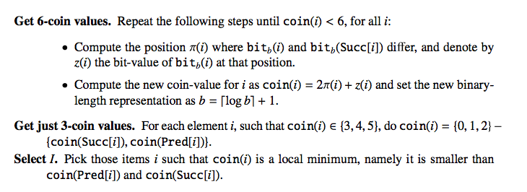
Deterministic coin tossing

Slide 25
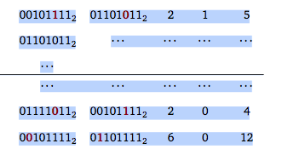
Deterministic coin tossing Example
Bit_{b}(i) Bit_{b}(succ(i)) π(i) z(i) new coin(i)

Slide 26
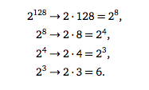
Deterministic coin tossing
Bit_{b}(n)=128 n=2¹²⁸
From b to logb+1

Slide 27
Deterministic coin tossing
Get 6-coin values The step is repeated until coin(i) <6 for all i. Coin(i)={0,1,…,5}
Observe: for all i : coin(i) is different from the coin(i) of its adjacent elements.
Proof by contraddiction: assume coin(i) = coin(succ(i)) then 2π(i)+z(i) = 2π(succ(i))+z(succ(i)) and it must be z(i) =z(succ(i)) then this is contradiction since I and succ(i) differs at position π(i). A similar argument holds for i and pred(i).
In addition: 2π(i)+z(i) ≤ 2(b-1)+1=2b-1
This max value can be represented by ⌈logb⌉+1 bits

Slide 28
Deterministic coin tossing
Get 3-coin values
The different values of coin(i) are (0,1, …5), since every 2 adjacent c(i) are different.
Hence:
if coin(i)= {3,4,5} the new value will be {0,1,2} – {coin(pred(i)), coin(succ(i))}

Slide 29
Deterministic coin tossing
The number of steps to get 6 values {0,1,…, 5} is log*n.
At each step:
b bits becomes logb+1 bits.
Log*n is the repeated application of the log function until value 1 is reached.
16
log(16)=4
log(4)=2
log(2)=1
log*(16)=3
Log*n is a function that grows very very slowly!

Slide 30
Select independent set Local minima
The list ranking problem is solved with coin tossing alg. with Õ(n/B) worst case I/Os
1 0 2 1 0 1 0 1

