Slide 1
Minimal Spanning Trees
Chapter 23
Cormen Leiserson Rivest&Stein:
Introduction to Algorithms

Slide 2
Minimal Spanning Trees
Weighted Graphs G(V, E, w)
W: E R
If w=1 for all edges BFS is the solution.
The MST is the way of connecting n vertices at minimal cost of connections.
Two greedy algorithms : Kruskal
Prim

Slide 3
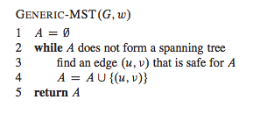
Minimal Spanning Trees
First a generic method utilized by the two algorithms:
Prior of each iteration, A is a subset of a MST
Determine a safe edge (u,v): A U (u,v) is still a subset of a MST.

Slide 4
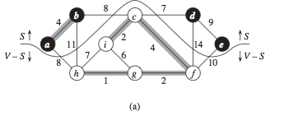
Minimal Spanning Trees
S vertices in MST (black). V-S vertices to be selected. The line is the cut. Light edges crossing the cut are the only edges that can be selected for the MST.
They are safe!

Slide 5
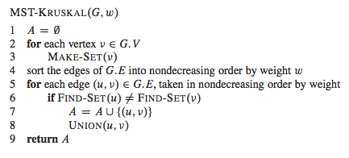
Kruskal Algorithm for MST
Uses a disjoint-set data structure to maintain several disjoint sets of elements. FIND-SET(u) returns a representative element of the set containing u.
(Disjoint set forest chapter. 21)

Slide 6
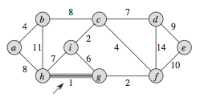
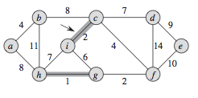
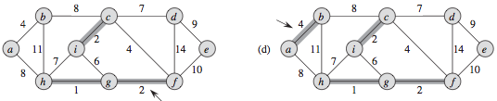
Kruskal Algorithm for MST

Slide 7
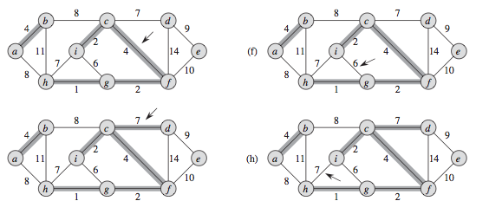
Kruskal Algorithm for MST

Slide 8
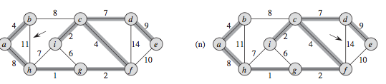
Kruskal Algorithm for MST

Slide 9
Kruskal Algorithm complexity
Complexity depends on how we implement the disjoint-set data structure.
(Disjoint set forest chapter. 21.3)
Sorting of the edges O(|E|log |E|)
Loop 5-8 O(|E|) FIND-SET and UNION operations on the disjoint set forest.
| V | operations of MAKE-SET
In total the loop takes O((|V| +|E|) α(V)) time , α is very slowly growing function (inverse of Ackermann fun.)
α(|V|)=O(log|V|) the loop takes O(|E|log|V|).
In total the Kruskal alg. takes O(|E| log|E|)
Since |E|<V², log|E|< O(log|V|) hence Kruskal takes
O(|E| log|V|)

Slide 10
PRIM algorithm for MST
Starts from an arbitrary vertex r the root.
The set A forms a single tree at any step.
All vertices not in the spanning tree form a min Heap Q based on the minimum weight of any edge connecting vertex v and the tree. Value v.key.
The termination condition is that the heap Q is empty, that means that all vertices have been connected to the MST.

Slide 11
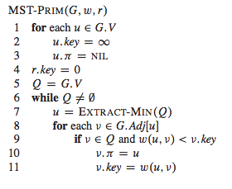
PRIM algorithm for MST
The parent in the MST

Slide 12
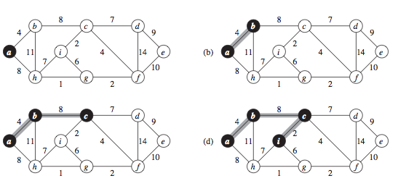
PRIM algorithm for MST
c

Slide 13
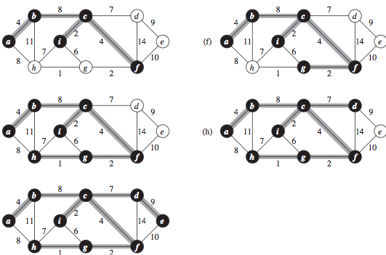
PRIM algorithm for MST

Slide 14
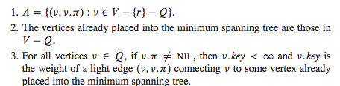
Loop 6-11 invariant

Slide 15
Complexity PRIM algorithm
Row 1-5 : Build min heap takes O(|V|)
The while loop is executed O(V) times and EXTRACT-MIN take O(log V) time hence in totla O(|V|log|V|)
The for loop is executed O(|E|) in total and the last operation is a DECREASE-KEY operation O(log|V|).
Prims algorithm takes O(|V|log|V| + |E|log|V|) = O(|E| log|V|) the same as Kruskal algortihm! It can be improved to:
O(|E| + |V| log |V|)
using for Q the data structure Fibonacci Heap

