Slide 1
Data Compression
The Burrows-Wheeler Transform

Slide 2
The Suffix Array
Prop 1. All suffixes in SUF(T) having prefix P are contiguous.
Prop 2. Starting position is the lexicographic one of P.
Θ(N²) space
5
T = mississippi#
T = mississippi#
SA
SUF(T)
12
11
8
5
2
1
10
9
7
4
6
3
#
i#
ippi#
issippi#
ississippi#
mississippi#
pi#
ppi#
sippi#
sissippi#
ssippi#
ssissippi#
suffix pointer
P=si
Suffix Array
SA: Θ(N log₂ N) bits
Text T: N chars
⇨ In practice, a total of 5N bytes

Slide 3
The big (unconscious) step...

Slide 4
The Burrows-Wheeler Transform (1994)
Let us given a text T = mississippi#
F
L
mississippi#
# mississipp i
ississippi#m
i #mississip p
ssissippi#mi
i ppi#missis s
sissippi#mis
i ssippi#mis s
issippi#miss
Sort the rows
i ssissippi# m
ssippi#missi
m ississippi #
T
sippi#missis
ippi#mississ
ppi#mississi
pi#mississip
i#mississipp
#mississippi
p i#mississi p
p pi#mississ i
s ippi#missi s
s issippi#mi s
s sippi#miss i
s sissippi#m i

Slide 5
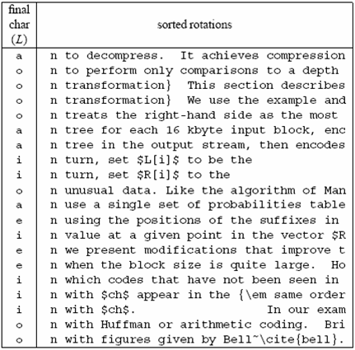
A famous example
Much
longer...

Slide 6
Compressing L seems promising...
Key observation:
L is locally homogeneous
L is highly compressible
Algorithm Bzip :
Move-to-Front coding of L
Run-Length coding
Statistical coder
Bzip vs. Gzip: 20% vs. 33%, but it is slower in (de)compression !

Slide 7
How to compute the BWT ?
SA
BWT matrix
L
We said that: L[i] precedes F[i] in T
12
11
8
5
2
1
10
9
7
4
6
3
#mississipp
i#mississip
ippi#missis
issippi#mis
ississippi#
mississippi
pi#mississi
ppi#mississ
sippi#missi
sissippi#mi
ssippi#miss
ssissippi#m
#mississipp
i#mississip
ippi#missis
issippi#mis
ississippi#
mississippi
pi#mississi
ppi#mississ
sippi#missi
sissippi#mi
ssippi#miss
ssissippi#m
i
p
s
s
m
#
p
i
s
s
i
i
L[3] = T[ 8 - 1 ]
Given SA and T, we have L[i] = T[SA[i]-1]
This is one of the main reasons for
the number of pubblications spurred
in ‘94-’10 on Suffix Array construction

Slide 8
A useful tool: L → F mapping
F
unknown
L
# mississipp i
i #mississip p
i ppi#missis s
i ssippi#mis s
i ssissippi# m
m ississippi #
Can we map L’s chars onto F’s chars ?
p i#mississi p
p pi#mississ i
s ippi#missi s
s issippi#mi s
s sippi#miss i
s sissippi#m i
... Need to distinguish equal chars...
Take two equal L’s chars
Rotate rightward their rows
Same relative order !!
Rank_{char}(pos) and Select_{char}(pos) are key operations nowadays

Slide 9
The BWT is invertible
F
unknown
L
# mississipp i
Two key properties:
i #mississip p
1. LF-array maps L’s to F’s chars
i ppi#missis s
2. L[ i ] precedes F[ i ] in T
i ssippi#mis s
i ssissippi# m
Reconstruct T backward:
m ississippi #
p
p
i
T = .... #
i
p i#mississi p
p pi#mississ i
s ippi#missi s
s issippi#mi s
s sippi#miss i
s sissippi#m i
Several issues about efficiency in time and space

Slide 10
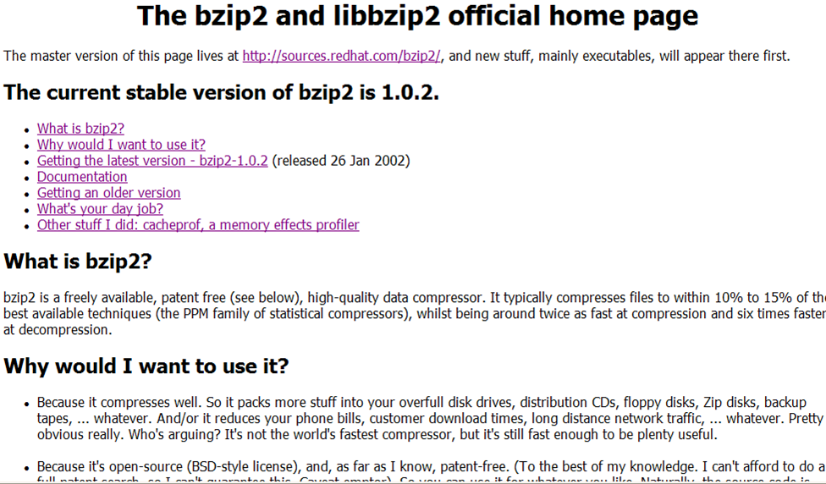
You find this in your Linux distribution

Slide 11
Decompress any substring
Search is possible,
not in these lectures...
F
unknown
L
Recall that LF-mapping means:
# mississipp i
k-th occurrence of σ in L
corresponds to
k-th occurrence of σ in F
i #mississip p
i ppi#missis s
i ssippi#mis s
i ssissippi# m
T = mississippi#
m ississippi #
m
i
s
1 4 8 12
p i#mississi p
p pi#mississ i
s ippi#missi s
s issippi#mi s
s sippi#miss i
s sissippi#m i
sampling step is 4
Trade-off between space (n log n/S bits) and decompression time of an L-long substring (S+ L time) due to the sampling step S
You can reconstruct any substring
backward IF you know the row of
its last character
How do we know where to start ? Keep sampled positions
Generalised Rank-Select over the column L

